Slide 1
七年级英语（JJ下）教学课件
Have a Good Summer!
WWW.PPT818.COM

Slide 2
Learning targets
➢Key words & phrases:
final, exam, tennis
➢Key sentences:
1. What are you going to do for the summer?
2. We will do so many things.
3. I’m looking forward to it.
➢Write sentences using “will” or “be
going to”

Slide 3
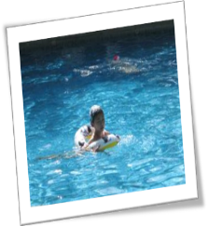
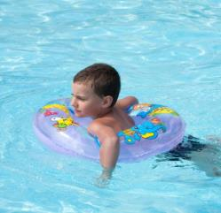
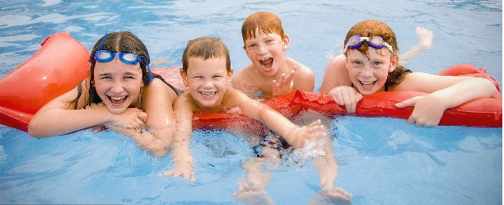
Warming up
1. What do you like to do in summer?
2. Do you like to swim?
3. When did you learn to swim?

Slide 4
Words and expressions
final
exam
tennis
adj. 最后的；最终的
v. 考试;检查
n. 网球
final 的 副词为 finally （最后；最终）；
同义词组：at last /in the end
例：We are all satisfied with the final result.

Slide 5
take an exam / final exams
be sure
play tennis /basketball/
volleyball/football
look forward to
wait for
have to
make a list
参加考试 /期末考试
确信
打网球/篮球/排球/
（踢）足球
盼望 ，期盼
等待
不得不
列清单

Slide 6
Presentation
Jenny and Danny took their final exams today.
School is over. They are excited for the summer.
Jenny: How did you do on the English exam，Danny?
Danny: Good... I hope.
Jenny: I'm sure you did well. What are you going to do
for the summer? Do you have any plans?
Danny: Yes，I have big plans. My uncle has a house
near the lake. I'm going to stay
for one month.

Slide 7
Jenny：Wow！That will be so fun.
Danny：Yeah. We will do so many things. We made a
long list. We will go swimming and play in
the sun every day！We will eat ice cream and
enjoy the hot weather. We will play basketball，
tennis，volleyball and football. It's going to
be a great summer. I'm looking forward to it！
How about you，Jenny？What are you going
to do?

Slide 8
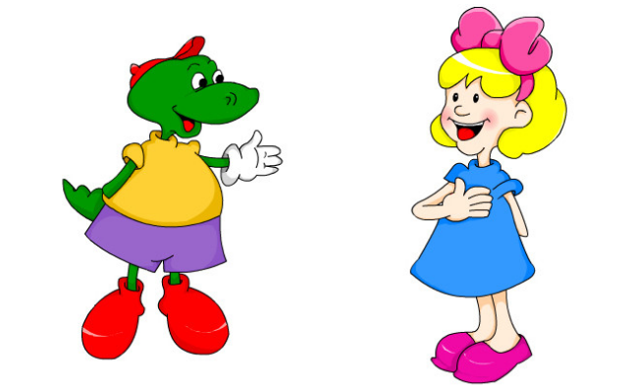
Jenny：Well，I'm going to...
Danny：Sorry，Jenny. My mum is waiting for me. I
have to go. Have a good summer!
Jenny：OK，Danny. You too!

Slide 9
Let’s Do It!
1. Read the lesson and complete Danny's diary.
Dear Diary,
I am so excited today. We wrote our final ______
and school is ______. The day after tomorrow, I
will go to my uncle’s house. I’ll stay there for one
______. Debby and I will play basketball, ______,
volleyball and ________. We will swim and play in
the ______. It’s going to be a great summer. I’m
looking forward to it so much.
exams
over
month
tennis
football
sun

Slide 10
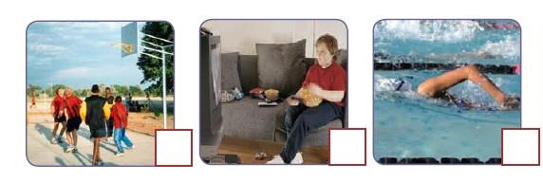
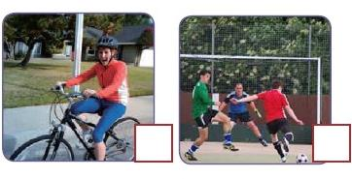
2. What will the boy and his family do for
the summer? Listen to the passage and
tick the correct pictures.

Slide 11
3. Rewrite the sentences using “will” or “be
going to”.
She has a new toy car.
→ She is going to have a new toy car tomorrow.
→ She will have a new toy car tomorrow.
2. Jane sings a folk song at the school party.
→__________________________________________
________________
→__________________________________________
________________
Jane is going to sing a folk song at the school
party tomorrow.
Jane will sing a folk song at the school party
tomorrow.

Slide 12
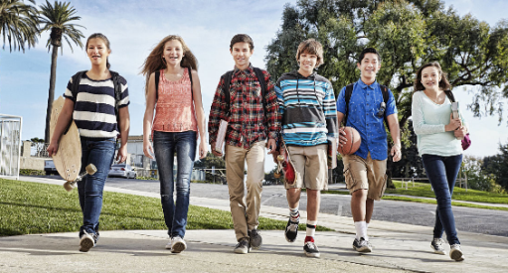
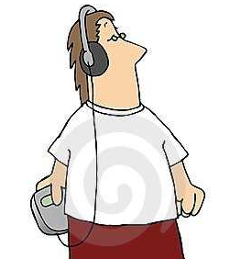
3. Sometimes I walk to school.
→_______________________________
→_______________________________
4. They listen to the radio every morning.
→_______________________________
→_______________________________
I’m going to walk to school.
I’ll walk to school.
They are going to listen to the radio.
They will listen to the radio.

Slide 13
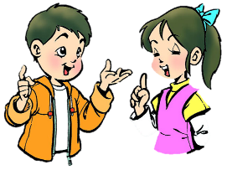
Work in groups
4. Work in pairs. Make a plan for your summer
holiday and then talk about it.
Where will you go?
What will you do?

Slide 14
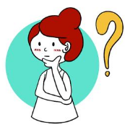
Language points
1. Jenny and Danny took their final exams today.
(1) final 形容词，意为“最后的，最终的”，其副词 为finally，相当于at last，in the end。
例：This is the final lesson of this term. I hope you all这是这学期的最后一节课。
Finally/At last/In the end, we won the game.
最后，我们赢得了比赛。

Slide 15
【辨析】final与last
二者都可意为“最后的”，有时可以互换使用。
区别如下：
final | 该词侧重强调结果，表示以此作为结束或到达终点，不表示顺序上的最后。
last | 该词主要指顺序、时间、位置等的最后，暗示其后没有其他的人或物。
(2)exam是名词，意为“考试，检查”。常用短语：take exams/an exam 参加考试。
例：They are taking an English exam.
他们正在进行英语考试。

Slide 16
2. I am sure you did well.
be sure 确定，确信。 be sure后面跟 that 从句做宾语，其中that 可省略。
例：She is sure she can pass the exam. 她确信她能通过这场考试。
sure 的其他用法：
(1)be sure to do sth. 一定/肯定做某事。sure后接不定式往往表示说话人的推测、评论，主语不一定是人。(2)be sure of/about＋名词/代词/动名词，意为“确信，对……有把握”，表示对客观事物有肯定的认识和判断，主语必须是人。

Slide 17
3. Do you have any plans？
plan作名词，意为“计划”。它为可数名词，其复
数形式为plans。
例：What plans do you have for the holiday？对于假
期你有什么计划？
【拓展】plan 还可以作动词，意为“计划”。常用
短语：plan to do sth. 计划做某事。
例：He planned to go to Paris for his holiday. 他计
划去巴黎度假。

Slide 18
4. (1) I am going to stay with his family for one month.
(2) We will do so many things.
这两个句子的共同点是_____________________.
【拓展】
定义:
结构:
时间
状语:
都使用了一般将来时
一般将来时 表示将来某一时刻要发生的动作
主语 + will + v. 或 主语 + be going to + v.
tomorrow, the day after tomorrow tonight,
next week, in three days, in the future

Slide 19
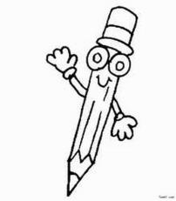
5. I’m looking forward to it.
(1) look forward to (doing) sth. 期待……，盼望……
后面接名词或者动名词。
例：I am looking forward to your good news.
我期待着你的好消息。
I' m looking forward to meeting you soon.
期待着尽早与你见面。
(2) it 在此处为代词，指代上文提到过的事物。
例：I have a new bike. It is a present from my mother.
我有一辆新自行车。它是妈妈送给我的礼物。

Slide 20
【辨析】one 与it
(1) one 意为“一个”，表示泛指，用来代替上文中提
到过的同类人和事物。
例：My bike is broken, I need to buy a new one.
我的自行车坏了，我需要买辆新的。
(2)it 意为“它”， 用来代替上文中提到过的同一事物。
it 既可替代单数可数名词，也可替代不可数名词或前
面提到的事情或情况。例：I lost my pen. I’m looking
for it. 我的钢笔丢了，我正在找它。

Slide 21
1. I'm looking forward to _________ (see) Frank
again.
2. — Mom, I’m hungry. Is there any food at home?
— Only one cake left. You can eat .
A． one B． it C． this
3.—Do you need to buy a new English-Chinese
dictionary, WangHua?
—No, Mum. Uncle Jim bought me yesterday.
A. one B. it C. that D. another
学以致用
seeing

Slide 22
6. How about you, Jenny?
How about…？相当于 What about…？ 常用来引起一个问句，表示提出建议和请求，征求意见或询问消息，意为“…… 好不好？”;“…… 怎么样？”后可接名词、代词和动名词。
例：I’d like some rice. What/How about you?
我想吃点米饭，你呢？ I did some shopping last weekend. How about you, Jenny? 我上周末去购物了。你呢，珍妮？

Slide 23
Exercises
一、单项选择。
1. —Is this iPad yours?
—Yes. My parents bought _______ for my
language learning.
A. one B. it C. other D. another
2. —The picnic is only in two days. Have you
made any ________？
—Not yet. So let's discuss what to prepare.
A．wishes B．plans
C．mistakes D．friends

Slide 24
3. —Let’s some fruit for Linda’s birthday.
—OK. ______ some bananas and oranges?
A. Think about
B. How about
C. What for
4. —There is still a copy of the book in the library, will you go and borrow______?
—No,I'd rather buy______ in the bookstore.
A. it; one B. one; one C.one; it D. it; it

Slide 25
二、根据汉语意思完成句子。
1. 努力学习，你一定会实现你的梦想。
Study hard, and you _________to make your
dream come true.
2. 期末考试过后，我父母和我都想去贵阳过暑假。
___________________，both my parents and I
want to spend the summer vacation in Guiyang.
3. 最终，他获得了一等奖。
，he got the first prize.
are sure
After the final exam
Finally

Slide 26
Summary
1. We learnt some new words and phrases:
final, exam, tennis, take an exam / final exams ,
be sure, play tennis /basketball/volleyball/football,
look forward to, wait for...
2. We learnt some sentences：
What are you going to do for the summer?
We will do so many things...

Slide 27
Homework
1. Preview the new words and phrases in
Lesson 44.
2. Choose one or two sentences you like in
the text to remember.
3. Talk about what you want to do this
summer.

