Slide 1
Unit 3 Topic 3
What were you doing at this
time yesterday?
Section B
WWW.PPT818.COM

Slide 2



Ask and answer
Did you see the movie — Harry Potter ?
Do you like it ?
How do you like it ?

Slide 3

scene n. 风景，景色，自然景观
Do you think the scene of Harry Potter is beautiful ?

Slide 4


1b
Watch the flash of 1a and mark T (True) or F (False).
( )1. Michael thinks that the movie Harry
Potter is wonderful.
( )2. Jane liked the movie because it is
interesting.
( )3. Michael enjoys the music of the movie.
( )4. Michael thinks Harry Potter is very
brave.
( )5. Jane doesn’t agree that Harry Potter is
brave.
F
T
T
T
F

Slide 5

Listen and read 1a together, then try to recite it in pairs.

Slide 6
Key points
我不同意。
I don’t agree.
这是表明自己观点、态度的表达方式。此外还有：
I agree (with you) .我同意（你的观点）。
I think so. 我认为是这样。
I don’t think so . 我认为不是这样的。
You are quite right . 你说得很对。

Slide 7
2. Wasn’t it interesting ? 它没有趣吗？
此句为一般疑问句的否定式。这类疑问句常表示提问人的惊讶、赞叹、怀疑或责难等语气。回答时根据实际情况来判断，如果事实上是，用yes; 如果事实上不是，用no。
Eg:
—— Don’t you play chess ? 你不下棋吗？
—— Yes, I do. / 不，我下棋。/
—— No, I don’t. 是的， 我不下棋。

Slide 8

Read 1a and practice
1c Read 1a together, then make up your own conversation in pairs.

Slide 9
Find the expressions in 1a to show agreement and disagreement. Then complete the table.
2a
Agreement | Disagreement
I agree _______ you. | I don’t ________ .
Yes, I think _______ . | No. I don’t ______ so.
You are quite ______ .
with
agree
so
think
right

Slide 10

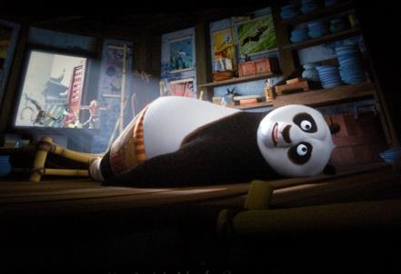
Let’s talk about some other movies.
Red Cliff
Kongfu Panda
OK!

Slide 11
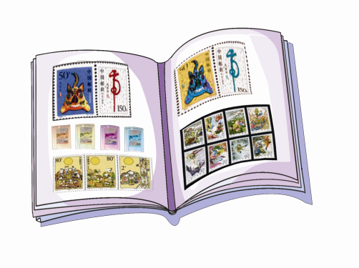
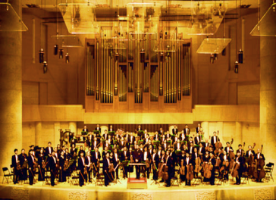
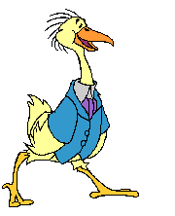
Group Work
Do you agree or disagree with the following ideas? Make conversations in groups according to your own opinions.
classical music/pleasant
collecting stamps/fun
collecting stamps/ fun

Slide 12


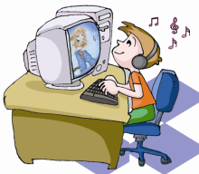
reading stories/interesting
cook / good
computer/useful

Slide 13
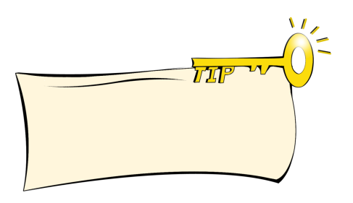


It’s important to know the correct ways to agree and disagree when you talk.
I agree with you.
I think classical music is pleasant.
No, I don’t think so . I think it is too serious.

Slide 14

collecting stamps / fun
I think collecting stamps is fun.

Slide 15
cook / good
I think he is a good cook.

Slide 16

reading stories / interesting
I think reading stories is interesting.

Slide 17
computer / useful
I think the computer is useful.

Slide 18
Read the pairs of the words and pay attention to the difference among / l /, / n / and / ŋ / .
3a
/ l / - / n / : line - nine light – night low – no slow – snow
/ n / - / ŋ / : win – wing thin – thing hand – hang in – ink

Slide 19


Listen and pay attention to assimilation, stress, liaison, weak form and incomplete plosion. Then read after the tape and imitate.
3b
A: ’Hello ! This is ’Maria speaking! May I ’spea(k)
to ’Jane?
B: ’Hol(d) the line, please.
2.A: I think ’collecting stamps mus(t) be ’fun.
B: ’No .’I don’(t) think so. I think it is ’jus(t) ’so-so.
3.A:’What were you ’doing a(t) ’this time
yesterday? I ’called you to ’go to the ’English
Corner bu(t) ’no one answered.
B: ’This time yesterday?’ Oh, I was ’taking a
‘shower.

Slide 20


Do the exercises.
Choose the best answer.
—The environment is very important to us. So we mustn’t
throw litter about.
—I ____ you.
A. agree on B. agree with C. agree to D. agree in
2. —How beautiful ! I think folk music is pleasant .
— _____ It’s too serious .
A. I think so. B. I don’t think so.
C. You’re right. D. It’s nothing.

Slide 21
Summary
How to express agreement or disagreement.
I agree (with you).我同意（你的观点）。
I think so. 我认为是这样。
I don’t think so. 我认为不是这样的。
You are quite right. 你说得很对。
2.The difference between /l/, /n/ and /ŋ/.

Slide 22
Homework
Recite 1a.
Read 3a and 3b.

