Slide 1
Unit 4 Lesson 21
A Party for Li Ming
WWW.PPT818.COM

Slide 2
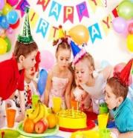
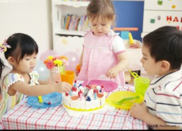
Warm-up
What party is it?
invitation cards

Slide 3
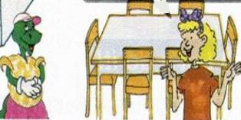
Let’s talk
Li Ming is leaving soon. Let's have a good-bye party for him.
Okay! I will invite some friends.
Will we tell Li Ming about the party?
No. Let's have a surprise party for him.

Slide 4
Ask and answer
Who is the party for?
It is for Li Ming.
When is the party?
Tomorrow.
What time will the party begin?
At 4:00 in the afternoon.
How many people are coming to the party?
Nine.

Slide 5
Circle the key words you learn.
happen late
tell party
early begin

Slide 6
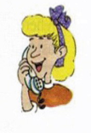
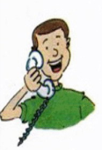
Let’s act
Steven: Hello?
Jenny: Hi, Steven. It's Jenny calling.
Would you come to a party for Li Ming?
Steven: Sure! When is the party?
Jenny: Tomorrow. It's a surprise for Li Ming. Please don't tell him.

Slide 7
Let’s act
Steven: Okay. What time does it begin?
Jenny: At 4:00 in the afternoon. Don't be late!
We want to surprise Li Ming!
Steven: Okay, I will come before 4:00.
Then I will be early!
Jenny: Great! See you tomorrow!

Slide 8
Let’s do it
Finish the invitation.
Saturday
4:00
the afternoon

Slide 9
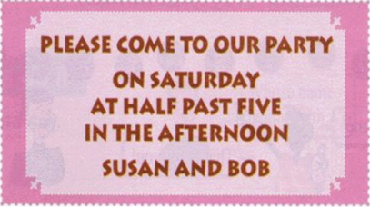
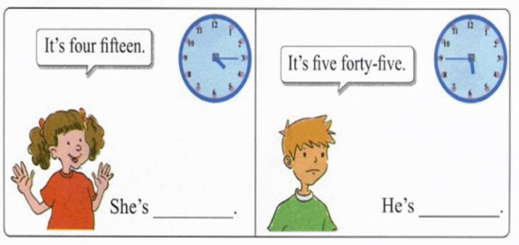
Look and write
early
late

Slide 10
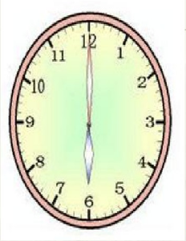
Let’s talk
What's the time? What time is it?
It's…
six o'clock

Slide 11
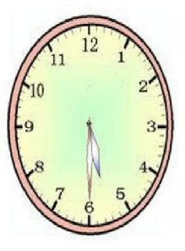
Let’s talk
What's the time? What time is it?
It's…
five thirty
half past

Slide 12
Let’s talk
What's the time? What time is it?
It's…
one fifty

Slide 13
Let’s talk
What's the time? What time is it?
It's…
ten ten

Slide 14
Summary and Evaluation
What have you learned in this class?
A excellent B good C adequate D need improvement
内容 | 学生自评 | 小组互评
我能认真听老师讲课，听同学发言
遇到我会回答的问题主动举手了
活动中坚持使用英语来交际
我能积极参与小组讨论活动，能与他人合作。

Slide 15
Homework
Finish the exercise book Lesson 21.

