Slide 1
He often plays football.
Unit 4 Lesson 2
WWW.PPT818.COM

Slide 2
复习：
What do you do at the weekend?
I often ….. Sometimes I ….
read books
go to the museum
visit my grandparents
go swimming
play basketball
watch TV
…

Slide 3
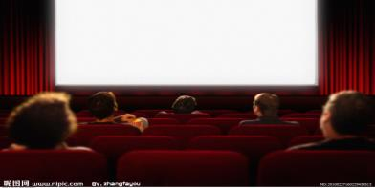
I often _____________ .
go shopping (去买东西)
go to the cinema
(去电影院)
Sometimes I ___________________.

Slide 4
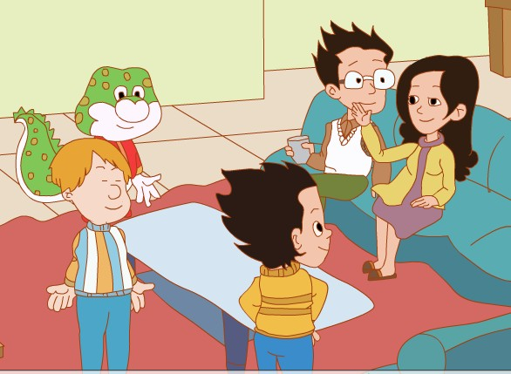
Li Ming and his family
How will they spend(度过) their weekend?

Slide 5
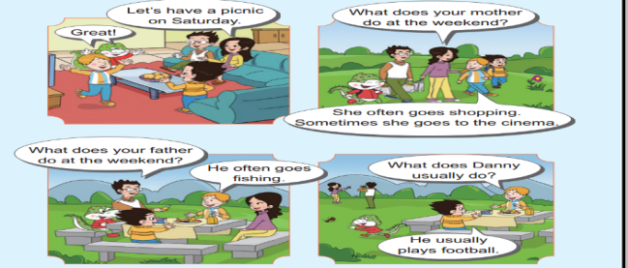
Watch and answer:
What do they do on Saturday?
have a picnic
They _________ on Saturday.

Slide 6
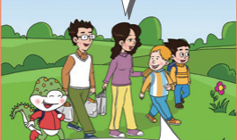
Read and answer:
1.What does Peter’s mother do at the weekend?
goes shopping
She often_______________.
goes to the cinema
Sometimes she ________________.

Slide 7
在一般现在时中，当主语是第三人称单数时，谓语动词要用第三
人称单数形式，即常在动词原形后加-s或-es
I/You/We/They ... She/He/Tom/My mother...
often often
clean cleans
play plays
read reads
do does
watch watches
go goes

Slide 8
Let's chant.
I go to school .
He goes to school.
I do sports.
She does sports.
I play football.
He plays football.
I watch TV.
She watches TV.

Slide 9
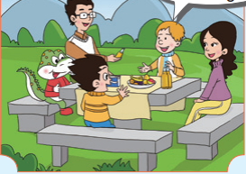
Read and answer:
2.What does Peter’s father do at the weekend?
goes fishing
He often___________.

Slide 10
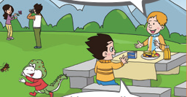
Read and answer:
What does Danny usually do at the weekend?
plays football
He usually ____________.

Slide 11
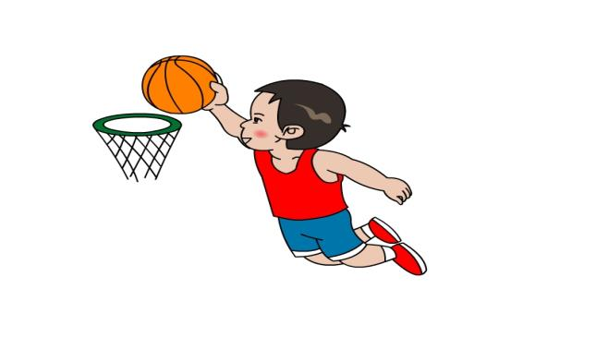
Let's guess.
What does he usually do at the weekend?
plays basketball
He usually_______________ .

Slide 12
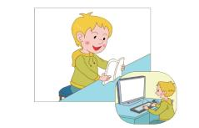
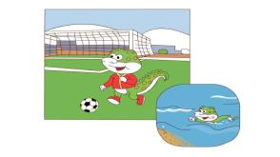
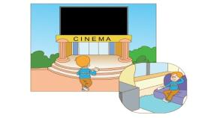
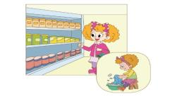
Let’s talk.
-What does Tom do at the weekend?
-He often…/Sometimes he …
He often reads books.
Sometimes he plays computer games.
read books
play computer games
play football
go swimming
go to the cinema
watch TV
go shopping
wash clothes

Slide 13
Arrange your weekend,
you’ll have a happy weekend
and you can enjoy your weekend!
安排好自己的周末，就会拥有快乐的周末，并且享受周末!

Slide 14
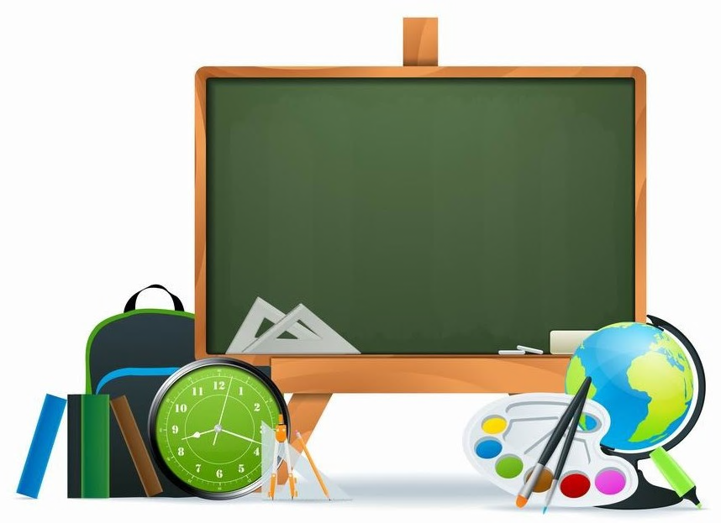
Homework:
Read the text two times.
Write about your mother’s weekend.

