Slide 1
Module 4 Unit 1
The balloons are flying away.
WWW.PPT818.COM

Slide 2
Learning goals
能够掌握单词: balloon。
能够掌握句型：Who can help me?

Slide 3
Lead-in
birthday card

Slide 4
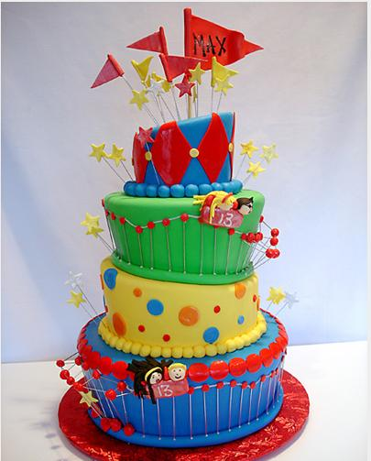
birthday cake

Slide 5
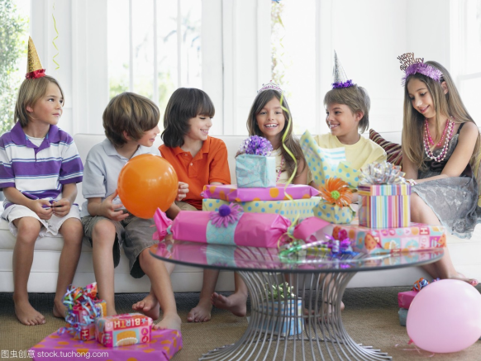
birthday party

Slide 6
课文学习
1 Listen and chant.
I like you.
You like me.
We like apples.
We like tea.

Slide 7
2 Listen, read and act out.
Daming: Where's your mum?
Simon: She's at the supermarket. She's buying things for your birthday.
Daming: Am I going to have a birthday party?
Simon: Yes, you are!
Later ...
Simon's mum: Who can help me? I can't carry everything.

Slide 8
Simon: Sorry, I can't. I'm on the phone.
Daming: I can help you. I can carry this box.
Simon's mum: Thank you, Daming.
Simon's mum: Be careful. That's the cake. Oh dear! The oranges are falling!
Daming: Simon, come and help us!
Simon's mum: The balloons are flying away!
Simon: But look at the balloons. They say, “Happy Birthday, Daming!”

Slide 9
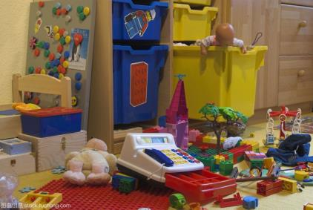
New words
balloon
mess

Slide 10
课文理解
Read and answer.
1. Where is Simon’s mum?
She is at the supermarket.
2. What is Simon’s mum doing?
She’s buying things for Simon’s birthday.
3. Can Simon help his mum?
No, he can’t.

Slide 11
补充学习
重点句型
寻求帮助的句型：
—Who can help me?
—Sorry, I can’t./主语+can help you.

Slide 12
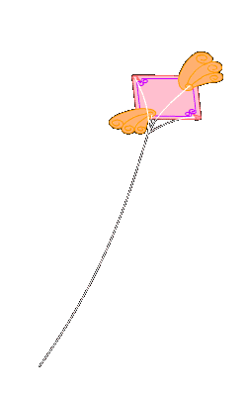
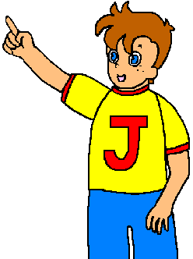
Example
My kite is flying away.
Who can help me?

Slide 13
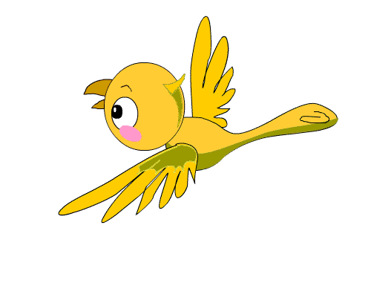
I can help you.
Sorry, I can’t.

Slide 14
My apples are falling.
Who can help me?

Slide 15
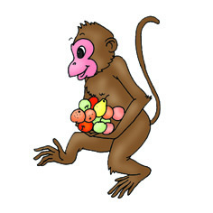
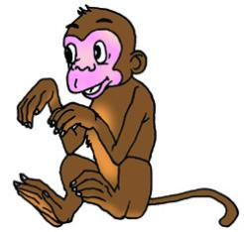
Sorry, I can’t.
I can help you.

Slide 16
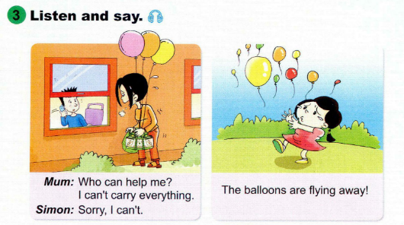
课文学习

Slide 17
4. Look and write. Then act them out.
A: ______________________________________________
B: _________________________________
C: _________________________________
My books are falling. Who can help me?
Sorry, I can’t.
I can help you.

Slide 18
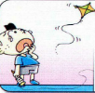
A: ______________________________________________
B: _________________________________
C: _________________________________
My kite is flying away. Who can help me?
Sorry, I can’t.
I can help you.

Slide 19
A: ______________________________________________
B: _________________________________
C: _________________________________
My apples are falling. Who can help me?
Sorry, I can’t.
I can help you.

Slide 20
Exercise
( C )1. Who can help _______?
A. he B. we C. them
( C )3. What is ________doing?
A. you B. they C. he
( A )5. The kite is ______________.
A. flying away B. fly away C. flies away

Slide 21
Homework
Read the text to your family.
Use “Who can help me?”to ask for help.

