Slide 1
Unit 3 Teenage problems
Welcome to the unit
WWW.PPT818.COM

Slide 2
课前自主预习
单词闯关 | 1.分数________ 2．发疯的；生气的________ 3.考试，测试________ 4．或许，可能________
mark
mad
exam
perhaps

Slide 3
drive sb mad
短语互译 | 1.使人受不了______________ 2．一天到晚；整天______________ 3．发胖______________ 4．在考试中______________ 5. too much ______________ 6．close friends ______________ 7．feel tired______________ 8．have time for sth/sb _________________
all day
get fat
in exams
太多
密友
感觉累
有做某事/陪某人的时间

Slide 4
句型在线 | 1.为什么不少吃点儿，并且多锻炼呢？ ________ eat less and ____________________？ 2．那些噪声几乎使我发狂。 The noise almost __________________________________. 3．我没有足够的时间做家庭作业。 I don't ______________________________ my homework. 4．或许你应该更好地安排你的时间并且早点儿睡觉。 ________ you should _________________ and go to bed earlier.
Why not
exercise more
drives me mad
have enough time to do
Perhaps
manage your time better

Slide 5
课堂互动探究
词汇点睛
●1 too much 太多
[观察] You eat too much. 你吃得太多。
Watching TV too much is bad for your eyes.
电视看得太多对你的眼睛有害。
You are driving much too fast.
你开车太快了。
There are too many rules in our school.
我们学校有太多的规则。

Slide 6
[辨析] too much, much too与too many
[一言辨析] The boy is much too fat because he eats too much
Meat and too many sweets every day.
这个男孩太胖了，因为他每天吃太多的肉和太多的糖果。

Slide 7
词条 | 含义及用法
too much | 意为“太多”，相当于形容词，常修饰不可数名词，放在名词前面。也可用在动词后作状语。
much too | 意为“太；非常”，副词短语，修饰副词或形容词原级，表示程度。
too many | 意为“太多”，形容词短语，修饰可数名词复数。

Slide 8
活学活用
1．(1)根据汉语意思完成句子不要吃太多的肉，否则你会变得太
胖。
Don't eat __________ meat, or you'll get ________ fat.
too much
much too

Slide 9
(2)单项选择
2017·乌鲁木齐 ________ teenagers are becoming the “Heads­down
Tribe”(低头族). It's ________ bad.
A．Too many; much too B．Too much; much too
C．Much too; too much D．Too many; too much
A

Slide 10
●2 perhaps adv. 或许，可能
[观察] Perhaps you should give him another chance.
或许你应该再给他一次机会。

Slide 11
[探究] perhaps常用于表示“某人(事)有可能但不肯定”，
所表示的可能性大致对半。在口语中，perhaps so意为“也许
会”；perhaps not意为“也许不会”。

Slide 12
2. 他也许不相信你的话。
____________ he does not believe your words.
Perhaps/Maybe

Slide 13
句型透视
●1 What's wrong, Eddie? 埃迪，你怎么了？
[探究] “What's wrong？”的常见用法：
(1)用于询问对方有什么问题或有什么不顺心的事，意为“怎么
啦？出什么事了？”
—What's wrong, Jim? 吉姆，你怎么啦？
—I left my umbrella on the bus. 我把雨伞忘在公共汽车上了。

Slide 14
(2)用于询问某东西出了什么毛病，意为“怎么啦？出什
么毛病了？”
What's wrong with the bus? 这辆公共汽车怎么啦？

Slide 15
[拓展] 相似表达有“What's the matter with sb/sth？”，
“What's the trouble with sb/sth？”或“What's up with
sb/sth？” 等。

Slide 16
活学活用
1．2017·渝北—________
—My back hurts.
A．How's it going? B．How do you do?
C．What's the matter with you? D．Where is the hospital?
C
【解析】根据答语“My back hurts.”可知，“我”的背部受伤了，故上句应问“你怎么了？”故选C。

Slide 17
●2 The noise almost drives me mad.
那些噪声几乎使我发狂。
[探究] drive sb mad意为“_________________________”。
使某人受不了，使某人发疯

Slide 18
[辨析] sound, noise与voice
词条 | 词义 | 用法
sound | 声音，响声 | 泛指大自然的任何声音
noise | 噪声，喧闹声 | 指不悦耳、不和谐的嘈杂声
voice | 嗓音 | 指说话、唱歌、谈笑等的声音

Slide 19
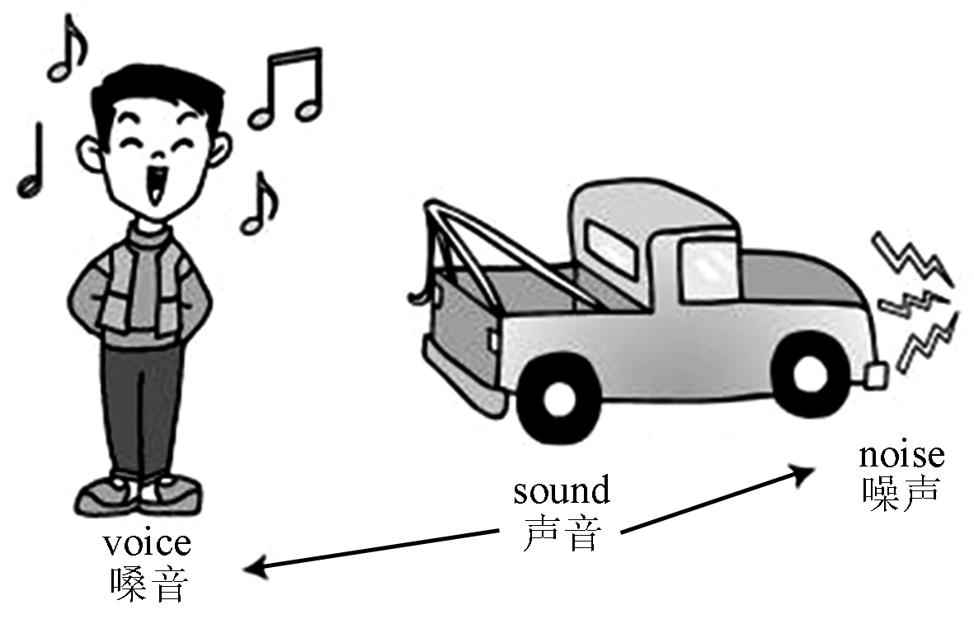
[图解助记]

Slide 20
2．用sound, noise或voice填空
(1)At midnight he heard a strange ________．
(2)The students made too much ________ in the classroom.
The monitor told them to stop talking in a loud ________．
sound
noise
voice

