Slide 1
Module 11 Way of life
Unit 1 In China, we open a gift later.
WWW.PPT818.COM

Slide 2
Practice
What must I do when I enter your home?
You must take off your shoes.
What must I wear at school?
You must wear your school uniforms.
What must I do in class?
You must put up your hands when you answer a question.
You mustn’t eat or drink anything.
What must I do in the library?
You mustn’t talk loudly.
You must keep quiet.

Slide 3
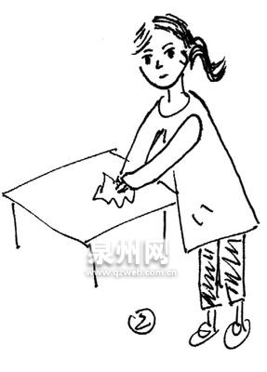
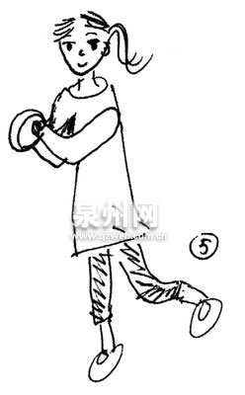
用 must, mustn’t和can’t 完成句子。
×
√
You _____ ______ the table.
must
clean
You _______ _____ the bowls
when you are jumping.
mustn’t
wash

Slide 4
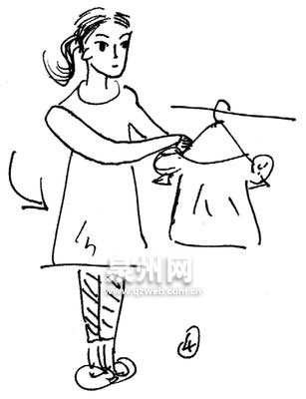
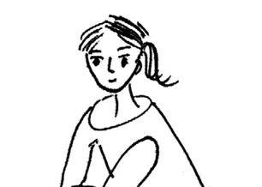
√
×
You _____ ____ your clothes on Sunday.
must
wash
mustn’t
play
You _______ ____ the guitar every evening.

Slide 5
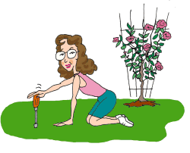
×
√
You _______ _____ the garden so dirty.
mustn’t
make
You _____ ____ your mother keep the garden beautiful.
must
help

Slide 6
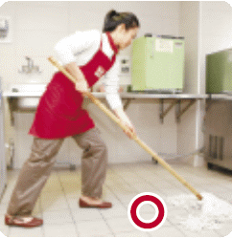
√
must
clean
a mop
You ____ _____ the floor with _____ (拖把).
can’t
You _____ _____ the floor with a towel (毛巾).
clean

Slide 7
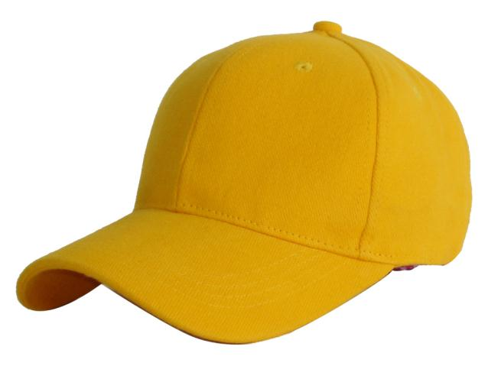
caps

Slide 8
dictionary

Slide 9
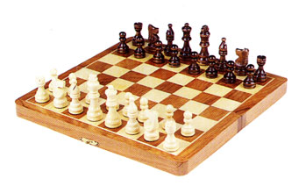
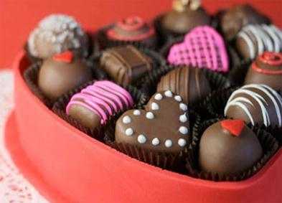
chocolate
chess set

Slide 10
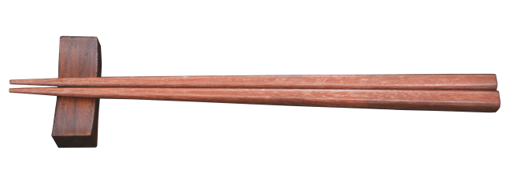
chopstick

Slide 11
Listen and number the words and expressions as you hear them.
baseball cap chess set chocolate chopsticks dictionary toy video game
6
2
3
4
7
1
5

Slide 12
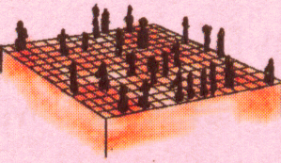
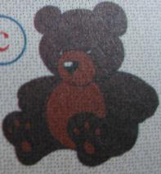
Match the words with the pictures.
chess set
video game
toy
dictionary
chocolate
chopsticks
baseball cap

Slide 13
Listen and answer the question.
1. Can Lingling open the present immediately?
Yes, she can.
2. What present did they buy for Lingling?
An dictionary.

Slide 14
Check (√) what you usually do in China.
1. Open a present immediately when you receive it.
2. Accept a present with both hands.
3. Use red paper for hongbao.
4. Do cleaning on the first day of the Spring Festival.
5. Break something during the Spring Festival.
6. Have your hair cut during the Spring Festival month.
√
√

Slide 15
Complete the passage with the words in the box.
accept attention surprise taste traditions
It is always a(n) (1) _______ to receive gifts from family members and friends. In China, we usually (2) ______ a gift with both hands and open it later. But in the West, people usually do not pay much (3) ________ to that.
surprise
accept
attention

Slide 16
accept attention surprise taste traditions
During the Spring Festival, there are many (4) _________. For example, people in the north of China eat lots of jiaozi. They (5) _____ great.
traditions
taste

Slide 17
Choose the best answer for each sentence.
In the USA, when someone gives you
a present, you must open it _______.
A. later B. immediately
C. five minutes
2. When you accept a present, you must use _____ in China.
A. left hand B. both hands
C. right hand

Slide 18
3. When you accept a present, you can use
_____ in Britain.
A. both hands B. one hand C. a box
4. Hongbao in ____ paper is lucky.
A. white B. green C. red
5. You mustn’t do any ______ on the first
day of the Spring Festival.
A. shopping B. cleaning C. cooking

Slide 19
Speaking

Slide 20
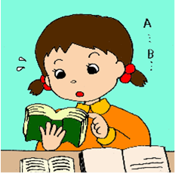
Read the passage and find out the sentences with can, can’t, must, mustn’t. And try to understand their meanings.

Slide 21
Listen and check how the speaker pronounces the underlined words.
1. I don’t think I should open it now.
2. You needn’t wait!
3. You mustn’t break anything.
4. You must only use red paper for hongbao.
5. You’d better not have your hair cut during the Spring Festival month.
Tips: 注意含情态动词的句子语调。
Now say the sentences aloud.

Slide 22
一、单项填空。
1. You have already tried your best, so
you ___ worry about the matter.
A. needn’t B. mustn’t
2. Usually he writes ___ ink and___ his
left hand.
A. in; by B. in; with
3. It’s ___.
A. a bad luck B. bad luck

Slide 23
4. -Can you play with a yo-yo, Jim?
-Yes, I ___. It’s easy.
A. must B. can
5. -What did the head teacher say at
the meeting?
-He said, “ We ___ be proud of working
hard. We mustn’t be lazy.”
A. must B. needn’t
6. You are very ill, so you ___ stay in bed
for a week.
A. need B. must

Slide 24
二、根据句意及首字母提示，写出相应的单词。
1. My brother is c______ happily with his
friends by QQ.
2. — Can you help me h___ up the
picture, Jack?
— No problem.
3. Jane came to see me i__________ after she
arrived in Beijing.
4. Our English teacher can’t a_____ our
invitation, because he is too busy.
5. — I passed the final exam yesterday.
— Wow, you are really a l____ dog.
hatting
ang
mmediately
ccept
ucky

Slide 25
三、根据汉语提示完成下列句子，每空一词。
1. 稍等一会儿， 我马上回来。
_____ __ a minute. I’m just coming.
2. —现在正在下大雨。我们只能呆在家里。
—倒霉。
—It’s raining heavily. We have to stay at home.
— It’s ___ ____.
3. 看！他的爸爸和妈妈来了。
Look! ____ _____ his father and mother.
4. 这仅仅是一个故事。你们不应当这么严肃吧!
This is only a story. You can’t __ ______!
5. 快点，否则你会错过末班车的。
___ _ _____ __, or you’ll miss the last bus.
Hang on
bad luck
Here come
be serious
Get a move on

Slide 26
Homework
Read the passage again and review
the new words and expressions.
2. 发挥想象，连词成文(50-70字)。
surprise, immediately, difference, accept, tradition, example, must, you’d better.

Slide 27
Preview
1. To preview the passage about customs and rules in England;
2. To practise the vocabulary.

