Slide 1
Unit 6
Outdoor fun
Reading
WWW.PPT818.COM

Slide 2
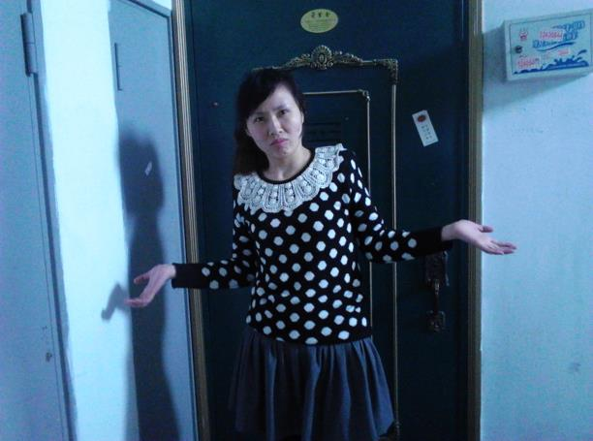
locked
I couldn’t
get in !
key

Slide 3
The Lost Key
※ The door was locked. I couldn’t find the key
※ I didn’t notice that there was a big hole
in my pocket.
※ The key and my mobile phone went
through the hole.
※ I saw someone with a mobile phone
passing by.
※ I asked him for help to call my husband.

Slide 4
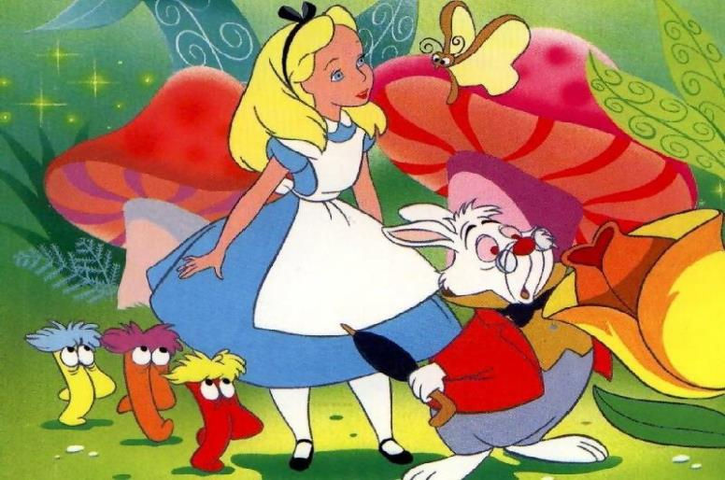
Fantasy Tale
Alice in Wonderland

Slide 5
Sum up the main idea of each part
Alice sat by the river with her
sister and saw a white rabbit.
Paragraphs1&2
Alice ran after the rabbit and
jumped down the hole.
Paragraph 3
Paragraphs4&5
Alice found herself in a
long, low hall alone.

Slide 6
Task 1 Ask and Answer for Paras.1&2
1. It was a sunny day.
2. She sat by the river with her sister.
3. She saw a white rabbit in a coat passing by.

Slide 7
Why did the rabbit look at the watch ?
What did the rabbit want to do?
imagination & creativity

Slide 8
Task 2 Rearrange the following actions
Read Para3 and put the actions into a right order.
Alice when she saw the rabbit.
The rabbit a big hole.
Alice the hole, too.
Alice did not want to let the rabbit
Alice the field after the rabbit.
1
stood up
3
jumped down
5
jumped down
4
get away
.
2
ran across
took…out of
saw… passing by
sat by
Retell the story with the key actions.
Work in pairs

Slide 9
Task3 Fill in the blanks according to Paras.4-5
Did Alice get out of the hall and get into the lovely garden?
There were doors all around,
Alice saw a small key on a table,
Alice saw a lovely garden on the other side, and tried to go through the door,
they were all locked.
BUT
it did not fit any of
the doors.
she was too big.

Slide 10
If Alice went through the door at last,
how did she do that?
who might help her?
imagination & creativity

Slide 11
Follow up
When Alice jumped down the hole, she found
there were two of her friends in the hall, too.
Work in a group of three. Make a conversation
to talk about
How you came to the hall
What you saw on the way
How you felt about it
What all of you wanted to do next
……
You can even think about how they went
through the door and what interesting things
happened in the lovely garden.

Slide 12
Imagination & Creativity
can make our life
more colourful !

Slide 13
Homework
Use your imagination to make up
an ending for the story and share
it with your classmates.

Slide 14
Thank you

