Slide 1
河北教育出版社 五年级 | 下册
Unit 4 Lesson23
An Email from Li Ming
WWW.PPT818.COM

Slide 2
河北教育出版社 五年级 | 下册
Warm-up
动词过去式的变化规则
一般情况下，直接在词尾加ed。
例如：walk, walked
动词以字母e结尾，则只在词尾加d。
例如：live, lived
有些不规则动词，则需特别记忆。
例如：is, was, are, were.

Slide 3
河北教育出版社 五年级 | 下册
Presentation
Who is the email sent to?
Jenny and Danny.
What is this email about?
Photos.
What happened with Danny?
He hurt his arm and Jenny helped him.

Slide 4
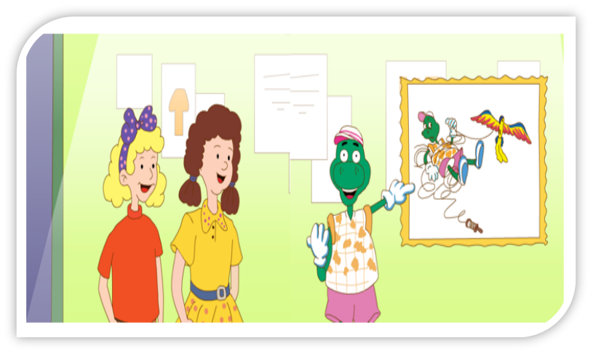
河北教育出版社 五年级 | 下册

Slide 5
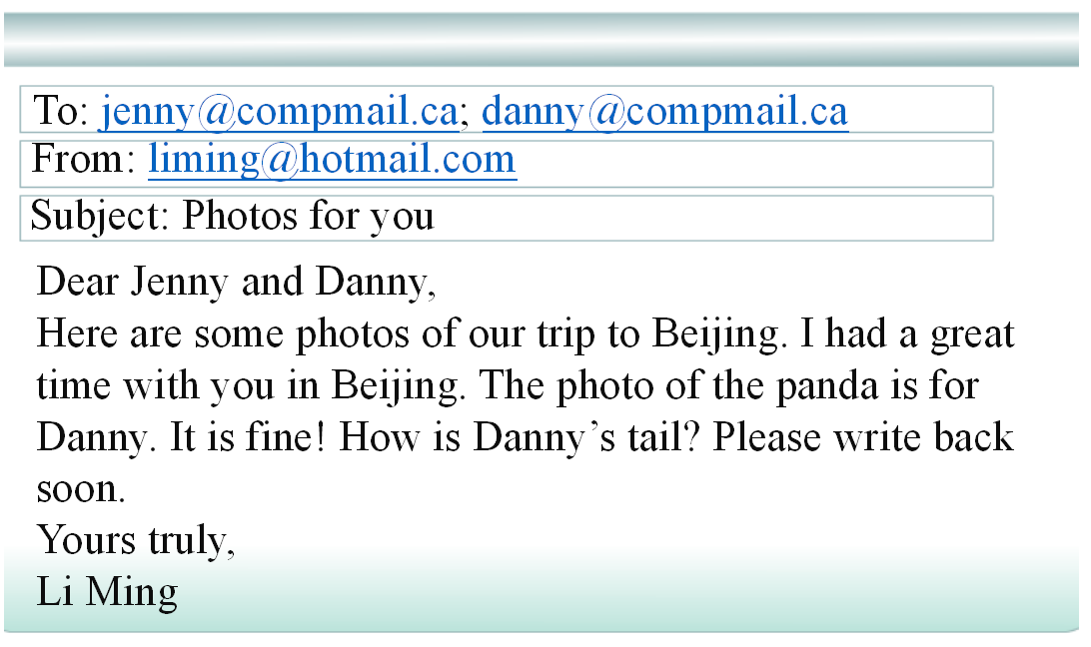
河北教育出版社 五年级 | 下册
Li Ming’s email

Slide 6
河北教育出版社 五年级 | 下册
Look! Danny was at Tian'anmen Square.
I wanted to fly a kite. I hurt my arm and Jenny helped me.
What happened?

Slide 7
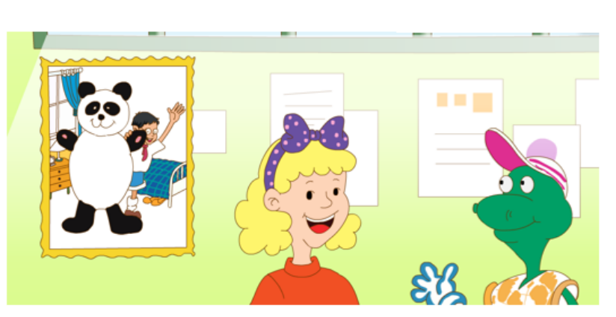
河北教育出版社 五年级 | 下册
This photo is for you, Danny.
That's my panda! Hi, panda! I miss you!

Slide 8
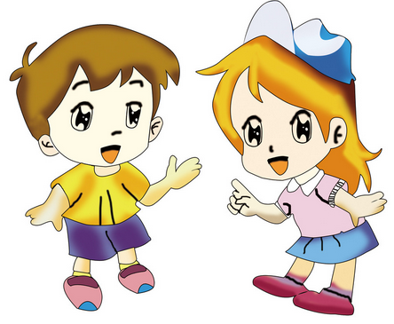
河北教育出版社 五年级 | 下册
Practice
Level1: 分角色朗读对话，注意模仿语音语调。
Level2: 三人一组，试着表演出来吧。

Slide 9
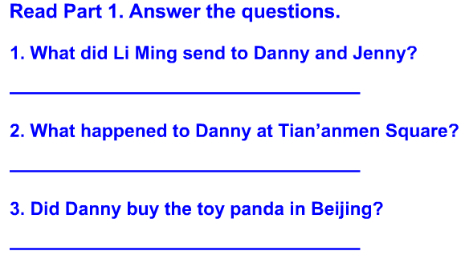
河北教育出版社 五年级 | 下册
Practice

Slide 10
河北教育出版社 五年级 | 下册
答案
1. He sent some photos.
2. Danny hurt his arm and Jenny helped him.
3. Yes, he did.

Slide 11
河北教育出版社 五年级 | 下册
我是小小演唱家
What did you do?
I walked to school.
What did you do?
I went to the zoo.
What did you do?
I watched a kangaroo.
What did you do?
I ate the donuts too.

Slide 12
河北教育出版社 五年级 | 下册
Summary
重点词汇：
back
重点句子：
I had a great time …
I had a great time with you in Beijing.

Slide 13
河北教育出版社 五年级 | 下册
Homework
Learn to sing the song Part3 and sing it to your family.
学唱歌曲Part3，并唱给自己的家人听。

