Slide 1
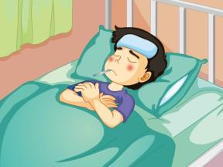
Unit 4 What’s wrong with you?
人教精通版英语五年级下册
WWW.PPT818.COM

Slide 2
>>Warm-up
Let’s sing

Slide 3
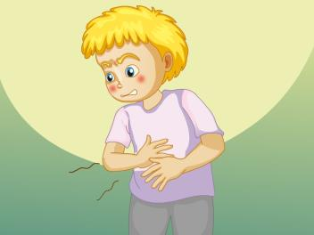
>>Lead-in
Let’s review
have a toothache
have a stomachache
What’s wrong with you?
I have a toothache/stomachache.

Slide 4
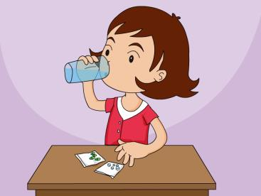
>>Lead-in
Let’s review
take some medicine
take a good rest
You should take some medicine and take a good rest.

Slide 5
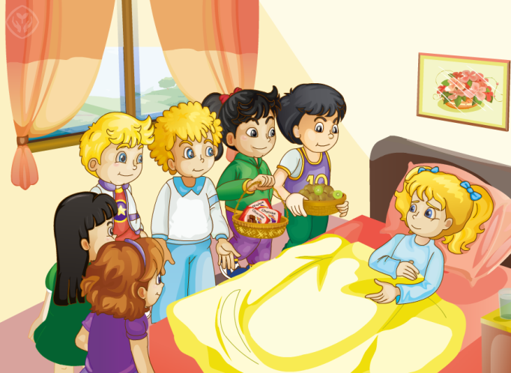
>>Presentation
Just talk

Slide 6
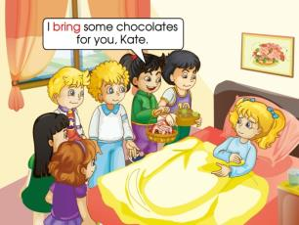
>>Presentation
Just talk
Kate is ill. Her classmates come to see her.
They bring her a lot of things.
They want to help her with her lessons. Kate feels very happy.
bring

Slide 7
>>Presentation
Just talk
Peter: How are you feeling today, Kate?
Kate: I feel much better.
feel
I feel good today.

Slide 8
>>Presentation
Just talk
Gao Wei: Here is some kiwi fruit for you.
Li Yan: I have some chocolates for you, too.
Lisa: Look! Here is a get-well card for you.

Slide 9
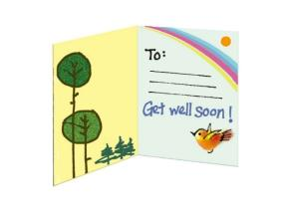
>>Presentation
Just talk
chocolate
I love chocolates!
get-well card
Here is a get-well card for you.

Slide 10
>>Presentation
Just talk
Kate: Oh, thank you! But I’m worried about my lessons.
Gao Wei: Don’t worry. I’ll help you with your maths.
worry about…

Slide 11
>>Presentation
Just talk
Bob: I’ll help you with your English.
Li Yan: I’ll help you with your Chinese.
Kate: Thank you very much.
help…with…

Slide 12
>>Practice
feel
with
chocolates
get-well
bring
1. I ________ much better today.
2. I like ice cream and _________.
3. Thanks for your ________ card.
4. He will help me ________ my English.
5. They ________ her a lot of things.

Slide 13
>>Practice
Group Work
分角色朗读

Slide 14
>>Summary
重点词汇：
bring
feel
chocolate
get-well card
如何询问对方今天感觉怎么样？
---How are you feeling today?
---I feel much better.
如何表达“这是给你的康复卡”？
Here’s a get-well card for you.

Slide 15
>>Homework
1. 观看课文动画，按照正确的语音、语调朗读课文。
2 . 自己动手制作一个康复卡。
3 . 预习Lesson24。
close

