Slide 1
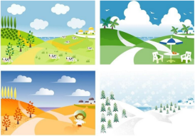
Unit6 There are four seasons in a year.
人教精通版六年级上册
WWW.PPT818.COM

Slide 2
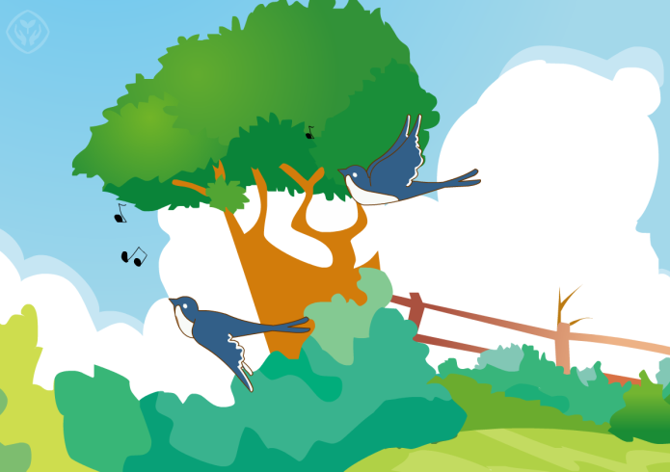
>>Warm-up
Let’s sing

Slide 3
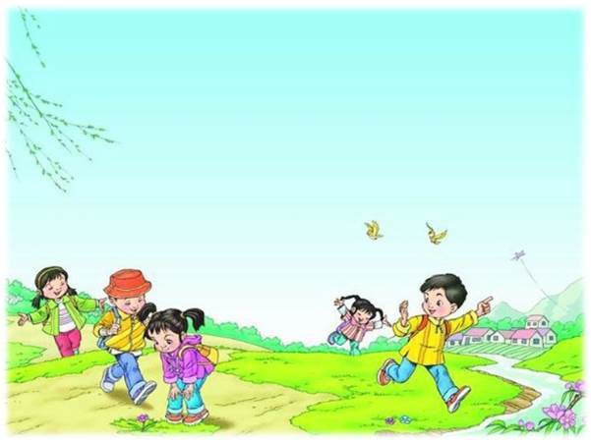
>>Warm-up
Let’s review
When does spring begin?
How’s the weather in spring?
What’s spring like?
What do people do in spring?

Slide 4
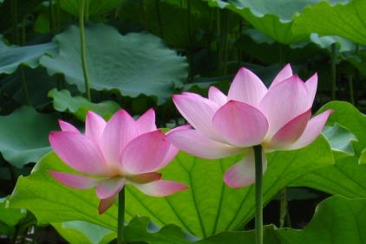
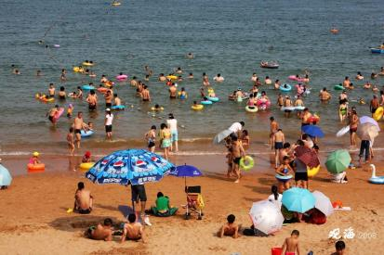
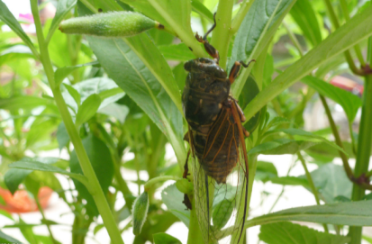
>>Lead-in
Look and say
summer

Slide 5
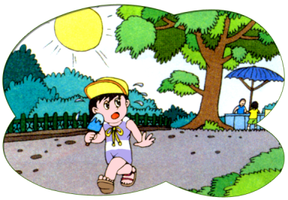
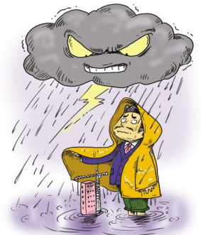
>>Presentation
Look and say
How’s the weather?
It is very hot.
It’s rainy.
It is heavy rain.

Slide 6
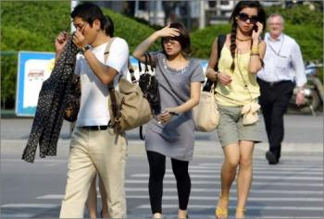
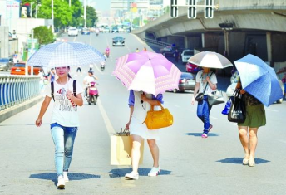
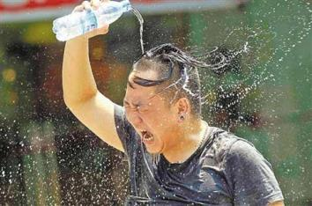
>>Presentation
hot
热
hotter
较热
hottest
最热

Slide 7
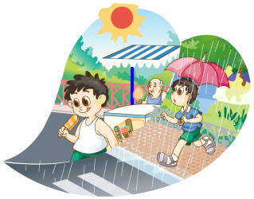
>>Presentation
Just read and talk
Look, listen and find the answers:
Q1: When does summer begin?
Q2: How’s the weather in summer?

Slide 8
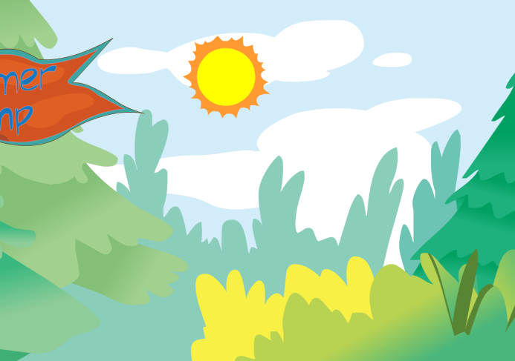
>>Presentation
Just read and talk

Slide 9
>>Presentation
Q1: When does summer begin?
Q2: How’s the weather in summer?
Just read and talk
It begins around June.
It’s very hot and there’s often a lot of rain.

Slide 10
>>Presentation
Just read and talk
Q3: What do students do in summer?
Q4: Do they enjoy the summer holidays?
Listen again and read:
Some of them go on trips with their
parents, some go camping with their
teachers, and some have summer classes.
Yes, they do.

Slide 11
>>Practice
Just read and talk
Listen and imitate
Summer is the second and the hottest season of the year.
In China, summer begins around June.
The weather is very hot and there’s often a lot of rain.
Sometimes there is heavy rain.

Slide 12
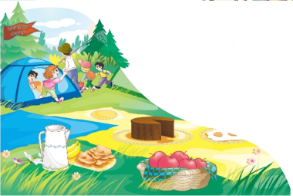
>>Practice
Just read and talk
Listen and imitate
In summer, schools close and students have their holidays.
Some of them go on trips with their parents, some go camping with their teachers, and some have summer classes.
They all enjoy the summer holidays.

Slide 13
>>Practice
Let’s read
Read together.
(齐读)
Read in pictures.
（分图读）
Read in groups.
(分组读）

Slide 14
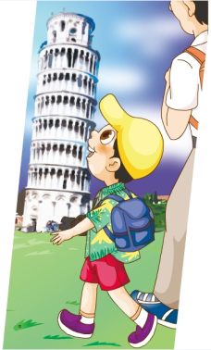
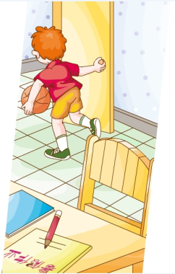
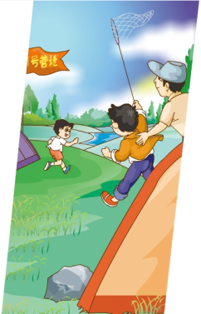
>>Practice
Look and match
go to a summer camp
have summer
holidays
go on a trip

Slide 15
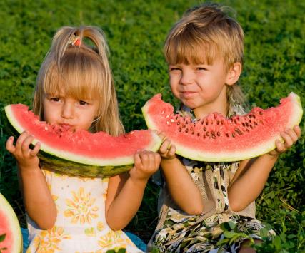
>>Practice
Look and say
What do they do in summer?
Eat watermelons

Slide 16
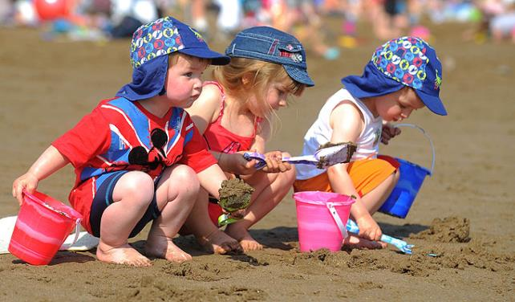
>>Practice
Look and say
Go to the beach

Slide 17
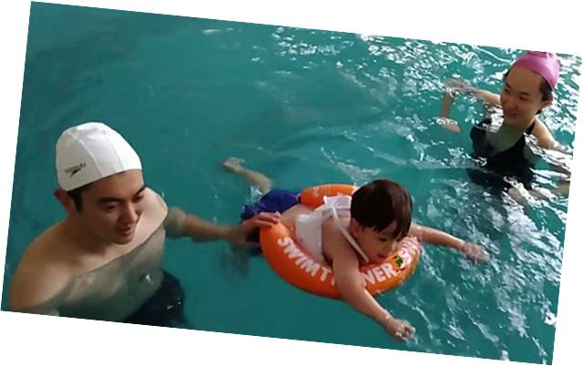
>>Practice
Look and say
Go swimming

Slide 18
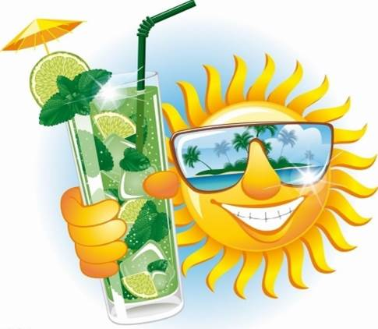
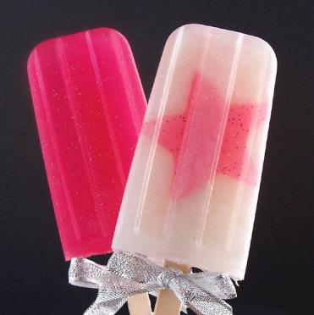
>>Practice
Look and say
Drink cold juice
Eat much ice cream

Slide 19
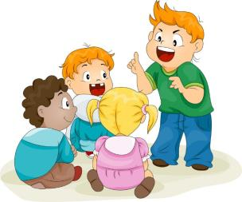
>>Practice
Group work
What do you like to do in summer?

Slide 20
>>Summary
本课学习的关于夏天的特点和活动的句子有哪些？
It begins around …
The weather is … and there’s …
Sometimes there is …
School … The students …
Some of them…, some … and some …

Slide 21
>>Homework
1.跟读课文动画或录音，按照正确的语音、语调朗读课文。 2.上网或看书查阅资料：在其他国家，春天和夏天是什么情景？尝试用英语简要表达出来。
3.预习 Lesson 35。

