Slide 1
Unit 1 Lesson 3
Let's Play!
WWW.PPT818.COM

Slide 2
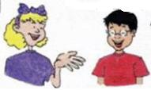
Warm-up
What are they going to do ?
Are you ready to learn to play basketball, Li Ming?
Yes! Are you ready to learn to play ping-pong?
I want to learn, too!

Slide 3
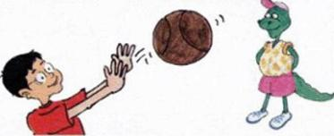
Let’s learn
try basketball
Let me try. Here I go!
I'm throwing the basketball!

Slide 4
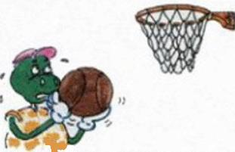
Let’s learn
heavy difficult
The ball is too heavy!
This is too difficult!

Slide 5
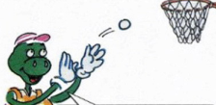
Let’s learn
light easy
The ball is too light!
This is easy!

Slide 6
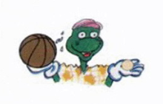
Let’s learn
The basketball is heavy.
The ping-pong ball is light.

Slide 7
Listen to the conversations on Page6 again and check the words you hear.
heavy difficult
basketball try
easy light

Slide 8
Let’s look and read
L: I am hitting the ball to Jenny.
Can you hit the ball to Jenny?
D: I think I can!

Slide 9
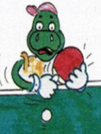
Let’s look and read
Li Ming hits the ball, but Danny hits his hand! Poor Danny!
Ouch! I hit my hand!

Slide 10
Look and write
The basketball is .
The ping-pong ball is .
heavy
light

Slide 11
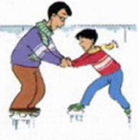
Look and write
The man is the boy to skate.
The boy is to skate.
teaching
learning

Slide 12
Look and write
Li Ming likes T-shirt.
He doesn’t like T-shirt.
this
that

Slide 13
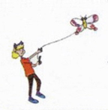
Look and write
Jenny can fly the kite very high. It's . Danny can't fly the kite. It's .
easy
difficult

Slide 14
Summary and evaluation
What have you learned in this class?
A excellent B good C adequate D need improvement
内容 | 学生自评 | 小组互评
我能认真听老师讲课，听同学发言
遇到我会回答的问题主动举手了
活动中坚持使用英语来交际
我能积极参与小组讨论活动，能与他人合作。

Slide 15
Homework
1. Copy the key words three times.
2. Recite the conversations on Page6.

