Slide 1
My favorite subject is science.
Section A 第2课时
WWW.PPT818.COM

Slide 2
Frank: Hi, Bob. How’s your day?
Bob: It’s OK.I like Monday because I have P.E. and history.
They’re my favorite subjects.
Frank: Who’s your P.E. teacher?
Bob: Mr. Hu. He always plays games with us.
Frank: That’s great! But why do you like history? It’s boring.
Bob: Oh, I think history is interesting. What’s your favorite day?
Frank: Friday.
Bob: Why?
Frank: Because the next day is Saturday!
Bob: Haha! That’s for sure. I like Friday, too.

Slide 3
Frank: Hi, Bob. How’s your day?
Bob: It’s OK.I like Monday because I have
P.E. and history. They’re my favorite subjects.
Frank: Who’s your P.E. teacher?
Bob: Mr. Hu. He always plays games with us.
Frank: That’s great! But why do you like history?
It’s boring.
Bob: Oh, I think history is interesting.
What’s your favorite day?
Frank: Friday.
Bob: Why?
Frank: Because the next day is Saturday!
Bob: Haha! That’s for sure. I like Friday, too.
How’s your day?
今天过得如何？
答语：It’s OK.还行。
Great! 棒极了！
2. have + 学科：
上某一学科的课。
have English 上英语课 have a class / lesson 上课

Slide 4
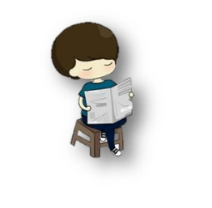
Frank: Hi, Bob. How’s your day?
Bob: It’s OK.I like Monday because I have
P.E. and history. They’re my favorite subjects.
Frank: Who’s your P.E. teacher?
Bob: Mr. Hu. He always plays games with us.
Frank: That’s great! But why do you like history?
It’s boring.
Bob: Oh, I think history is interesting.
What’s your favorite day?
Frank: Friday.
Bob: Why?
Frank: Because the next day is Saturday!
Bob: Haha! That’s for sure. I like Friday, too.
1. who是疑问代词，意为“谁”，引导特殊疑问句对人提问，作主语。
2. who作主语时，句型：“who+谓语+其他？” who做第三人称单数，谓语动词要与其保持一致。
---Who helps you do it?
---Mary and Tom.

Slide 5
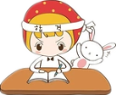
Frank: Hi, Bob. How’s your day?
Bob: It’s OK.I like Monday because I have
P.E. and history. They’re my favorite subjects.
Frank: Who’s your P.E. teacher?
Bob: Mr. Hu. He always plays games with us.
Frank: That’s great! But why do you like history?
It’s boring.
Bob: Oh, I think history is interesting.
What’s your favorite day?
Frank: Friday.
Bob: Why?
Frank: Because the next day is Saturday!
Bob: Haha! That’s for sure. I like Friday, too.
1. play with...意为“和……一起玩”。
Can you come out to play with me?
2. play with还可以意为“玩弄，玩耍”。
The boy is playing with his toy car.
3. 的确如此！

Slide 6
根据汉语补全句子
I like Monday because I_____ ____ ____ _______. （上体育和历史课）
They’re____ ________ ________.（我最喜欢的科目）
_______ your P.E. teacher? （谁是）
---Why do you like Friday?
--- Because ____ _____ _____ is Saturday! （第二天）
have P.E. and history
my favorite subjects
Who’s
the next day

Slide 7
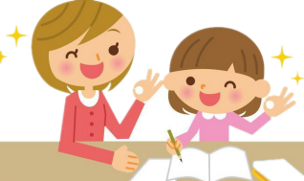
单项选择
1. My ____favorite subject is P.E.
brother B. brother’s C. of brother D. of brother’s
2. Who ____ with Anna everyday?
A. play B. plays C. playing D. playing
B
B

Slide 8
短语
have+学科
play with
句型
How is your day？
Who+谓语+……？

