Slide 1
Module 9 Unit 1
Best wishes to you!
WWW.PPT818.COM

Slide 2
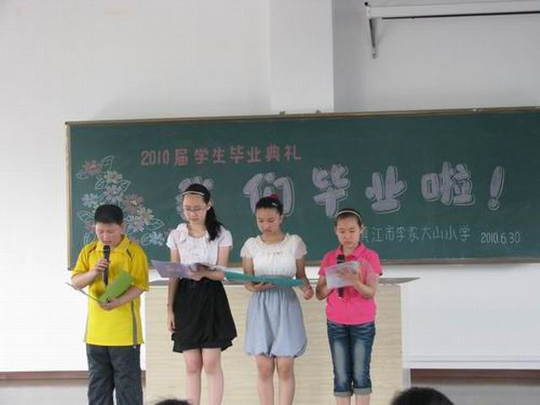
We are going to be a graduate.

Slide 3
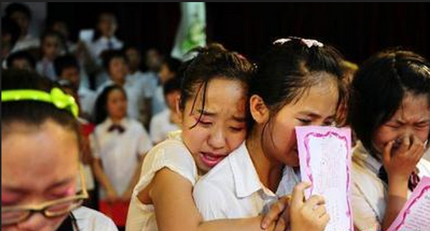
Say goodbye to my friends.

Slide 4
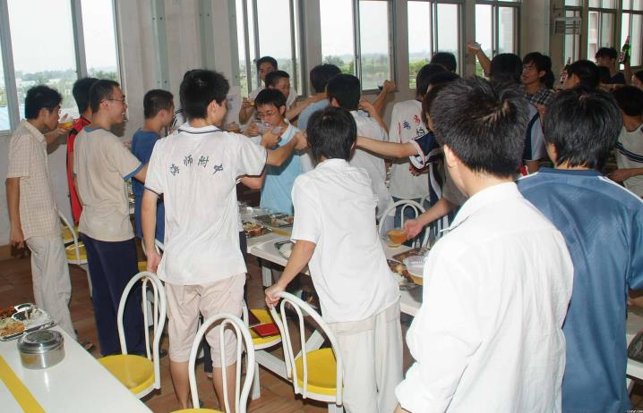
Graduation dinner

Slide 5
Listen and chant.
Best wishes to you!
Good luck to you!
You are a great friend.
And I will miss you.

Slide 6
Listen and read.
Daming 12 years old China.
Dear friends,
We’re going to say goodbye to our primary school soon. I enjoyed our time together. I want to remember you all. Please write a message in this book. I’ll keep it forever. Thank you!
Daming

Slide 7
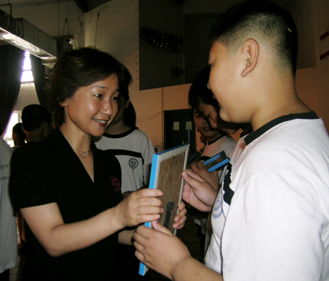
Daming and his teacher

Slide 8
Lingling 13 years old China
Daming
You’re a naughty but lovely boy.
You helped me in sport.
You brought us lots of joy.
Good luck for the future!
Lingling

Slide 9
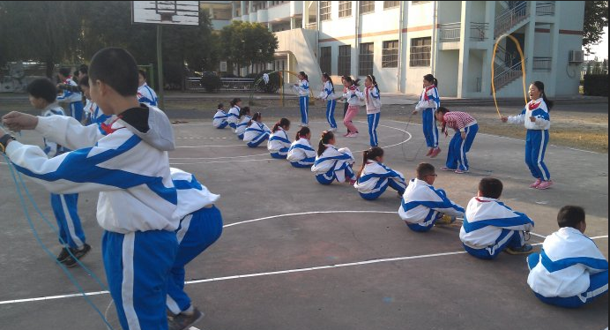
Daming helps Lingling in sport.

Slide 10
Amy 13 years old UK
Daming,
We had a happy time at school, you very much. You’re a wonderful friend. I will miss you.
Amy

Slide 11
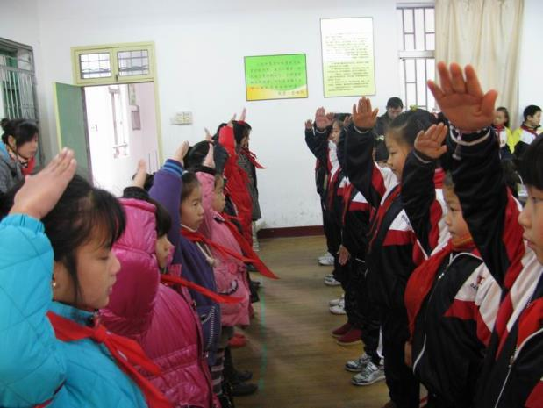
Daming and Amy at school.

Slide 12
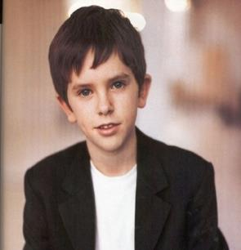
Sam 12 years old UK
You’re my best friend, Daming
I’ll never forget our time together.
Best wishes to you!
Come to the UK to watch football games with me!
Sam

Slide 13
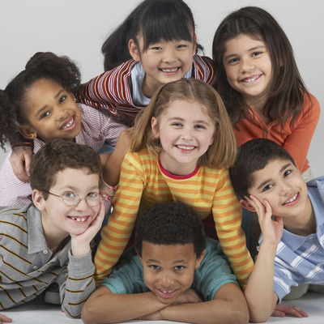
Daming and Sam are laughing.

Slide 14
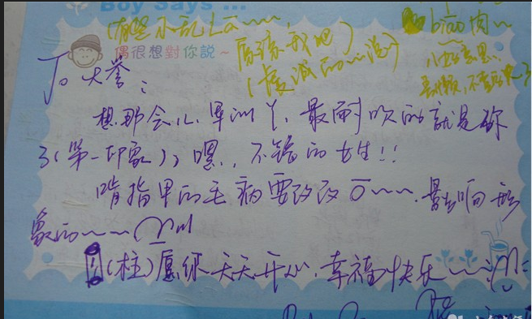

Slide 15
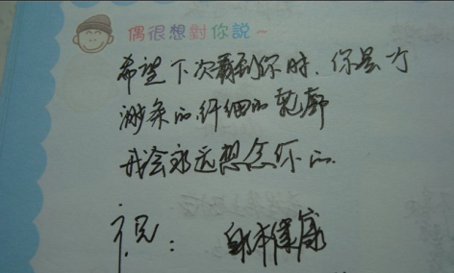

Slide 16
homework
1.给你最好的朋友写一些毕业的话
2.听听录音和他们的故事

Slide 17
Thank you!

