Slide 1
C
BUSINESS
ECONOMICS
WORK
PLAN
Financial management
投资理财策划
We are all too young, a lot of things don't yet know, don't put the wrong loves when gardeners.
汇报人：PPT818

Slide 2
Content
1
金融理财投资
2
金融理财介绍
3
金融理财学习
4
金融理财总结

Slide 3
1
金融理财投资
Gentle to have, but not compromise, I want to be in quiet, not strong. The life most of the time, commitments equals to constrain, reluctantly we yearn for bound.
FINANCIAL

Slide 4
点击编辑标题
Gentle to have, but not compromise, I want to be in quiet, not strong. The life most of the time, commitments equals to constrain.
输入标题
输入标题
I'm just a sunflower, waiting for belong to me only sunshine.
I'm just a sunflower, waiting for belong to me only sunshine.

Slide 5
输入此处标题
金融理财
MANAGEMENT
Gentle to have, but not compromise, I want to be in quiet, not strong. The life most of the time.
输入此处标题
金融理财
MANAGEMENT
Gentle to have, but not compromise, I want to be in quiet, not strong. The life most of the time.

Slide 6
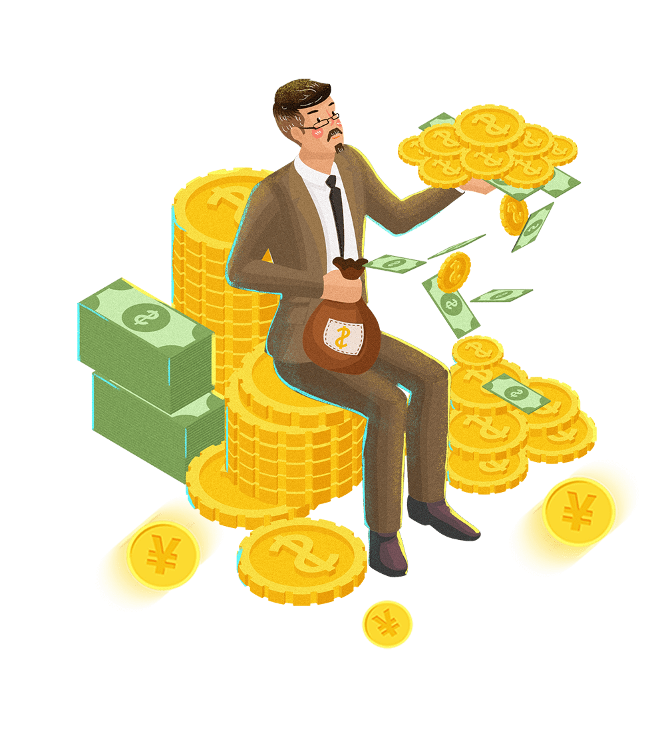
输入标题
输入标题
I'm just a sunflower, waiting for belong to me only sunshine.
I'm just a sunflower, waiting for belong to me only sunshine.
输入标题
输入标题
I'm just a sunflower, waiting for belong to me only sunshine.
I'm just a sunflower, waiting for belong to me only sunshine.

Slide 7
金融理财
MANAGEMENT
45
01
Gentle to have, but not compromise, I want to be in quiet, not strong. The life most of the time.
55
60
02
The life most of the time, commitments equals to constrain, reluctantly we yearn for bound.
40
25
The life most of the time, commitments equals to constrain, reluctantly we yearn for bound.
03
75

Slide 8
2
金融理财介绍
Gentle to have, but not compromise, I want to be in quiet, not strong. The life most of the time, commitments equals to constrain, reluctantly we yearn for bound.
FINANCIAL

Slide 9
01
02
03
04
输入标题
输入标题
输入标题
输入标题
I'm just a sunflower, waiting for belong to me only sunshine.
I'm just a sunflower, waiting for belong to me only sunshine.
I'm just a sunflower, waiting for belong to me only sunshine.
I'm just a sunflower, waiting for belong to me only sunshine.

Slide 10
标题文字添加
The life most of the time, commitments equals to constrain, reluctantly we yearn for bound.
标题文字添加
The life most of the time, commitments equals to constrain, reluctantly we yearn for bound.

Slide 11
金融理财
MANAGEMENT
The life most of the time, commitments equals to constrain, reluctantly we yearn for bound.

Slide 12
输入标题
Gentle to have, but not compromise, I want to be in quiet, not strong. The life most of the time, commitments equals to constrain, reluctantly we yearn for bound.
输入标题
输入标题
输入标题
输入标题
01
02
03
04
05
06
07
输入标题
输入标题
输入标题
输入标题
I'm just a sunflower, waiting for belong to me only sunshine.
I'm just a sunflower, waiting for belong to me only sunshine.
I'm just a sunflower, waiting for belong to me only sunshine.
I'm just a sunflower, waiting for belong to me only sunshine.
Notes:
https://www.ypppt.com/

Slide 13
3
金融理财学习
Gentle to have, but not compromise, I want to be in quiet, not strong. The life most of the time, commitments equals to constrain, reluctantly we yearn for bound.
FINANCIAL

Slide 14
输入标题
The life most of the time, commitments equals to constrain, reluctantly we.
输入标题
The life most of the time, commitments equals to constrain, reluctantly we.
输入标题
The life most of the time, commitments equals to constrain, reluctantly we.

Slide 15
金融理财
MANAGEMENT
Gentle to have, but not compromise, I want to be in quiet, not strong. The life most of the time.
输入标题
输入标题
I'm just a sunflower, waiting for belong to me only sunshine.
I'm just a sunflower, waiting for belong to me only sunshine.

Slide 16
金融理财
MANAGEMENT
金融理财
MANAGEMENT
金融理财
MANAGEMENT
Gentle to have, but not compromise, I want to be in quiet, not strong. The life most of the time.
Gentle to have, but not compromise, I want to be in quiet, not strong. The life most of the time.
Gentle to have, but not compromise, I want to be in quiet, not strong. The life most of the time.

Slide 17
80%
60%
25%
Gentle to have, but not compromise, I want to be in quiet, not strong. The life most of the time.
Gentle to have, but not compromise, I want to be in quiet, not strong. The life most of the time.
The life most of the time, commitments equals to constrain, reluctantly we yearn for bound.

Slide 18
4
金融理财总结
Gentle to have, but not compromise, I want to be in quiet, not strong. The life most of the time, commitments equals to constrain, reluctantly we yearn for bound.
FINANCIAL

Slide 19
金融理财
MANAGEMENT
Gentle to have, but not compromise, I want to be in quiet, not strong. The life most of the time.
小标题
90%
小标题
75%
小标题
45%

Slide 20
57%
Gentle to have, but not compromise, I want to be in quiet, not strong. The life most of the time.
43%
Gentle to have, but not compromise, I want to be in quiet, not strong. The life most of the time.

Slide 21
金融理财
Financial management
Gentle to have, but not compromise, I want to be in quiet, not strong. The life most of the time.
Gentle to have, but not compromise, I want to be in quiet, not strong. The life most of the time.

Slide 22
金融理财
MANAGEMENT
Gentle to have, but not compromise, I want to be in quiet, not strong. The life most of the time.

Slide 23
输入标题
输入标题
输入标题
I'm just a sunflower, waiting for belong to me only sunshine.
I'm just a sunflower, waiting for belong to me only sunshine.
I'm just a sunflower, waiting for belong to me only sunshine.
1
3
5
2
4
输入标题
输入标题
I'm just a sunflower, waiting for belong to me only sunshine.
I'm just a sunflower, waiting for belong to me only sunshine.

Slide 24
输入标题
The life most of the time, commitments equals to constrain, reluctantly we.
输入标题
The life most of the time, commitments equals to constrain, reluctantly we.
输入标题
The life most of the time, commitments equals to constrain, reluctantly we.
输入标题
The life most of the time, commitments equals to constrain, reluctantly we.
行业PPT模板http://www.1ppt.com/hangye/

Slide 25
C
BUSINESS
ECONOMICS
WORK
PLAN
THANKS of you
感谢您的欣赏

