Slide 1
财务报表知识培训
资产负债表 | 利润表 | 现金流量表 | 财务状况
Each day is a new beginning
Each day is a new beginning Seize new opportunities from now on Each day is a new beginning Seize new opportunities from now onEach day is a new beginning Seize new opportunities from now on

Slide 2
https://www.PPT818.com/
CONTENTS
怎么阅读资产负债表
怎么阅读利润表
01
02
Each day is a new beginning
Each day is a new beginning
Each day is a new beginning
怎么阅读现金流量表
怎么评价企业财务状况
03
04
Each day is a new beginning
Each day is a new beginning

Slide 3
资产负债表
Each day is a new beginning
PART.01
Each day is a new beginning
Each day is a new beginning Seize new opportunities from now on Each day is a new beginning Seize new opportunities from now onEach day is a new beginning Seize new opportunities from now on

Slide 4
怎么阅读资产负债表
01
Each day is a new beginning
标题文字添加
The user can demonstrate on a projector or computer, or print the presentation and make it into a film to be used
Each day is a new beginning

Slide 5
怎么阅读资产负债表
01
Each day is a new beginning
单击此处输入标题
The user can demonstrate on a projector or computer, or print the presentation and
单击此处输入标题
The user can demonstrate on a projector or computer, or print the presentation and
单击此处输入标题
The user can demonstrate on a projector or computer, or print the presentation and
Each day is a new beginning
单击此处输入标题
The user can demonstrate on a projector or computer, or print the presentation and
单击此处输入标题
The user can demonstrate on a projector or computer, or print the presentation and

Slide 6
怎么阅读资产负债表
01
Each day is a new beginning
单击此处输入标题
The user can demonstrate on a projector or computer, or print the presentation and make it into a film to be used
单击此处输入标题
The user can demonstrate on a projector or computer, or print the presentation and make it into a film to be used
Each day is a new beginning
单击此处输入标题
The user can demonstrate on a projector or computer, or print the presentation and make it into a film to be used

Slide 7
怎么阅读资产负债表
01
Each day is a new beginning
加入标题描述
70%
单击此处输入标题
I love you more than I've ever loved any woman. And I've waited longer for you than I've waited for any woman.
加入标题描述
92%
Each day is a new beginning
加入标题描述
87%
单击此处输入标题
I love you more than I've ever loved any woman. And I've waited longer for you than I've waited for any woman.
加入标题描述
52%

Slide 8
怎么阅读利润表
Each day is a new beginning
PART.02
Each day is a new beginning
Each day is a new beginning Seize new opportunities from now on Each day is a new beginning Seize new opportunities from now onEach day is a new beginning Seize new opportunities from now on
Notes:
PPT模板： www.ypppt.com/moban/ 行业PPT模板：www.ypppt.com/hangye/
节日PPT模板：www.ypppt.com/jieri/ PPT素材： www.ypppt.com/sucai/
PPT背景图片：www.ypppt.com/beijing/ PPT图表： www.ypppt.com/tubiao/
优秀PPT下载：www.ypppt.com/xiazai/ PPT教程： www.ypppt.com/powerpoint/
Word教程： www.ypppt.com/word/ Excel教程： www.ypppt.com/excel/
个人简历： www.ypppt.com/jianli/ PPT课件： www.ypppt.com/kejian/
手抄报： www.ypppt.com/shouchaobao/ 试题下载： www.ypppt.com/shiti/
教案下载： www.ypppt.com/jiaoan/ 字体下载： www.ypppt.com/ziti/

Slide 9
02
怎么阅读利润表
Each day is a new beginning
03
标题文字添加
The user can demonstrate on a projector or computer, or presentation and make it film to be used in a wider field
01
标题文字添加
The user can demonstrate on a projector or computer, or presentation and make it film to be used in a wider field
Each day is a new beginning
02
标题文字添加
The user can demonstrate on a projector or computer, or presentation and make it film to be used in a wider field

Slide 10
02
怎么阅读利润表
Each day is a new beginning
标题文字添加
标题文字添加
The user can demonstrate on a projector or computer, or presentation and make it film to be used in a wider field
The user can demonstrate on a projector or computer, or presentation and make it film to be used in a wider field
Each day is a new beginning
标题文字添加
标题文字添加
The user can demonstrate on a projector or computer, or presentation and make it film to be used in a wider field
The user can demonstrate on a projector or computer, or presentation and make it film to be used in a wider field

Slide 11
02
怎么阅读利润表
Each day is a new beginning
The user can demonstrate on a projector or computer, or presentation and make it film to be used in a wider field
The user can demonstrate on a projector or computer, or presentation and make it film to be used in a wider field
标题文本预设
标题文本预设
标题文本预设
Each day is a new beginning
标题文本预设
标题文本预设
The user can demonstrate on a projector or computer, or presentation and make it film to be used in a wider field
The user can demonstrate on a projector or computer, or presentation and make it film to be used in a wider field
The user can demonstrate on a projector or computer, or presentation and make it film to be used in a wider field

Slide 12
02
怎么阅读利润表
Each day is a new beginning
标题文字添加
The user can demonstrate on a projector or computer, or presentation and make it film to be used in a wider field
Each day is a new beginning
The user can demonstrate on a projector or computer, or presentation and make it film to be used in a wider field
The user can demonstrate on a projector or computer, or presentation and make it film to be used in a wider field
The user can demonstrate on a projector or computer, or presentation and make it film to be used in a wider field
Notes:
https://www.ypppt.com/

Slide 13
怎么阅读现金流量表
Each day is a new beginning
PART.03
Each day is a new beginning
Each day is a new beginning Seize new opportunities from now on Each day is a new beginning Seize new opportunities from now onEach day is a new beginning Seize new opportunities from now on

Slide 14
03
怎么阅读现金流量表
Each day is a new beginning
Each day is a new beginning
The user can demonstrate on a projector or computer, or presentation and make it film to be used in a wider field
The user can demonstrate on a projector or computer, or presentation and make it film to be used in a wider field
The user can demonstrate on a projector or computer, or presentation and make it film to be used in a wider field
标题文本预设
标题文本预设
标题文本预设

Slide 15
03
怎么阅读现金流量表
Each day is a new beginning
标题文字添加
The user can demonstrate on a projector or computer, or presentation and make it film to be used in a wider field
单击此处输入标题
The user can demonstrate on a projector or computer, or print the presentation and
Each day is a new beginning
单击此处输入标题
The user can demonstrate on a projector or computer, or print the presentation and

Slide 16
03
怎么阅读现金流量表
Each day is a new beginning
标题文字添加
The user can demonstrate on a projector or computer, or presentation and make it film to be used in a wider field
标题文字添加
The user can demonstrate on a projector or computer, or presentation and make it film to be used in a wider field
Each day is a new beginning
标题文字添加
The user can demonstrate on a projector or computer, or presentation and make it film to be used in a wider field
标题文字添加
The user can demonstrate on a projector or computer, or presentation and make it film to be used in a wider field

Slide 17
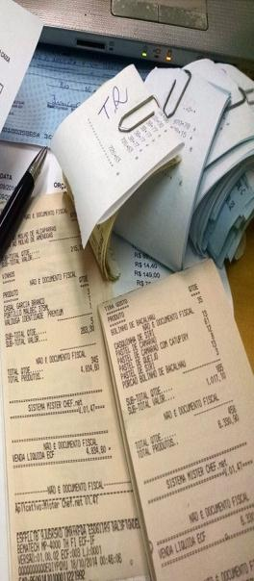
03
怎么阅读现金流量表
Each day is a new beginning
2007
Company History
Each day is a new beginning
标题文字添加
标题文字添加
标题文字添加
The user can demonstrate on a projector or compu
The user can demonstrate on a projector or compu
The user can demonstrate on a projector or compu

Slide 18
怎么评价企业财务状况
Each day is a new beginning
PART.04
Each day is a new beginning
Each day is a new beginning Seize new opportunities from now on Each day is a new beginning Seize new opportunities from now onEach day is a new beginning Seize new opportunities from now on

Slide 19
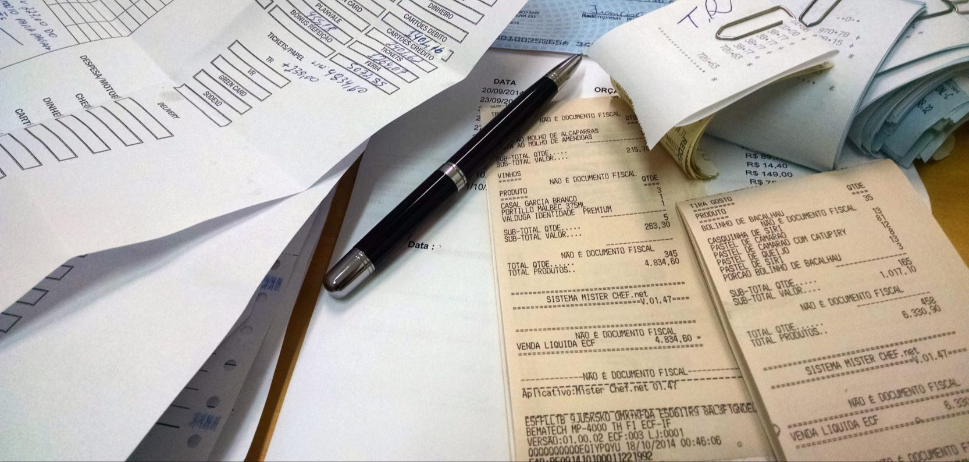
04
怎么评价企业财务状况
Each day is a new beginning
添加标题内容
The user can demonstrate on a projector or computer, or presentation and make it film to be used in a wider field
Each day is a new beginning
添加标题内容
The user can demonstrate on a projector or computer, or presentation and make it film to be used in a wider field
添加标题内容
The user can demonstrate on a projector or computer, or presentation and make it film to be used in a wider field

Slide 20
04
怎么评价企业财务状况
Each day is a new beginning
标题文字添加
The user can demonstrate on a projector or computer, or presentation and make it film to be used in a wider field
The user can demonstrate on a projector or computer, or presentation and make it film to be used in a wider field
标题文字添加
The user can demonstrate on a projector or computer, or presentation and make it film to be used in a wider field
The user can demonstrate on a projector or computer, or presentation and make it film to be used in a wider field
Each day is a new beginning
标题文字添加
The user can demonstrate on a projector or computer, or presentation and make it film to be used in a wider field
The user can demonstrate on a projector or computer, or presentation and make it film to be used in a wider field

Slide 21
04
怎么评价企业财务状况
Each day is a new beginning
标题文字添加
The user can demonstrate on a projector or computer, or presentation and make it film to be used in a wider field
Each day is a new beginning
标题文字添加
The user can demonstrate on a projector or computer, or presentation and make it film to be used in a wider field
标题文字添加
The user can demonstrate on a projector or computer, or presentation and make it film to be used in a wider field

Slide 22
04
怎么评价企业财务状况
Each day is a new beginning
标题文字添加
标题文字添加
The user can demonstrate on a projector or computer, or presentation and make it film to be used in a wider field
The user can demonstrate on a projector or computer, or presentation and make it film to be used in a wider field
Each day is a new beginning
标题文字添加
标题文字添加
The user can demonstrate on a projector or computer, or presentation and make it film to be used in a wider field
The user can demonstrate on a projector or computer, or presentation and make it film to be used in a wider field

Slide 23
THANK YOU
资产负债表 | 利润表 | 现金流量表 | 财务状况
Each day is a new beginning
Each day is a new beginning Seize new opportunities from now on Each day is a new beginning Seize new opportunities from now onEach day is a new beginning Seize new opportunities from now on

