Slide 1

BUS INESS
商务
项目提案
her for being silly. Some might even ignore what was said. But this was a moment of affirmation in a young child's life. Time when
LET IS GO

Slide 2

CONTENT
优品部分
项目情况介绍
第二部分
市场情况分析
Enter your title here
Enter your title here
第三部分
项目实施计划
第四部分
项目投资回报
Enter your title here
Enter your title here

Slide 3

01
项目情况简介
her for being silly. Some might even ignore what was said. But this was a moment of affirmation in a young child's life. Time when innocent trust can be nurtured so that it will bloom into faith
输入你的文本内容
friend started the engine and began to taxi onto the runway of the airport. Mr. Johnson had heard that the most dangerous part of a flight were the take-off and the landing, so he wasfriend started the engine and began to taxi onto the runway of the airport. Mr. Johnson had heard that the most dangerous part of a flight were the take-off and the landing, so he was
https://www.PPT818.com/

Slide 4

相关标题文本
点击添加您的标题
Life is like a sea, only the strong-willed can reach the other shore. Life is like a sea, only the strong-willed can reach the other shore.
相关文本 内容
something
添加标题内容
Far far away, behind the word mountains, far from the countries Vokalia and Consonantia, there live the blind texts. Separated they live in Bookmarksgrove right at the coast of the Semantics, a large language ocean.

Slide 5
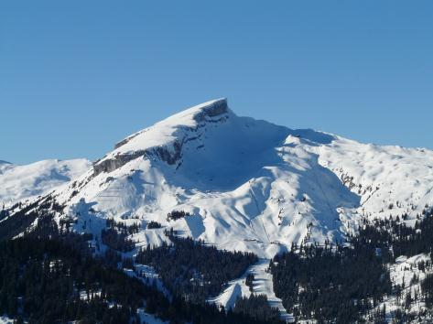
相关标题文本
TITLE
This is awesome title
Far far away, behind the word mountains, far from the countries Vokalia and Consonantia, there live the blind texts.

Slide 6
相关标题文本
点击此处输入相关文本内容点击此处输入相关文本内容
点击此处输入相关文本内容点击此处输入相关文本内容
点击此处输入相关文本内容点击此处输入相关文本内容
点击此处输入相关文本内容点击此处输入相关文本内容
点击此处输入相关文本内容点击此处输入相关文本内容
点击此处输入相关文本内容点击此处输入相关文本内容
点击此处输入相关文本内容点击此处输入相关文本内容
点击此处输入相关文本内容点击此处输入相关文本内容

Slide 7


相关标题文本
添加标题
点击输入内容点击输入内容点击输入内容点击输入内容
点击输入内容点击输入内容点击输入内容
点击输入内容点击输入内容
点击输入内容
Text
添加标题
点击输入内容点击输入内容点击输入内容点击输入内容
点击输入内容点击输入内容点击输入内容
点击输入内容点击输入内容
点击输入内容

Slide 8
02
市场情况分析
her for being silly. Some might even ignore what was said. But this was a moment of affirmation in a young child's life. Time when innocent trust can be nurtured so that it will bloom into faith
输入你的文本内容
friend started the engine and began to taxi onto the runway of the airport. Mr. Johnson had heard that the most dangerous part of a flight were the take-off and the landing, so he wasfriend started the engine and began to taxi onto the runway of the airport. Mr. Johnson had heard that the most dangerous part of a flight were the take-off and the landing, so he was

Slide 9

相关标题文本
添加标题
点击输入内容点击输入内容点击输入内容点击输入内容
点击输入内容点击输入内容点击输入内容
添加标题
点击输入内容点击输入内容点击输入内容点击输入内容
点击输入内容点击输入内容点击输入内容
添加标题
点击输入内容点击输入内容点击输入内容点击输入内容
点击输入内容点击输入内容点击输入内容
PPT模板 http://www.PPT818.com/moban/

Slide 10

相关标题文本
点击添加您的标题
点击添加您的标题
点击添加您的标题
点击添加您的标题
点击添加您的标题
点击添加您的标题
View Detail Feature

Slide 11

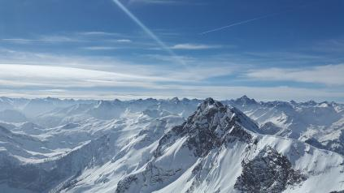
相关标题文本
编辑标题
点击编辑你想替换的内容点击编辑你想替换的内容点击编辑你想替换的内容点击编辑你想替换的内容点击编辑你想替换的内容点击编辑你想替换的内容点击编辑你想替换的内容点击编辑你想替换的内容点击编辑你想替换的内容点击编辑你想替换的内容点击编辑你想替换的内容。
OPTION 01
OPTION 02
OPTION 03
点击编辑你想替换的内容点击编辑你想替换的内容点击编辑你想替换的内容点击编辑你想替换的内容。

Slide 12
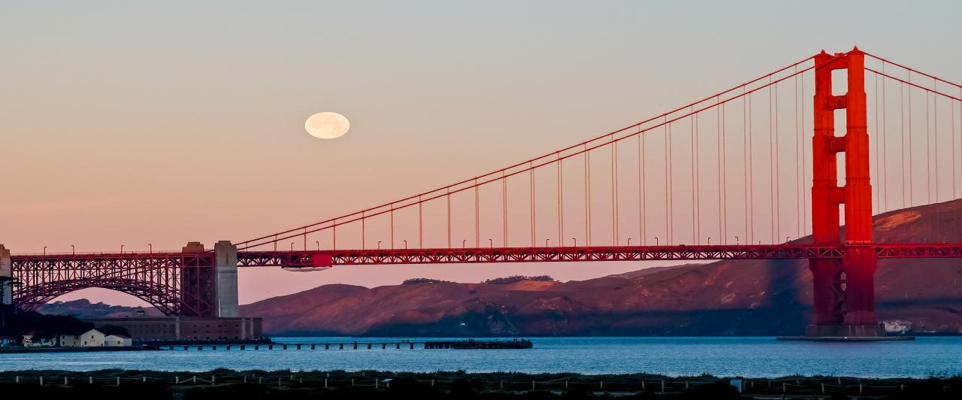


相关标题文本
点击此处输入相关文本内容点击此处输入相关文本内容
点击此处输入相关文本内容点击此处输入相关文本内容

Slide 13

相关标题文本
1
2
添加标题
添加标题
点击输入内容点击输入内容
点击输入内容点击输入内容点击
点击输入内容点击输入内容
点击输入内容点击输入内容点击
关键字
3
4
添加标题
添加标题
点击输入内容点击输入内容
点击输入内容点击输入内容点击
点击输入内容点击输入内容
点击输入内容点击输入内容点击
Notes:
https://www.ypppt.com/

Slide 14
03
项目实施计划
her for being silly. Some might even ignore what was said. But this was a moment of affirmation in a young child's life. Time when innocent trust can be nurtured so that it will bloom into faith
输入你的文本内容
friend started the engine and began to taxi onto the runway of the airport. Mr. Johnson had heard that the most dangerous part of a flight were the take-off and the landing, so he wasfriend started the engine and began to taxi onto the runway of the airport. Mr. Johnson had heard that the most dangerous part of a flight were the take-off and the landing, so he was

Slide 15
相关标题文本
70%
60%
50%
在此输入标题内容
在此输入标题内容
在此输入标题内容
双击输入替换内容，内容，双击输入替换内容，内容
双击输入替换内容，内容，双击输入替换内容，内容
双击输入替换内容，内容，双击输入替换内容，内容

Slide 16


相关标题文本
添加标题文字
添加标题文字
添加标题文字
这里输入简单的文字概述这里输入简单文字概述简单这
里输入简单的文字
这里输入简单的文字概述这里输入简单文字概述简单这
里输入简单的文字
这里输入简单的文字概述这里输入简单文字概述简单这
里输入简单的文字

Slide 17
相关标题文本
01
输入标题文本
输入标题文本
输入替换内容内容输入替换内容内容
输入替换内容内容输入替换内容内容
02
输入标题文本
输入标题文本
输入替换内容内容输入替换内容内容
输入替换内容内容输入替换内容内容
03
输入标题文本
输入标题文本
输入替换内容内容输入替换内容内容
输入替换内容内容输入替换内容内容

Slide 18
04
项目投资回报
her for being silly. Some might even ignore what was said. But this was a moment of affirmation in a young child's life. Time when innocent trust can be nurtured so that it will bloom into faith
输入你的文本内容
friend started the engine and began to taxi onto the runway of the airport. Mr. Johnson had heard that the most dangerous part of a flight were the take-off and the landing, so he wasfriend started the engine and began to taxi onto the runway of the airport. Mr. Johnson had heard that the most dangerous part of a flight were the take-off and the landing, so he was

Slide 19

相关标题文本
添加标题
添加标题
添加标题
添加标题
点击输入内容点击输入内容
点击输入内容点击输入内
容点击点击输入内容点击输容
点击输入内容点击输入内
点击输入内容点击输入内容
点击输入内容点击输入内
容点击点击输入内容点击输容
点击输入内容点击输入内
点击输入内容点击输入内容
点击输入内容点击输入内
容点击点击输入内容点击输容
点击输入内容点击输入内
点击输入内容点击输入内容
点击输入内容点击输入内
容点击点击输入内容点击输容
点击输入内容点击输入内

Slide 20
相关标题文本
关键词
添加标题
添加标题
点击输入内容点击输入内容
点击输入内容点击输入内容点击
点击输入内容点击输入内容
点击输入内容点击输入内容点击
关键词
关键词
添加标题
添加标题
关键词
点击输入内容点击输入内容
点击输入内容点击输入内容点击
点击输入内容点击输入内容
点击输入内容点击输入内容点击

Slide 21
相关标题文本
文本内容
文本内容
文本内容
点击此处输入文本内容点击此处输入文本内容点击此处输入文本内容点击此处输入输入文本内
点击此处输入文本内容点击此处输入文本内容点击此处输入文本内容点击此处输入输入文本内
点击此处输入文本内容点击此处输入文本内容点击此处输入文本内容点击此处输入输入文本内
文本内容
文本内容
文本内容
点击此处输入文本内容点击此处输入文本内容点击此处输入文本内容点击此处输入输入文本内
点击此处输入文本内容点击此处输入文本内容点击此处输入文本内容点击此处输入输入文本内
点击此处输入文本内容点击此处输入文本内容点击此处输入文本内容点击此处输入输入文本内

Slide 22

相关标题文本
添加标题
添加标题
点击输入内容点击输入内容
点击输入内容点击输入内容点击
点击输入内容点击输入内容
点击输入内容点击输入内容点击
添加标题
添加标题
点击输入内容点击输入内容
点击输入内容点击输入内容点击
点击输入内容点击输入内容
点击输入内容点击输入内容点击

Slide 23

相关标题文本
输入标题文本
输入标题文本
输入替换内容内容输入替换内容内容
输入标题文本
输入替换内容内容输入替换内容内容
输入标题文本
输入替换内容内容输入替换内容内容

Slide 24
相关标题文本
1
1
1
1
2
3
文本内容
文本内容
文本内容
点击此处输入文本内容点击此处输入文本内容点击此处输入文本内容点击此处输入输入文本内
点击此处输入文本内容点击此处输入文本内容点击此处输入文本内容点击此处输入输入文本内
点击此处输入文本内容点击此处输入文本内容点击此处输入文本内容点击此处输入输入文本内

Slide 25
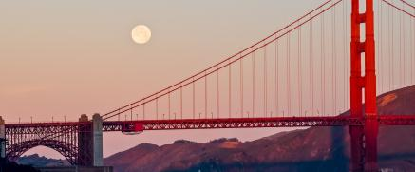
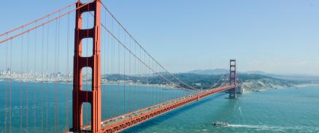


相关标题文本
标题文字添加
标题文字添加
print the presentation and make it into a film to be used in a wider field
print the presentation and make it into a film to be used in a wider field
标题文字添加
标题文字添加
print the presentation and make it into a film to be used in a wider field
print the presentation and make it into a film to be used in a wider field

Slide 26
BUS INESS
谢谢
您的观看
her for being silly. Some might even ignore what was said. But this was a moment of affirmation in a young child's life. Time when
END

