Slide 1
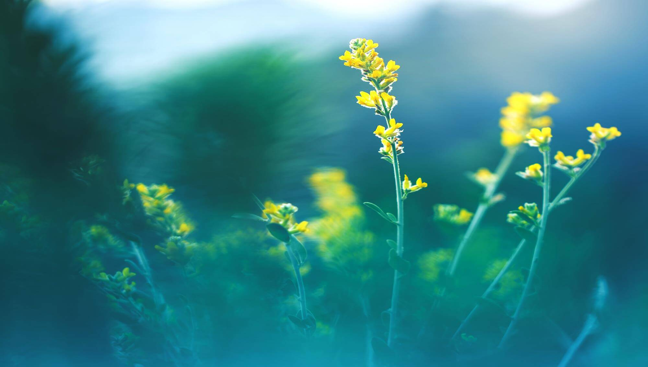
I love you more than I've ever loved any woman. And I've waited longer for you than I've waited for any woman.
ALL OR NOTHING
清新自然
NOW OR NEVER

Slide 2
CONTENTS
Click here to add your title
Click here to add your title
Click here to add your title
Click here to add your title

Slide 3
https://www.PPT818.com/
ONE
Click here to add your title
I love you more than I've ever loved any woman. And I've waited longer for you than I've waited for any woman.I love you more than I've ever loved any woman. And I've waited longer for you than I've waited for any woman.

Slide 4
Click here to add your title
I love you more than I've ever loved any woman. And I've waited longer for you than I've waited for any woman.
I love you more than I've ever loved any woman. And I've waited longer for you than I've waited for any woman.I love you more than I've ever loved any woman. And I've waited longer for you than I've waited for any woman.
THE NEXT

Slide 5
Click here to add your title
I love you more than I've ever loved any woman. And I've waited longer for you than I've waited for any woman.
I love you more than I've ever loved any woman. And I've waited longer for you than I've waited for any woman.I love you more than I've ever loved any woman. And I've waited longer for you than I've waited for any woman.
THE NEXT
PPT模板 http://www.PPT818.com/moban/

Slide 6
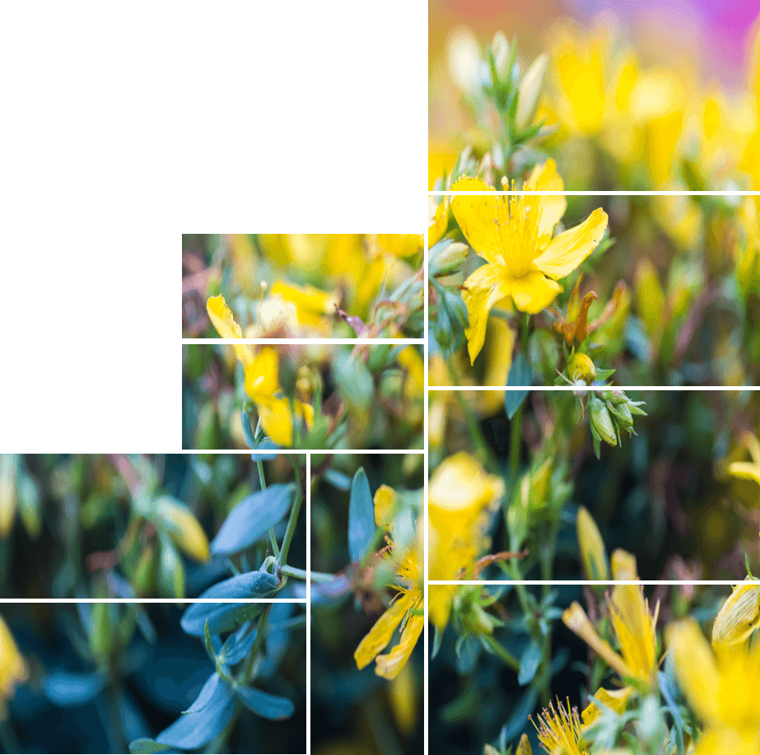
ALL OR NOTHING
NOW OR NEVER
Click here to add your title
I love you more than I've ever loved any woman. And I've waited longer for you than I've waited for any woman.
I love you more than I've ever loved any woman. And I've waited longer for you than I've waited for any woman.I love you more than I've ever loved any woman. And I've waited longer for you than I've waited for any woman.
THE NEXT

Slide 7
Click here to add your title
I love you more than I've ever loved any woman. And I've waited longer for you than I've waited for any woman.
I love you more than I've ever loved any woman. And I've waited longer for you than I've waited for any woman.I love you more than I've ever loved any woman. And I've waited longer for you than I've waited for any woman.
I love you more than I've ever loved any woman. And I've waited longer for you than I've waited for any woman.
ALL OR NOTHING

Slide 8
TWO
Click here to add your title
I love you more than I've ever loved any woman. And I've waited longer for you than I've waited for any woman.I love you more than I've ever loved any woman. And I've waited longer for you than I've waited for any woman.

Slide 9
Click here to add your title
I love you more than I've ever loved any woman. And I've waited longer for you than I've waited for any woman.
I love you more than I've ever loved any woman. And I've waited longer for you than I've waited for any woman.I love you more than I've ever loved any woman. And I've waited longer for you than I've waited for any woman.
THE NEXT

Slide 10
ALL OR NOTHING
NOW OR NEVER
I love you more than I've ever loved any woman. And I've waited longer for you than I've waited for any woman.I love you more than I've ever loved any woman. And I've waited longer for you than I've waited for any woman.

Slide 11
Click here to add your title
I love you more than I've ever loved any woman. And I've waited longer for you than I've waited for any woman.
I love you more than I've ever loved any woman. And I've waited longer for you than I've waited for any woman.I love you more than I've ever loved any woman. And I've waited longer for you than I've waited for any woman.

Slide 12
ALL OR NOTHING
NOW OR NEVER
Click here to add your title
I love you more than I've ever loved any woman. And I've waited longer for you than I've waited for any woman.
I love you more than I've ever loved any woman. And I've waited longer for you than I've waited for any woman.I love you more than I've ever loved any woman. And I've waited longer for you than I've waited for any woman.

Slide 13
I love you more than I've ever loved any woman. And I've waited longer for you than I've waited for any woman.I love you more than I've ever loved any woman. And I've waited longer for you than I've waited for any woman.
ALL OR NOTHING
NOW OR NEVER
I love you more than I've ever loved any woman. And I've waited longer for you than I've waited for any woman.
Notes:
https://www.ypppt.com/

Slide 14
THREE
Click here to add your title
I love you more than I've ever loved any woman. And I've waited longer for you than I've waited for any woman.I love you more than I've ever loved any woman. And I've waited longer for you than I've waited for any woman.

Slide 15
ALL OR NOTHING
NOW OR NEVER
Click here to add your title
I love you more than I've ever loved any woman. And I've waited longer for you than I've waited for any woman.I love you more than I've ever loved any woman. And I've waited longer for you than I've waited for any woman.

Slide 16
I love you more than I've ever loved any woman. And I've waited longer for you than I've waited for any woman.I love you more than I've ever loved any woman. And I've waited longer for you than I've waited for any woman.
Click here to add your title
I love you more than I've ever loved any woman. And I've waited longer for you than I've waited for any woman.I love you more than I've ever loved any woman. And I've waited longer for you than I've waited for any woman.

Slide 17
Click here to add your title
ALL OR NOTHING
NOW OR NEVER
I love you more than I've ever loved any woman. And I've waited longer for you than I've waited for any woman.I love you more than I've ever loved any woman. And I've waited longer for you than I've waited for any woman.

Slide 18
I love you more than I've ever loved any woman. And I've waited longer for you than I've waited for any woman.I love you more than I've ever loved any woman. And I've waited longer for you than I've waited for any woman.
FRESH
I love you more than I've ever loved any woman. And I've waited longer for you than I've waited for any woman.I love you more than I've ever loved any woman. And I've waited longer for you than I've waited for any woman.
I love you more than I've ever loved any woman. And I've waited longer for you than I've waited for any woman.I love you more than I've ever loved any woman. And I've waited longer for you than I've waited for any woman.
HAPPY
SMILE

Slide 19
ALL OR NOTHING
NOW OR NEVER
Click here to add your title
I love you more than I've ever loved any woman. And I've waited longer for you than I've waited for any woman.I love you more than I've ever loved any woman. And I've waited longer for you than I've waited for any woman.
I love you more than I've ever loved any woman. And I've waited longer for you than I've waited for any woman.I love you more than I've ever loved any woman. And I've waited longer for you than I've waited for any woman.
I love you more than I've ever loved any woman. And I've waited longer for you than I've waited for any woman.I love you more than I've ever loved any woman. And I've waited longer for you than I've waited for any woman.

Slide 20
Click here to add your title
FOUR
I love you more than I've ever loved any woman. And I've waited longer for you than I've waited for any woman.I love you more than I've ever loved any woman. And I've waited longer for you than I've waited for any woman.

Slide 21
ALL OR NOTHING
NOW OR NEVER
I love you more than I've ever loved any woman. And I've waited longer for you than I've waited for any woman.
I love you more than I've ever loved any woman. And I've waited longer for you than I've waited for any woman.I love you more than I've ever loved any woman. And I've waited longer for you than I've waited for any woman.

Slide 22
Click here to add your title
Click here to add your title
Click here to add your title
I love you more than I've ever loved any woman. And I've waited longer for you than I've waited for any woman.
I love you more than I've ever loved any woman. And I've waited longer for you than I've waited for any woman.
I love you more than I've ever loved any woman. And I've waited longer for you than I've waited for any woman.

Slide 23
Click here to add your title
I love you more than I've ever loved any woman. And I've waited longer for you than I've waited for any woman.I love you more than I've ever loved any woman. And I've waited longer for you than I've waited for any woman.
I love you more than I've ever loved any woman. And I've waited longer for you than I've waited for any woman.I love you more than I've ever loved any woman. And I've waited longer for you than I've waited for any woman.
THE NEXT

Slide 24
Click here to add your title
I love you more than I've ever loved any woman. And I've waited longer for you than I've waited for any woman.I love you more than I've ever loved any woman. And I've waited longer for you than I've waited for any woman.
Click here to add your title
I love you more than I've ever loved any woman. And I've waited longer for you than I've waited for any woman.I love you more than I've ever loved any woman. And I've waited longer for you than I've waited for any woman.
Click here to add your title
I love you more than I've ever loved any woman. And I've waited longer for you than I've waited for any woman.I love you more than I've ever loved any woman. And I've waited longer for you than I've waited for any woman.

Slide 25
I love you more than I've ever loved any woman. And I've waited longer for you than I've waited for any woman.
ALL OR NOTHING
清新自然
NOW OR NEVER

