Slide 1
Unit 1 Topic 2
We should learn teamwork.
Section C
WWW.PPT818.COM

Slide 2
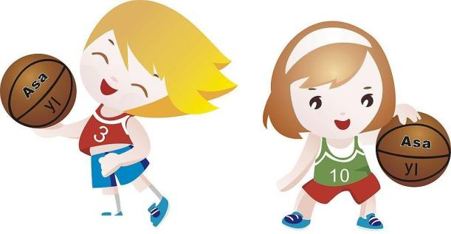
Let's talk
Do you like playing basketball?

Slide 3
Let's talk
Is a basketball match exciting?

Slide 4
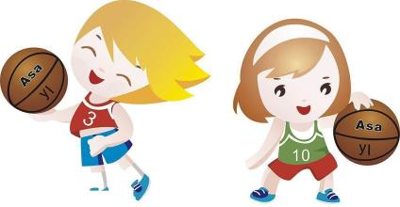
Let's talk
Maybe there are five.
How many players are there in a basketball team?

Slide 5
Let's talk
What are the rules in basketball?
Who invented basketball, do you know?
？
？
？

Slide 6
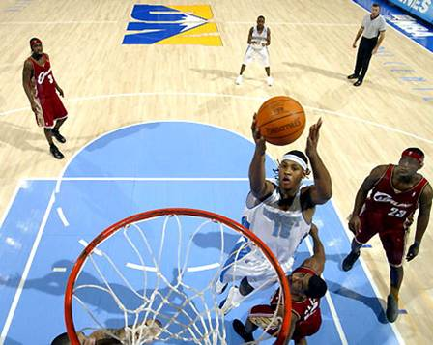

Do you know who invented basketball?

Slide 7
Class activities
Basketball
We run for health and for fun.
Trying not to trip or fall.
We want to be number one.
As we throw and catch the ball.
Playing outside in the sun.
Basketball’s the best sport of all!

Slide 8
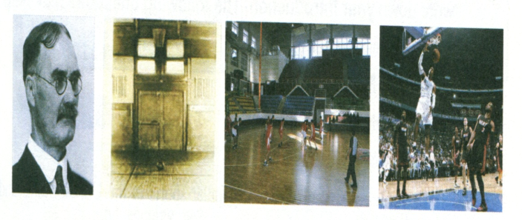

Basketball is one of the most popular sports in
The United States and other parts of the world.
It has a history of over a century. The inventor
of basketball, James Naismith, came from
Canada. He invented basketball for his students
in 1891. At first, It was both an indoor so that

Slide 9
the students could play in bad weather.
Basketball soon became very popular. In 1946
The national basketball association ( NBA)
Came into being. There were many great
basketball stars in the NBA. For many years they
were all Americans. But now many good players
came from other countries.
Basketball is both an indoor and outdoor
game. It is a team sport with two teams of five
players each. The goal is to throw the ball through
the other side’s basket, and to stop other team
from doing so. You can throw it from any part

Slide 10
of the court with one hand or both hands. You
can also pass the ball to your teammates. But
you must follow the rules. For example, you can’t
hold the ball and run with it. To win basketball
games , you should have good skills. But it’s more
Important for you and the other players to play
as a team. you are sure to enjoy playing this
poplar sport.

Slide 11
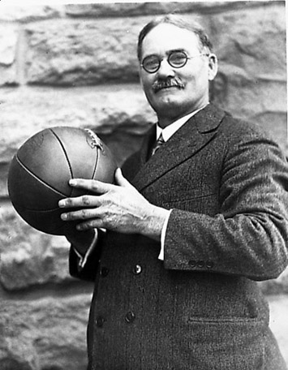
The inventor of basketball was born in Canada and graduated from McGill University and from the Presbyterian seminary (长老会学院) in Toronto. In 1890 he entered the YMCA college (国际青年会训练学院) in Springfield, Massachusetts (马萨诸塞州,美国麻省), and it was there that James Naismith came up with the new game.
James Naismith

Slide 12
Mark (T) for True or (F) for False.
1. James Naismith, an American, invented basketball in 1891 ( )
2. The inventor invented basketball for his students. ( )
3. The first basketball court outdoor. ( )
4. There are six players on each basketball team. ( )
T
T
F
F

Slide 13
1b Read 1a again and check True or False.
True False
The inventor of basketball was born in Canada.
Basketball became popular soon after James Naismith invented it.
Sometimes teamwork is more important than a player’s good skills in a basketball game.
You cannot throw the ball through the basket with one hand.
To win basketball games, you can hold the ball and run with it.
T
T
T
F
F

Slide 14
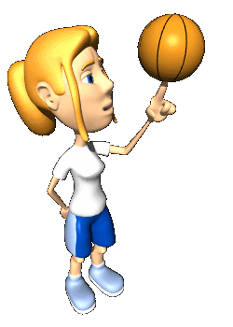

Intensive reading
Listen and read for more details.
______________ invented basketball.
James Naismith
________, he invented basketball.
In 1891
_________________________________ came into being.
In 1946 the National Basketball Association
_____ players play in a basketball match.
Ten

Slide 15
Intensive reading
Listen and read for more details.
The rules in basketball
The goal is :
You can:
You should:
You can’t:
to throw the ball through the other side’s basket, and to stop the other team from doing so
throw it from any part of court with one hand or both hands
pass the ball to your teammates
have good skills
play as a team
hold the ball and run with it

Slide 16
1c. Pair work
Ask and answer more questions:
Who invented basketball?
When did he invented basketball?
What are the rules in basketball?
How do you score in basketball?
Basketball is one of the most popular sports in the United States and other parts of the world. It is both an indoor and outdoor game.______
_________________________________________

Slide 17
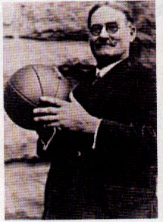
Let's review
James Naismith was Canadian.
He invented basketball in 1891.

Slide 18
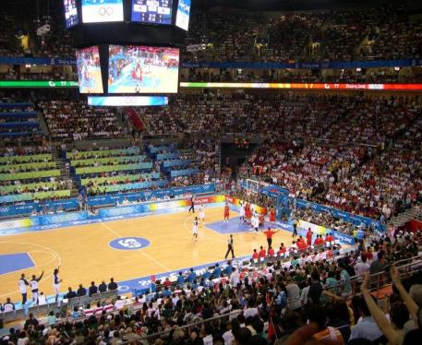
Let's review
Basketball is an indoor and outdoor game.
We can play it even in bad weather.

Slide 19
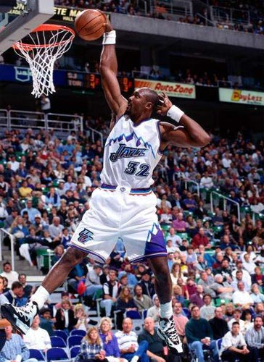
Let's review
How can he score in the game?
Just throw the ball through the other side’s basket.

Slide 20
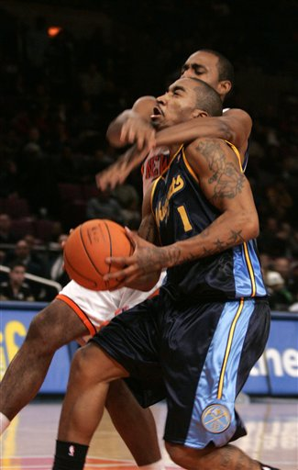
Let's review
You must follow the rules in the game.

Slide 21
2. Read and understand the first sentence. Then complete the second one with the correct form of each word or phrase in the box.
pass…to… century popular come into being all over
Basketball has a history of over one hundred years.
Basketball has a history of over a ______________.
2. A large number of people enjoyed basketball.
Basketball soon became very ______________.
century
popular

Slide 22
3. In 1946 the National Basketball Association
(NBA) was born.
In 1946 the National Basketball Association
(NBA) __________________.
4. You can also pass a teammate the ball.
You can also ________ the ball ______ a teammate.
5. Basketball is becoming more and more popular
around the world.
Basketball is becoming more and more popular
__________ the world.
came into being
pass to
all over

Slide 23

Key points
1.Basketball is one of the most popular sports in …
one of + 可数名词复数： “……之一”，该短语作主语时，谓语动词常用单数形式。
Eg: 我最喜欢的歌手之一是周笔畅。
________ my favorite singers ___ Zhou Bichang.
One of
is
2. It was an indoor game so that students could play in bad weather.
so that: 目的是，为了。后面加句子。
Eg: 他们很早起床是为了赶上早班车。
They get up early ________ they can catch the early bus.
so that

Slide 24
Key points
3. The goal is to stop the other team from doing so.
stop … from doing sth. 意为：阻止……做某事
Eg: 糟糕的天气可能阻碍我们打篮球。
The bad weather may stop us from playing basketball.
4. It’s more important for you and other players to play as a team. 对于你和你的队友来说，团队协作更重要。
It’s + adj.+for sb.+to do sth. 意为：对某人做某事很……

Slide 25
Key Points
5. He invented basketball in 1891.
6. He invented an indoor game for his students so that they could play even in bad weather.
invent v. 发明
invention n. 发明
inventor n. 发明者
so that “以便”，
引导目的状语从句

Slide 26
★ so that “以便”，引导目的状语从句
★ so that “因此” ，引导结果状语从句
★ so + adj./adv. + that从句
“如此……以至于……”
1) He gets up early so that he won’t be late
for school.
2) I missed many math lessons this term,
so that I didn’t pass the exam.
3) She worked so hard that she could get
something enough to eat.

Slide 27
score v. & n. 进球，得分
No one scored in the first half.
The final score was 2-1.
7. Do you know how to score in the game?
8. You can throw the ball into the basket from any part of the court and ….
9. But you must follow the rules.
10. Now, basketball is becoming more and more popular all over the world.
球场的任何一部分
遵循规则
越来越
受欢迎

Slide 28
★ 比较级 + and + 比较级
“越来越……”
1) 我们的生活变得越来越好。
Our life is getting better and better.
2) 我们的学校变得越来越漂亮。
Our school is getting more and more
beautiful.

Slide 29
summary
We know:
the history of basketball
We can:
talk something about basketball.

Slide 30
根据首字母提示或汉语填空，完成句子，使句子完整，语法正确。
1. F_____ me please, I’ll show you the way.
2. Lily is 19 years old and she is studying in a c______.
3. My dear children, could you please put these apples into this _______(篮子)?
4. Please don’t ______(扔) your books on the floor.
ollow
ollege
basket
throw

Slide 31
5. Next year, Lin Tao will be in _______(俄罗斯).
6. Now we can play basketball ______(即使) in bad weather.
7. In this English test, I got 99. This is a high s_____.
8. James Naismith i________ an indoor
game for his students.
Russia
even
core
nvented

Slide 32
单项选择
1. – Tomorrow I’ll go to Shanghai. Next month I’ll
visit Hangzhou. Next year I’ll be in Korea.
– That’s a lot of ______.
A. traveled B. traveling C. travelings D. travels
2. – You look very strong. You must do exercise
much.
– Yes, you’re right. I enjoy _____ sports.
A. to do B. do C. did D. doing
3. This book is very _____.
A. excited B. excites C. exciting D. interested
B
D
C

Slide 33
4. – I like running. What about you, Jane?
– I like it ______.
A. also B. as well C. as well as D. either
B
5. – What’s your favorite sport?
– ______ is my favorite.
A. Play the basketball
B. Play basketball
C. Playing the basketball
D. Playing basketball
6. – Maria, would you like to tell me your plans ____ this term?
A. in B. at C. for D. with
D
C

Slide 34
7. – Peter, what should I do then?
– Don’t worry. You can throw the basketball ___ one hand.
A. in B. to C. with D. on
8. Jane has two friends. One is from Russia, ___ is from Canada.
A. the other B. other
C. others D. another
A
A
C
9. Would you please ______ to the zoo?
A. walking B. to walk C. walk D. walks

Slide 35
10. — _______ do you watch TV.
— Twice a week.
A. How long B. How many
C. How much D. How often
11. Could you please ______ baseball here?
A. not play B. not playing
C. not to play D. playing
D
A

Slide 36
Homework
1.熟读1a 文章
2. 完成练习册Section C
3. 预习Section D

