Slide 1

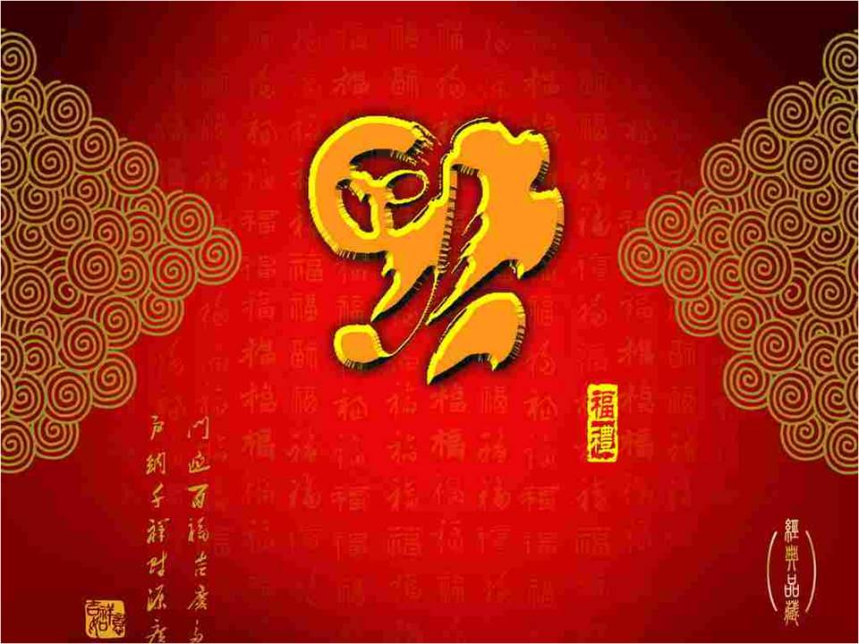

Unit 8
Chinese New Year
WWW.PPT818.COM

Slide 2

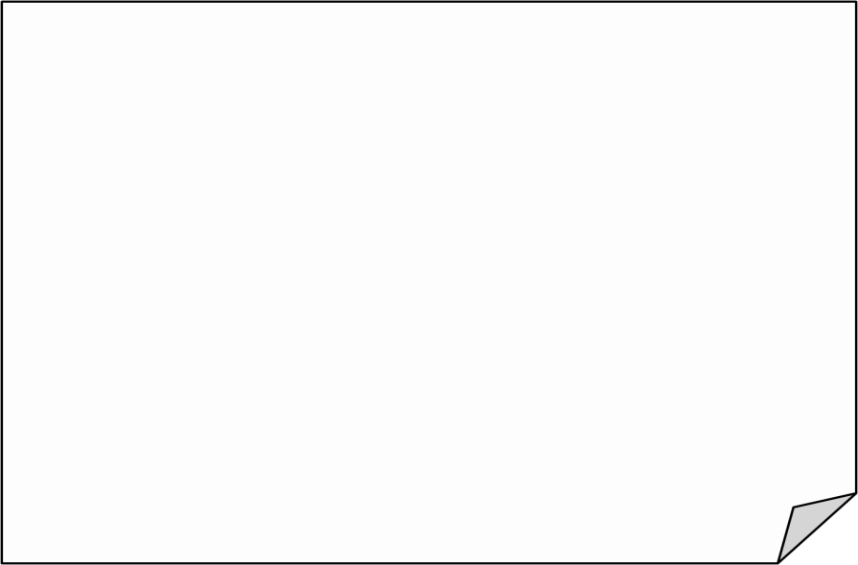
Learning aims
I can read the sentences.
Grammar
time
I can understand the grammar “the future tense”.
I can use “ be going to…” to talk about plans.
I can play the game.
Fun
time
I can know some names of festivals.
I can talk about plans of the festivals.

Slide 3
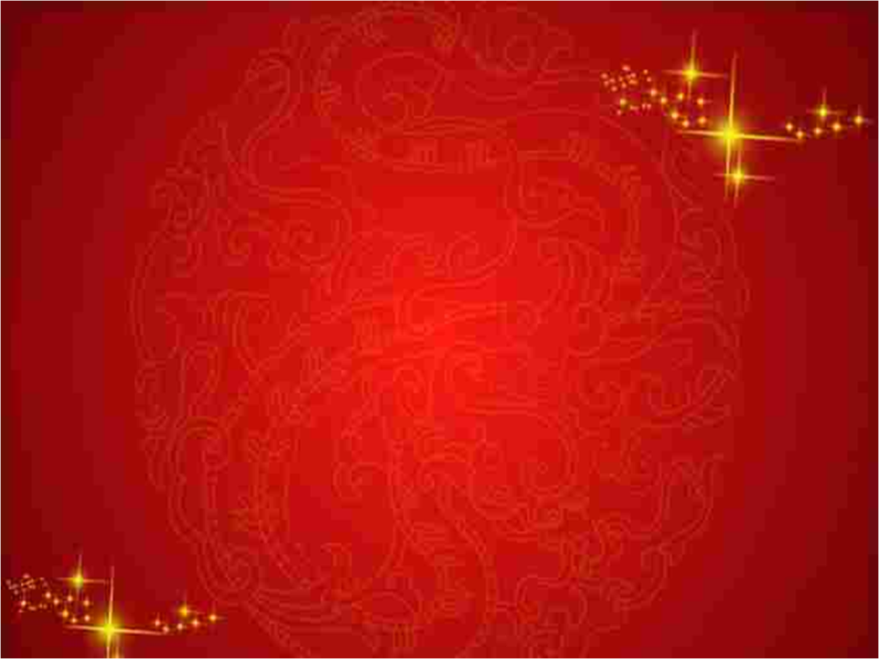


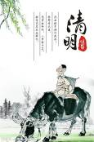
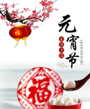
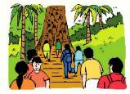

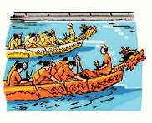
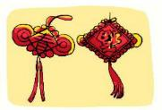
Brain storm
?
The
Qingming
Lantern
Festival
Festival
Chinese
traditional
festivals
Double Ninth
Festival
中国传统节日
Mid-Autumn
Festival
Dragon Boat Festival
Spring Festival

Slide 4

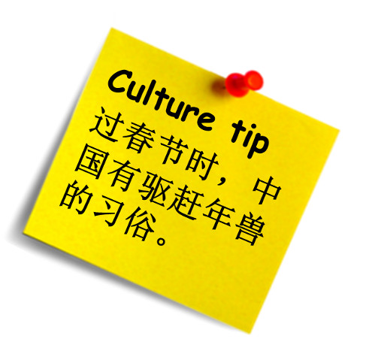

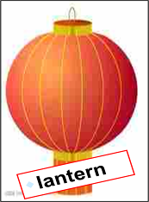
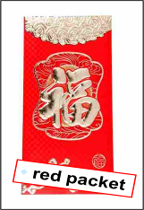
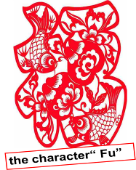
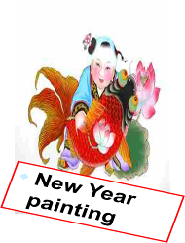
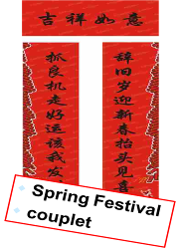

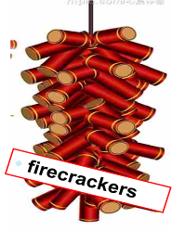
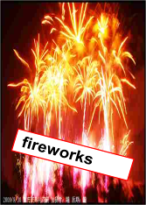
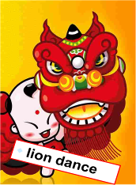



Slide 5
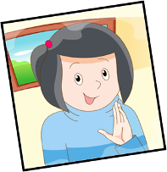
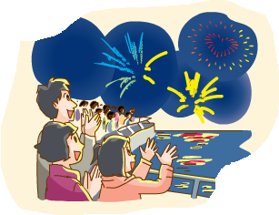
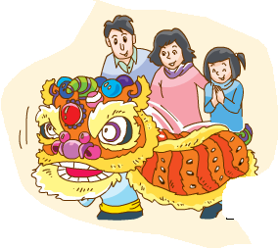
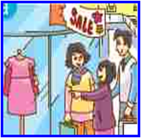
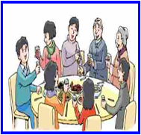
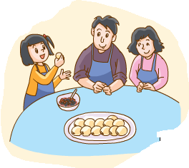
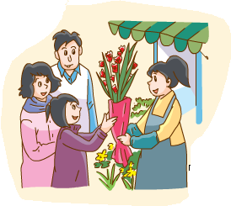




Anna's plan for Chinese New Year

Slide 6
Share our plans
A: What are you going to do this Chinese New Year?
B: I’m going to …

Slide 7


Tip: 如果节日后面带有day或eve,介词 就用on;如果没有day,一般用at。
Think and read
What |  | you | going to |  | do |  |  | Chinese New Year’s Eve?
I’m |  |  |  |  |  |  | a big dinner.
are
on
going to
have
What |  | you |  | do |  | Chinese New Year’s Eve？
We’re |  |  | make | some cakes and tangyuan.
are
going to
on
going to
What |  | he |  | watch |  | Chinese New Year’s Day？
He’s |  |  |  | a lion dance.
is
going to
on
going to
watch
What |  | she |  | watch |  | Chinese New Year’s Day？
She’s |  |  |  |  | fireworks.
is
going to
on
going to
watch
What |  |  | they |  |  | buy |  | Chinese New Year?
They’re |  |  |  |  |  |  | some flowers.
are
going to
at
going to
buy

Slide 8
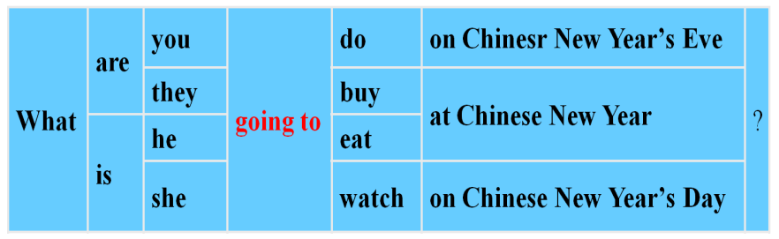
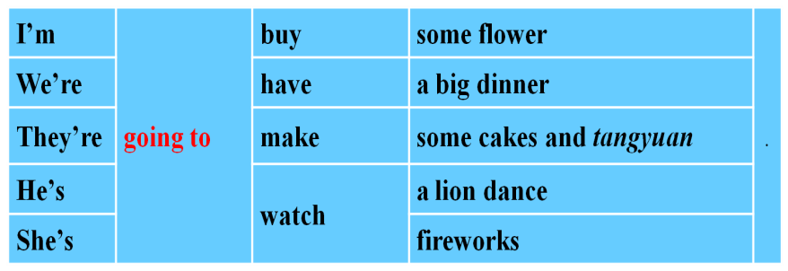

Grammar time
s
be going to
表示计划打算
+ do

Slide 9
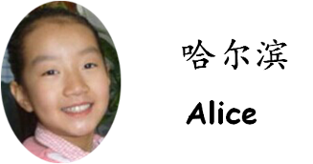
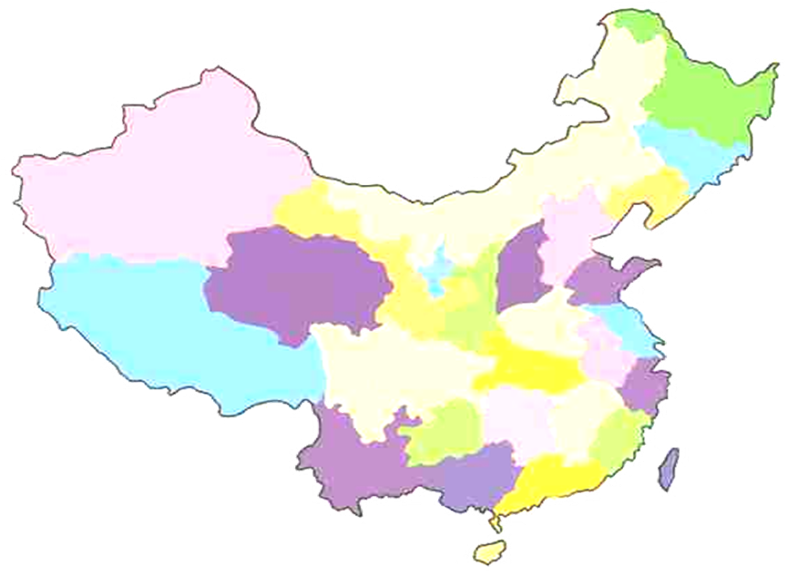
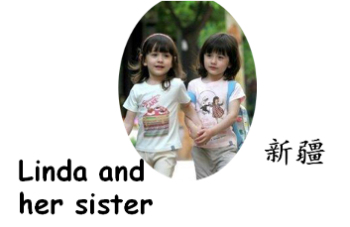
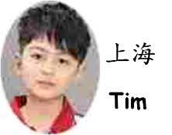
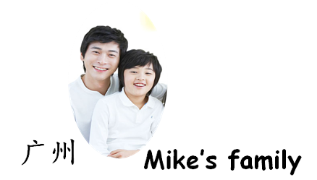
?

Slide 10

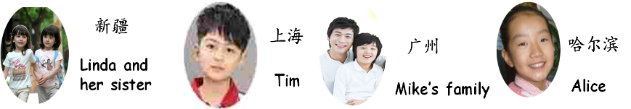
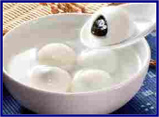
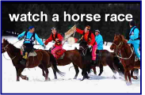
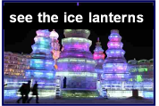
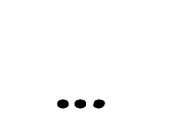
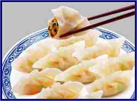
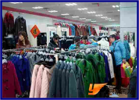

Let's guess
A: What is/are...going to do at Chinese New Year?
B: Maybe/I think he's/she's/they're going to ...

Slide 11
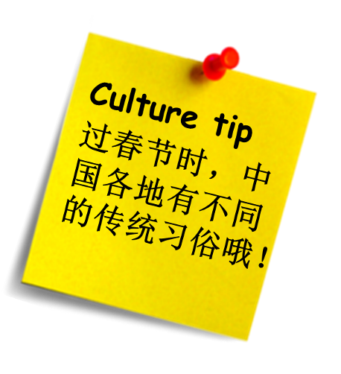
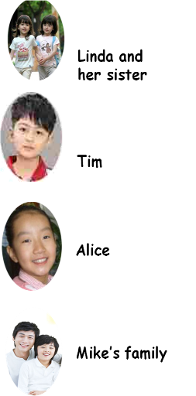






Listen and match

Slide 12
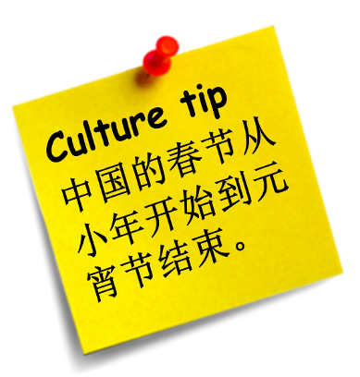
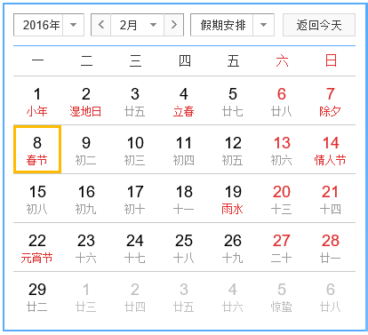

Do you know?

Slide 13
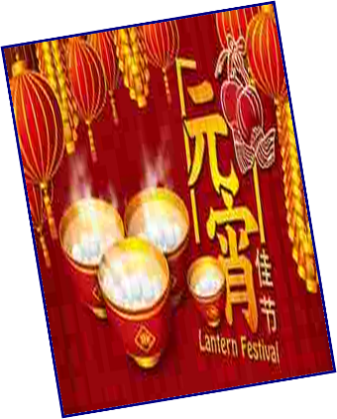
Lantern Festival

Slide 14

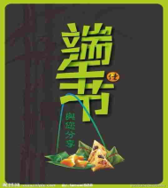
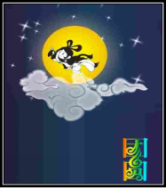
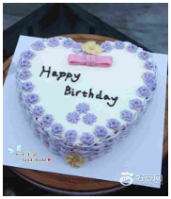
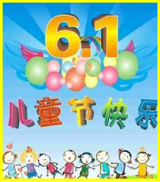
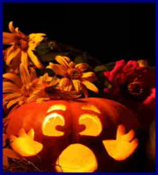
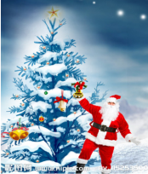
Read and guess
It is in May or June. People usually eat rice dumplings and watch dragon boat races at this festival. What is it ?
It is in September or October.
People usually eat moon cakes
and watch the moon at this
festival. What is it?
People usually have a big dinner with their family and friends. They always have a big cake on that day. What is it?
Dragon Boat Festival
Mid-Autumn Festival
Birthday
It's on the 1st of June. Children
usually have a party at school. At the party they often sing and
dance. They are all very excited.
What is it?
It's on the 25th of December. People buy presents for their family and friends. They have a big lunch. They eat a turkey and Christmas pudding. What is it?
It's on the 31st of October. Children dress up in costumes and go to a party. They always make some pumpkin lanterns. What is it?
Children’s Day
Halloween
Christmas

Slide 15

Let's play cards

Slide 16

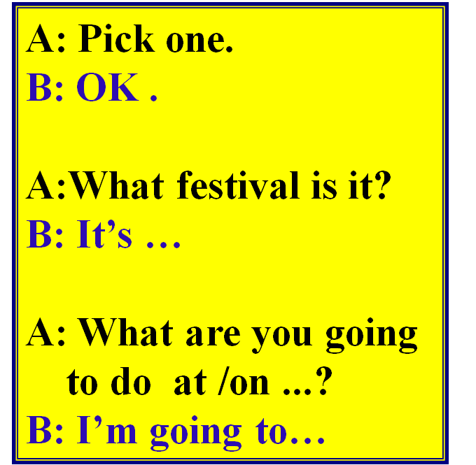

Fun time
Talk in groups
小组成员依次挑选卡片
依据所选节日进行问答

Slide 17







Let's play the game

Slide 18



Play a game

Slide 19

Task: Design a plan
Rules:
1.每人根据小组的内容设计自己的节日计划。
2.根据自己节日计划设计两个问题。
3.个人汇报并相互问答。

