Slide 1
Unit 1 Touch and feel
Period 2
WWW.PPT818.COM

Slide 2
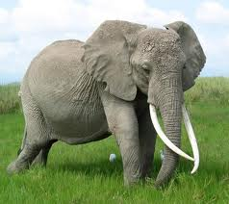
Look and say
The elephant is smooth and hard.
The elephant is big and thick.
The elephant is big and soft.
The elephant is long and thin.
Notes:
2

Slide 3
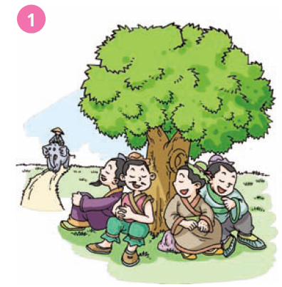
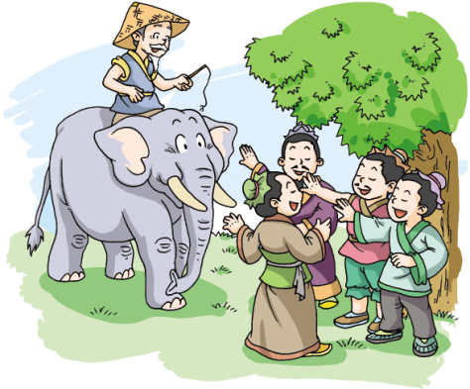
The blind men and the elephant
There are _____ men under a tree. They cannot ______. They are ______. One day, a man comes with his __________.
four
see
blind
elephant
Notes:
3

Slide 4
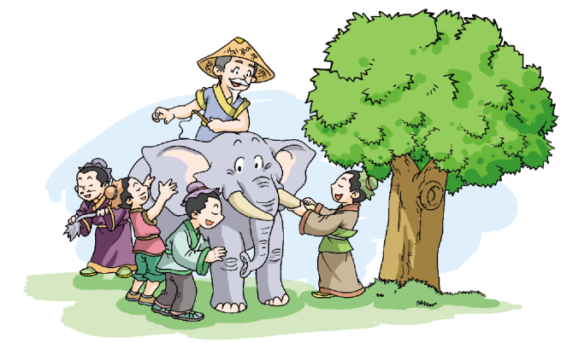
cannot
The four men _______ see the elephant, but they can ______ it.
touch
One man touches the elephant’s tusks and says the elephant is _______. Another man touches its ______ and says the elephant is _______. Another man touches its _______ and says the elephant is _______. The last man touches its leg and says the elephant is _______.
hard
ear
soft
tail
thin
thick

Slide 5
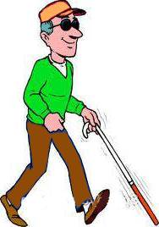
Blind man, blind man.
The man is blind.
Blind man, blind man.
He can not see.
Blind man, blind man.
He can touch .
He needs help.
Let’s help him.
Let’s chant
blind man
Notes:
5

Slide 6


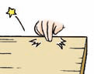



Look and say
Touch this. How does it feel?
It’s…
soft
hard
smooth
rough
Notes:
6

Slide 7
S1: Touch the window. How does it feel?
S2: It’s …
Notes:
7

Slide 8



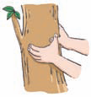
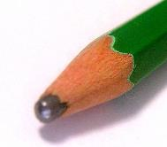

Touch this. How does it feel?
It’s…
smooth
rough
thick
thin
thick
thin
sharp
blunt
Notes:
8

Slide 9
Think and say
hard
soft
thick
thin
fluffy
sharp
smooth
blunt
rough
hot
cool
cold
warm
Notes:
9

Slide 10
Let’s chant
How does it feel？ It’s_____.
How does it feel ？ It’s_____.
How does it feel ？ It’s_____.
How — does— it— feel？
It’s _____.

Slide 11
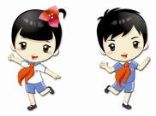

How does it feel?
It’s_____.
What is it ?
Is it_____?
Yes, well done!
Sorry, try again!

Slide 12
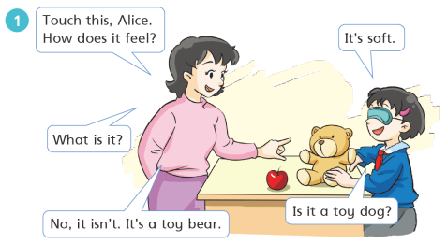
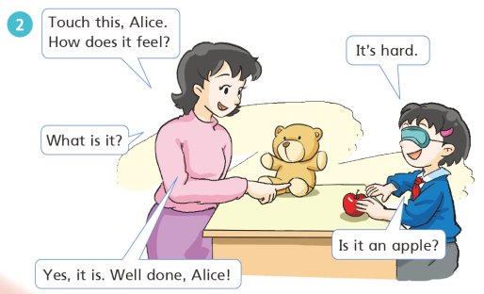
Role-play
Notes:
12

Slide 13

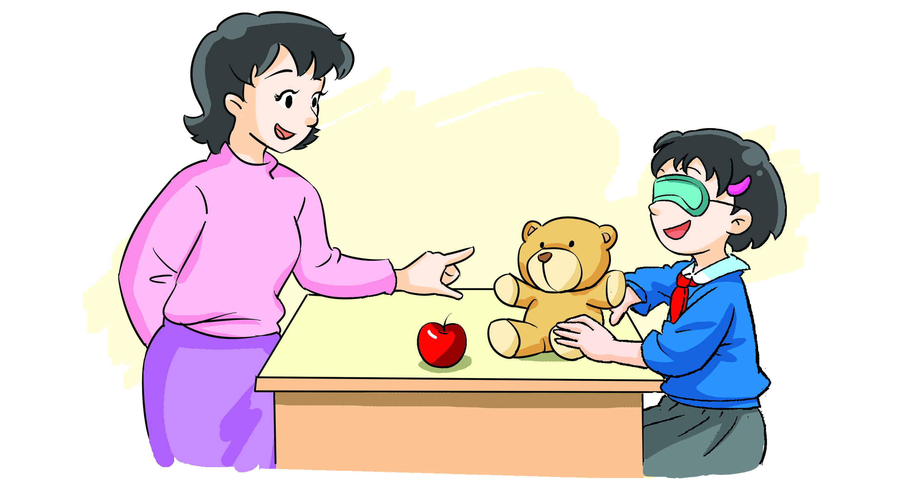
____this,Alice.
How does it ____?
It’s___.
__ __ a toy bear?
What is it?
No, ___ ___.
____ a toy bear.
Notes:
13

Slide 14
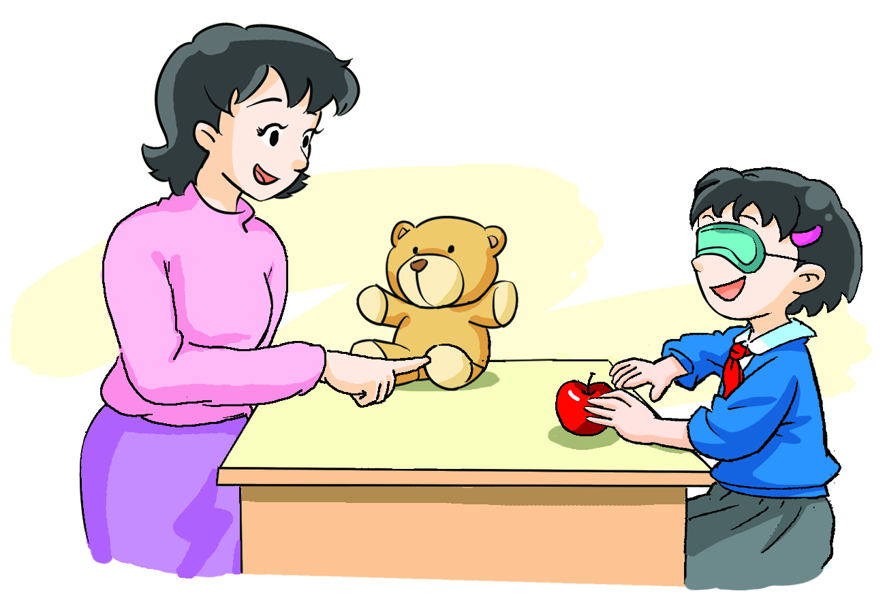

____this,Alice.
___ ___ ___ ___?
It’s___.
__________?
___ ___ ___?
__, ___ ___.
___________.
Notes:
14

Slide 15
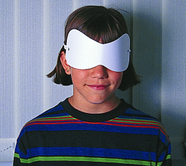
Play a game
S1: How does it feel?
S2: It’s ______________.
S1: Touch these. How do they feel?
S2: They’re ______________.
Notes:
15

Slide 16
Choose and say
hard soft smooth rough cold hot warm …
How does the orange feel?
______________________.
How _____ the desk feel?
_____________________.
How ______ the desks feel?
_______________________.
does
do
Notes:
16

Slide 17
Assignment:
Play “Touch and feel” game with your classmates.
WB P92: Reading

