Slide 1
Unit 6 Disaster and hope
Part Ⅱ Using language——省略
WWW.PPT818.COM

Slide 2
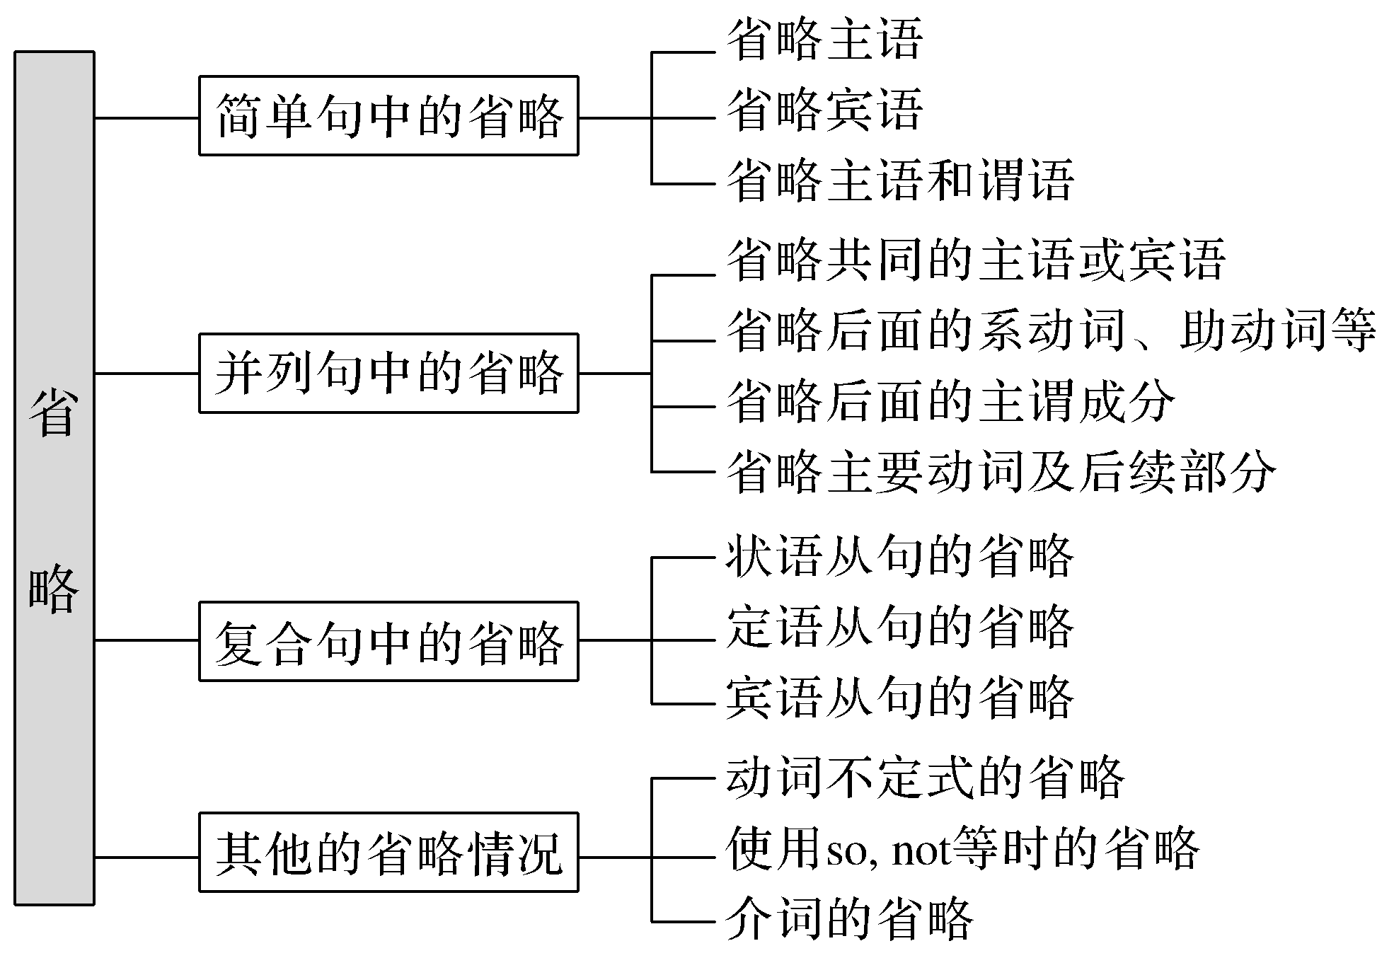
【思维导图】

Slide 3
名词所有格修饰的名词，若表示住宅、店铺、教堂或上下文已暗示或明确指出过的事物时，常常可以省略。
如：We spent the weekend at Mary’s.(我们在玛丽家过的周末。)
what和how引导感叹句时，常可省略主语it和be动词。如：
What a wonderful victory (it is) for Tom!
How beautiful (it is) to be treated like a child!

Slide 4
Ⅰ.基本特征感悟
【感悟用法】
①(You)Come in，please!
②John is a lawyer，and his wife (is) a cleaner.
③You’d better look out when (you are) crossing the street.
④He is the man (who/whom/that) you can depend on.
⑤The boy wanted to play football in the street，but his mother did not allow him to (play football in the street).
⑥It shows (that) a knowledge of first aid can make a real difference.

Slide 5
【自我总结】
1.例句1为____________句中的省略。
2.例句2为____________句中的省略。
3.例句3为____________的省略。当状语从句的主语和主句的主语指的是同一人或物，且由人称代词的主格担当，或当状语从句的主语为it，而且从句谓语中含有be动词时，可以把从句的____________________一起省略。
4.例句4为____________的省略。当关系代词在限制性定语从句中作________时可以省略。
5.例句5为__________的省略。有时可用不定式符号“to”来替代上文中出现的不定式。
6.例句6为____________中连接词____________的省略。
简单
并列
状语从句
主语和be动词
关系代词
宾语
不定式
宾语从句
that

Slide 6
Ⅱ.主要用法精讲
为了避免重复，或为了使句子更简练，在一些句子中常常省去一个或某几个成分，这种语法现象在英语中叫省略。
在英语句子中，常见的省略情况有以下几种：
一、简单句中的省略
1.省略主语：一般情况下，主语是不能省略的，但在祈使句和其他不容易引起歧义的情况下，特别是在口语中，主语常常省略，主要是祈使句中的you和疑问句中的主语。
(I) Beg your pardon.请再说一遍。
(It) Doesn’t matter.没关系。

Slide 7
2.省略宾语：当上、下或前后两个句子的宾语一致时，下句或后句常省略宾语。
—Do you know Miss Gao？——你认识高女士吗？
—I don’t know (her).——不认识。
3.省略主语和谓语(或谓语的一部分)：在某些具体的场合下，主语和谓语都很明确，此时为了简化或显得亲切等，可将主语和谓语(或谓语的一部分)同时省略，只剩下表语、宾语、状语或其他成分。
(You come) This way，please.
请这边走。(省略了主语和谓语)
(Have you) Got any ink?
你有墨水吗？(省略了主语和谓语的一部分)

Slide 8
二、并列句中的省略
在由and或but连接的并列句中，常省略一些重复的词或词组。
1.省略共同的主语或宾语。
Tom picked up a book on the floor and (Tom) handed it to his teacher.
汤姆在地板上捡起了一本书并把它交给了老师。
2.若主语不同，而谓语部分的系动词、助动词或情态动词相同，则省略后面的系动词、助动词或情态动词。
Jack must have been playing football and Mary (must have been) doing her homework.杰克肯定一直在踢足球，玛丽肯定一直在做家庭作业。

Slide 9
3.若主语与谓语动词相同，则省略后面的主谓成分。
His advice made me happy，but (his advice made) Jim angry.
他的建议使我高兴，却使吉姆生气。
4.若主语不同，但主要动词及后续部分相同，则省略主要动词及后续部分。
He has a knowledge of first aid but his friend doesn’t (have a knowledge of first aid).
他具备急救知识，但他朋友不具备。

Slide 10
三、复合句中的省略
1.状语从句的省略
(1)在when，while，if，as if，though，although，as，until，once，whether，unless，whenever等连接的状语从句中，当从句主语跟主句的主语相同且从句谓语中含有系动词be或从句的主语为it时，则从句中主语和be动词常被省略。
Wood gives off much smoke while (it is) burning.木头燃烧时产生很多烟。
Whenever (it is) possible，they would stop him and ask him the three questions.
只要有可能，他们就让他停下并问他这三个问题。

Slide 11
When (it is) heated，ice can be turned into water.
加热的时候冰可以变成水。
Will you be free this Sunday? If (it is) so，let’s go camping.
这个周日你有空吗？如果有，我们去野营吧。
(2)在than，as等引导的比较状语从句中常省略某些成分。
They don’t use more water than (it is) necessary.
他们使用的水没有超出需要量。
He runs as fast as Bob (runs).他和鲍勃跑得一样快。

Slide 12
2.定语从句的省略
(1)在限制性定语从句中，作宾语用的关系代词whom，which，that可省略(但whom，which紧跟在介词后时不能省略)。
The exact year (which/that) Angela and her family spent together in China was 2008.
安哥拉和她的家人一起在中国度过的那一年是2008年。
(2)修饰way的关系词that/in which可以省略。
The way (that/in which) he speaks to us is really annoying.
他对我们讲话的方式真是让人讨厌。

Slide 13
3.宾语从句的省略
(1)及物动词后接宾语从句时，连接词that一般可以省略；但如果及物动词接两个或两个以上that引导的宾语从句，那么只有第一个that可以省略。
I truly believe (that) beauty comes from within.我真的相信美丽源自内心。
He said (that) the text was very important and that we should learn it by heart.
他说这篇课文很重要，我们应该牢记在心。
(2)when，where，how和why引导的宾语从句有时可以仅保留引导词。
I know that a movie star will come to our city but I don’t know when (he will come to our city).
我知道一个电影明星将要来我们市，但我不知道他什么时候来。

Slide 14
四、其他的省略情况
1.动词不定式的省略
(1)当不定式在形容词afraid，anxious，eager，glad，happy，ready，willing等后作状语时，to后的内容常省略。
You can’t force him to answer the question if he’s not ready to (answer the question).
如果他不愿意回答这个问题，你不能强迫他。

Slide 15
(2)某些使役动词，如：make，let，have等和感官动词，如：see，watch，notice，observe，hear等后面作宾补的不定式须省略to，但若这些动词用于被动语态，则to不省略。
We often hear her sing an English song in the classroom.
She is often heard to sing an English song in the classroom.(被动语态)
我们经常听见她在教室唱英文歌。

Slide 16
(3)并列的不定式可以省略后面的不定式符号to。但若两个不定式之间表示对比关系时，不能省略to。
He likes to swim more than (to) skate.比起溜冰他更喜欢游泳。
He believes it important to study rather than to make friends.(比较)
他认为最重要的是学习而不是交朋友。
(4)当不定式在某些动词后作宾语时，常可省略。常见的动词有agree，afford，expect，forget，hope，know，manage，pretend，remember，refuse，want，wish，would like等。
I would do it for you，but I don’t know how to (do it for you).
我愿意为你做这件事，但是我不知怎么去做。

Slide 17
(5)介词but，except (除了) 前有实义动词do的某种形式时，后面的不定式不带to。
All he could do was nothing but wait and see.他所能做的只有等着瞧。
(6)当不定式在be going to，be able to，have to，ought to，used to后作复合谓语时，不定式可省略。
They didn’t visit their parents as much as they ought to (visit their parents).
他们应该多看望父母，但他们没有。

Slide 18
2.使用so，not等时的省略
在英语中，可以用so，not或其他方式来省略上文或问句中的一部分或整个句子。
—Can you finish your work today？——你今天能完成工作吗？
—I think so.——我认为能。
—I don’t think so./I think not.——我认为不能。

Slide 19
3.介词的省略
(1)一些与动词、名词或形容词搭配的介词常常可以省略，而保留介词后的动名词。常见的结构有：
①have difficulty/trouble (in) doing sth
②be busy (in) doing sth
③spend some time (in) doing sth
④stop/prevent sb (from) doing sth
The heavy rain prevented him (from) arriving there on time.
大雨使得他没能按时到达那里。

Slide 20
(2)表示时间的介词at，on和in在next，last，this，these，yesterday，tomorrow，one，any，every，each，some等词之前时，一般省略。
We go to school (on) every day except Sundays.
除星期天外，我们每天都上学。

Slide 21
即学即练1
补全下列省略句
①Have a seat，please!
____________ have a seat，please!
②Looks like rain.
____________ looks like rain.
③Let’s do the dishes.I’ll wash and you dry.
Let’s do the dishes.I’ll wash and you dry __________________________.
④Got any idea about the plan?
____________ got any idea about the plan?
You
It
them/the dishes
Have you

Slide 22
即学即练2
写出下列句中可以省略的部分
①Some of us study Japanese，and others study English._________________
②He gave up drinking several months，but he returned to his old way later.____________
③My friend didn’t come to school，but I wonder why he/she didn’t come to school. ___________________________
名师提醒
省略句中的谓语动词和主语之间构成主动关系，则使用现在分词；若构成被动关系，则使用过去分词；若谓语动词表示的动作尚未发生，则使用不定式。
others后的study
he
he/she didn’t come to school

Slide 23
即学即练3
(1)用所给词的适当形式填空
①When ____________ (surf) the Internet，I downloaded the film.
②Video games can be a poor influence if ____________ (leave) in the wrong hands.
③He shook his head as if ____________ (say) “no”.
(2)把下列句子改为省略句
①If it is so，I hope you will have a wonderful time.
→____________，I hope you will have a wonderful time.
②The winters in Hangzhou are not so mild as they are in Guangzhou.
→The winters in Hangzhou are not _____________________.
surfing
left
to say
If so
so mild as in Guangzhou

Slide 24
即学即练4
(1)写出下列句中可以省略的部分
①Among the many dangers which sailors have to face，probably the greatest of all is fog.____________
②Please send us all the information that you have about the candidate for the position.____________
which
that

Slide 25
(2)写出下列句中可以省略的部分
①Jerry did not regret giving the comment but felt that he could have expressed it differently.____________
②She didn’t go to school yesterday.I don’t know why she didn’t go to school yesterday.
_____________________________________
that
why后面的she didn’t go to school yesterday

Slide 26
名师提醒
①省略的不定式内容若含有作助动词用的have或be的任何形式时，to后要保留原形的have或be。
②类似这样用法的还有动词短语ought to，be going to，be about to，be supposed to，have to，used to及形容词glad，happy，pleased，delighted等。
He didn’t come，but he ought to have(come).他没来，但他应该来。
—Are you a farmer?
—No，but I used to be (a farmer).
——你是个农民吗？
——不是，但我过去是。

Slide 27
即学即练5
回答问题
(1)My mother wouldn’t let me to go to see the film.
(2)We can do nothing but to give up.
(3)He was noticed to leave the office.
(4)The city now is much noisier than it used to be.
①以上句子中，加黑部分应省略的是： ____________
②不能省略的是： ____________
名师提醒
hope，guess，be afraid的否定形式只能用not的形式，不能用not...so的形式。
(1)(2)
(3)(4)

Slide 28
即学即练6
补全句子
①—Is he feeling better today?
—_____________________________(恐怕没有好转).
②—Tom was injured，or he would have won the race.
—______________________________(我认为如此).
I’m afraid not
I think so

Slide 29
即学即练7
补全下列句中省略的介词
①It was quite light and ____________ any moment now the sun would rise.
②There were plenty of empty seats ____________ that night.
③I have some trouble ____________ learning English.
at
on
in

