Slide 1
Unit 4 Topic 1
What can I do for you?
Section B
WWW.PPT818.COM

Slide 2
Look and learn
20
twenty
ty
sixty
60
ty
30
thirty
ty
seventy
70
ty
eighty
40
forty
80
ty
ty
ninety
50
fifty
90
ty
ty

Slide 3





twenty-eight
365 three hundred (and) sixty-five

Slide 4

Say the price
A: How much is this cap?
B: It’s fifty-six yuan.
￥56
A: How much is that T-shirt?
B: It’s seventy-nine yuan.
￥79

Slide 5

Say the price
A: How much are these pants?
B: They are ninety-nine yuan.
￥99
A: How much are these shoes?
B: They’re two hundred (and)
forty-eight yuan.
￥248

Slide 6
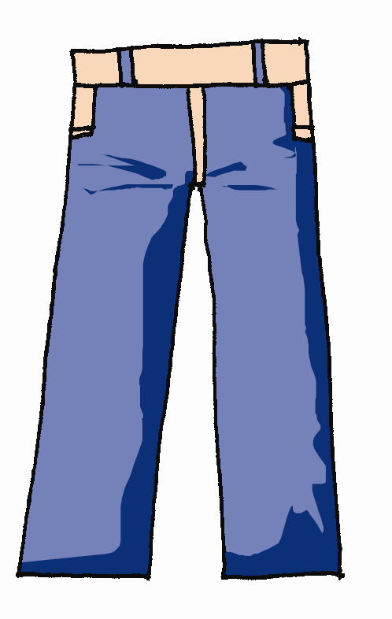

Guess
How much is it/are they? (≤ ￥500)
It’s … / They’re …
￥125
￥?
￥?
￥375

Slide 7
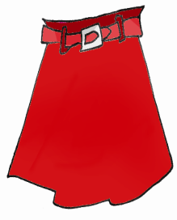
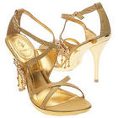
Guess
How much is it/are they? (≤ ￥500)
It’s … / They’re …
￥?
￥458
￥129
￥?

Slide 8

￥688？！！
I’ll think about it!
考虑
服装店
￥688
New Words

Slide 9

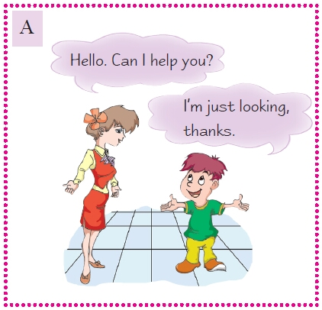
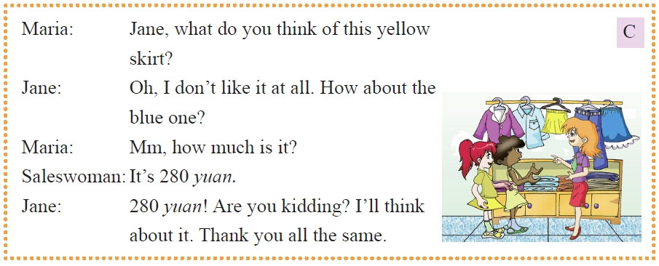
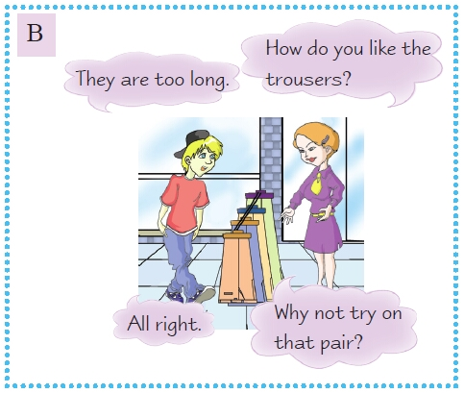
1a
Look, listen and say.
A----Q1: Does the boy buy anything?
B----Q2: How does Michael like this pair of pants?
C----Q3: How much is the blue skirt?

Slide 10
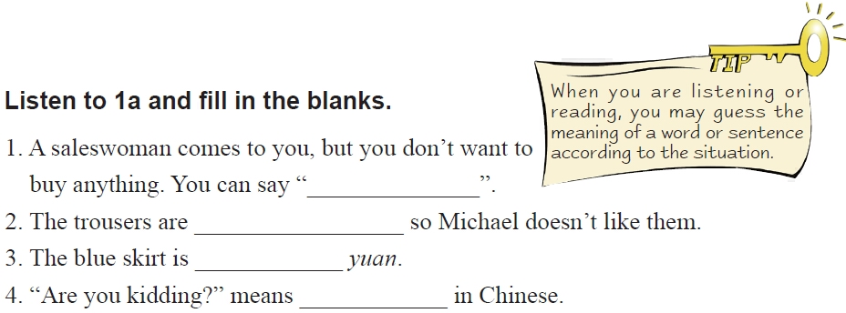

I’m just looking
too long
280
开玩笑

Slide 11
Key Points
What do you think of …?
=How do you like …?
你认为……怎么样？
I like it/them very much.
I don’t like it/them at all.

Slide 12
Key Points
Are you kidding?
你在开玩笑吧？
Thank you all the same.
=Thanks all the same.
仍然感谢你。

Slide 13

Make up a new one
What can I do for you? / May/Can I help you?
Can I try it on?
What do you think of …?
How much is it/are they?
It’s … / They’re …
We’ll take it. / I’ll think about it.
Thank you all the same.
…

Slide 14







Listen and write down the price.
￥7.00
￥18.00
￥25.00
￥5.00
￥100.00
￥108.00
￥139.00
￥180.00

Slide 15

Make a shopping list.
Suppose Maria’s parents only have 300 yuan with them.
what can they buy? Help them make a shopping plan.
Shopping Plan
______________
______________
______________
______________
￥7.00
￥18.00
￥25.00
￥60.00
￥100.00
￥108.00
￥139.00
￥180.00

Slide 16
Practice
S1: What do you think of …? / How do you like …?
你认为……怎么样？
S2: It is/They are nice/too long.
S1: Why not …?
How much is/are …?

Slide 17

On Sale
T: This pen is 2 yuan. It’s Li Yuchun’s pen. If
you want it, how much do you want to give?
S1: 3 yuan.
S2: 5 yuan.
S3: 10 yuan.
T: 10 yuan! 10 yuan! Any more? OK. Come and
take it!

Slide 18
Summary
What do you think of …?
=How do you like …?
I like it/them very much.
I don’t like it/them at all.
Why not try on that pair?

Slide 19
Summary
How/What about the blue one?
Are you kidding?
I’ll think about it.
Thank you. / Thanks all the same.

Slide 20

Homework
Make a dialogue about shopping according to Section A&B.
Preview Section C.

