Slide 1
Unit 2 Topic 1
You should see a dentist.
Section A
WWW.PPT818.COM

Slide 2
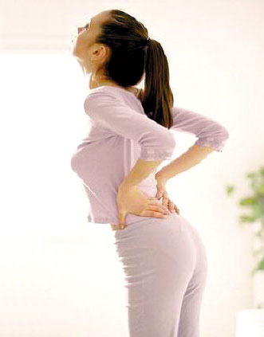

What’s wrong with you?
I have a backache.

Slide 3
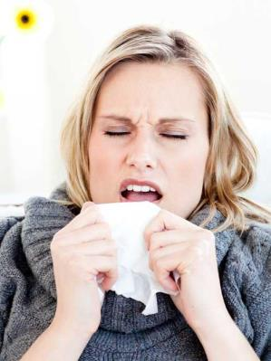

What’s wrong with her ?
She has a cold.

Slide 4
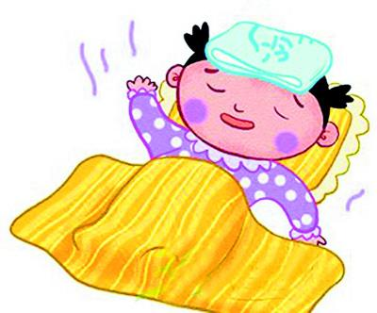

What’s wrong with her ?
She has a fever.

Slide 5
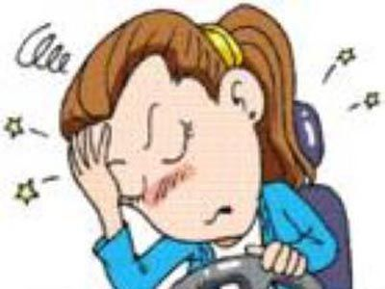
What’s wrong with her ?
She has a headache.

Slide 6
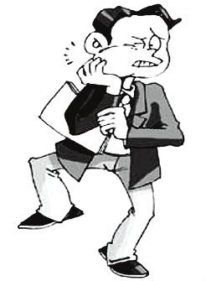
What’s wrong with him ?
He has a toothache.

Slide 7
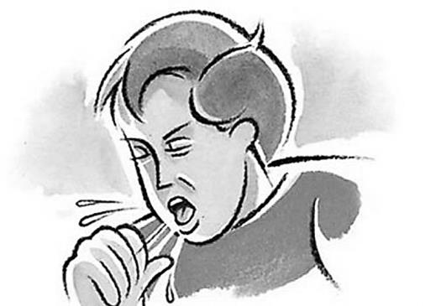
What’s wrong with him?
He has a cough.

Slide 8
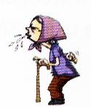
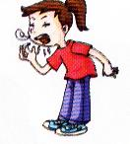
— What’s wrong with him/her?
— He/She has …
a cough
the flu

Slide 9
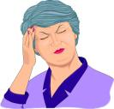
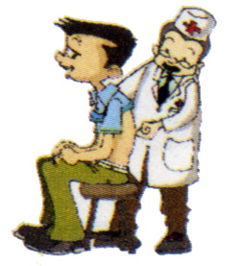
— What’s wrong with him/her?
— He/She has …
a headache
a backache

Slide 10
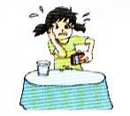
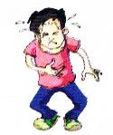
— What’s wrong with him/her?
— He/She has …
a toothache
a stomachache

Slide 11
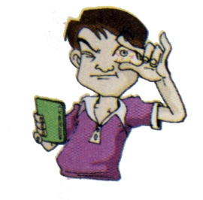
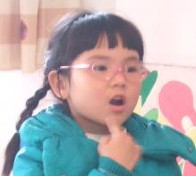
— What’s wrong with him/her?
— He/She has …
sore eyes
a sore throat

Slide 12








感冒
have a cold
牙痛
have a toothache
发烧
have a fever
背痛
have a backache
illnesses
咳嗽
胃痛
have a cough
have a stomachache
头痛
have a headache

Slide 13
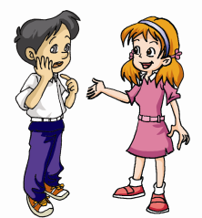


Listen, look and say.
1a
Betty:
Kangkang:
Betty:
Kangkang:
Betty:
Kangkang:
Hello, Kangkang! You don’t look well. What’s wrong with you?
I have a toothache.
I’m sorry to hear that. You should see a dentist.
I think I will.
I hope you’ll get well soon.
Thank you.

Slide 14




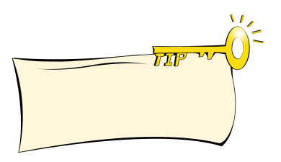
1b
Listen to 1a and choose the correct answers.
1. Kangkang has a ______.
A backache B headache C toothache
2. Betty suggests that Kangkang should see a ___.
A doctor B dentist C nurse
3. Betty hopes Kangkang will ______ well soon.
A go B get C make
Guess the meanings of backache and headache according to toothache.

Slide 15

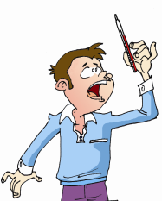
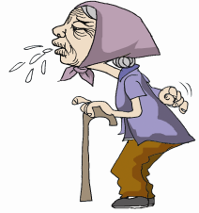
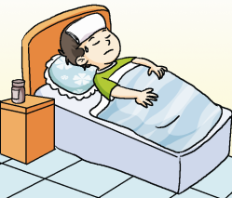
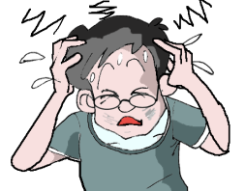
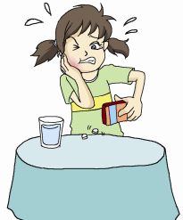
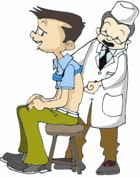
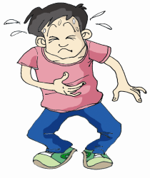
1c
Listen and number the pictures. Then ask and answer with your partner
4
1
3
7
6
2
5

Slide 16
Example :
A: What’s wrong?
B: I have a bad cold.
A: What’s the matter with him?
B: He has a fever.

Slide 17
2. Pair work
Make conversations with your partner after the example.
Example:
A: What’s wrong with you?
B: I have a headaches.
A: You should go to see a doctor.

Slide 18
1. A: What wrong with you?
B: I have a cough.
A: You should see a doctor.
2. A: What’s wrong with you?
B: I have sore eyes.
A: You should not read too long.
3. A: What’s wrong with you?
B: I have a backache.
A: You should take a rest.

Slide 19
Practice more.
1. drink coffee or tea in the evening
2. drink plenty of boiled water
3. lift heavy things
4. stay in bed and have a good sleep
I have a headache.
4
You should ______
I have a fever.
2
You should ______
I can’t sleep well at night.
1
You shouldn’t _______
I have a backache.
3
You shouldn’t _______

Slide 20

Pair work
You should _______________________.
I have a headache.
stay in bed and have a good sleep

Slide 21
Pair work
You should ______________________.
I have a fever.
drink enough boiled water

Slide 22
Pair work
You shouldn’t ______________________.
I can’t sleep well at night.
drink coffee or tea in the evening

Slide 23
Pair work
You shouldn’t ____________.
I have a backache.
lift heavy things

Slide 24


Practice
I have a ____.
You should _______.
I have a ____.
You should _______.
I have a ____.
You shouldn’t _______.

Slide 25

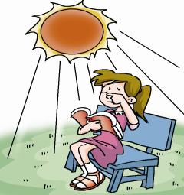
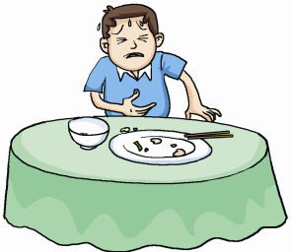
A. Listen to the conversations and
number the pictures.
3
2
1
3

Slide 26
B. Listen again and then write down the advice, using should/shouldn’t.
3
1.____________________________________
2.____________________________________
3.____________________________________
You shouldn’t read in the sun.
He should see a doctor.
You shouldn’t eat too much.

Slide 27
Key Phrases
1. 患感冒
2. 发烧
3. 咳嗽
4. 患流感
5. 眼睛痛
6. 牙痛
7. 头痛
8. 背痛
9. 肚子痛; 腹痛
10. 喉咙痛
have a cold
have a fever
have a cough
have the flu
have sore eyes
have a toothache
have a headache
have a backache
have a stomachache
have a sore throat

Slide 28
Key points
1.What’s wrong with you?
=what’s the matter with you?
你怎么了？
2.You should see a dentist.
should/shouldn’t 应该/不应该
e.g. 我们应该吃多点水果。
你不应该在这里吸烟。
We should eat more fruits.
You shouldn’t smoke here.

Slide 29
Exercises
英汉互译
have a stomachache _____
2. have a fever ______
3. take a rest ________
4. have a toothache_____
5. have a cold _______
6. see a doctor _____
7. 你应当早点上床睡觉。 _____________________
8. 你妈妈看起来气色不太好。___________________
9. 你应该多喝水。 ________________________
10. 你怎么啦? ____________________________
胃痛
发烧
休息一下
牙痛
患感冒
看医生
You should go to bed early.
Your mother doesn’t look well.
You should drink more water.
What’s wrong/the matter with you?

Slide 30
matter
1. — What’s the ________(事情) ?
— I have the _____(流感).
2. He has a ___________(头痛), so he
has to take a rest at home.
3. I am not feeling well. I have a _____
(咳嗽).
4. — What’s wrong with him?
— He ____(患) a cold.
5. You should see a ________(牙医).
6. You’d better drink more ________
water (开水) .
flu
headache
cough
has
dentist
boiled

Slide 31
Summary
I have a headache.
2. I have a cold.
3. I have a toothache.
You should have a good rest.
You should go to see a doctor.
You shouldn’t eat too much candy.

Slide 32
Homework
Make a dialog with your classmates like this:
A: Hi … What’s wrong?
B: I have a …
A: I’m sorry to hear that. You should …
B: I think I will.
A: I hope …
B: Thank you.

