Slide 1
Unit 5 Wild animals
第6课时
WWW.PPT818.COM

Slide 2
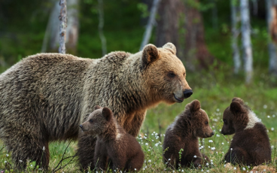
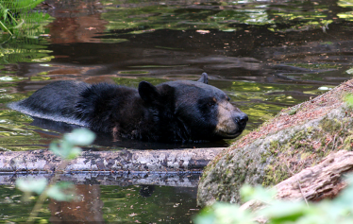

Slide 3
A report on an animal in danger
A)Simon wants to write a report on bears for the Wild Animals Club. Read his notes below.
A report on bears
Looks
•big and heavy, large body, short and strong legs, large paws, short tail
Food
•most eat meat and fish, some also eat plants and insects

Slide 4
Abilities
•can run very fast, good at climbing and swimming
Qualities
•move around slowly in the daytime, sleep through the winter, seldom hurt people
Danger
•hunters catch them for their fur and paws

Slide 5
Useful expressions
...are big and heavy/strong/small/ lovely/cute.
They have....
Their...are....
They eat meat/fish/plants/insects.
They can....
They are good at....
They seldom/often....
People catch/hunt...for....
We should take action to....

Slide 6
知识点
report /rɪ'pɔːt/ n．报告；报道 &v.报告；报道
1
eg: She reported the success of a new experiment.
她报道一次新的试验的成功。
report to...向……汇报
其中to为介词。
It was reported that...据报道……
拓展

Slide 7
知识点
2
move /muːv/ vt.& vi.移动；搬迁
eg: He moved his chair nearer the fire.
他把他的椅子移动得更靠近火。
We'll move to the country next month.
我们下个月将搬到乡下。
相关短语：
move into 搬进，move off启动，
move to搬到，move out of 搬出

Slide 8
知识点
through / θruː / prep. 穿过
3
表示从物体内部穿过，如森林， 玻璃等；也可指事情从头到尾，由始至终。
across 穿过， 表示从物体表面穿过， 如沙漠，街道等
拓展

Slide 9
B)Help Simon complete his report using his notes in Part A.
Bears are in danger!
Bears are big and ________. They have large bodies, short and ________ legs and large paws. Their tails are ________.
Most bears eat meat and ________，but some also eat plants and ________.
Bears can ____________. They are good at ________ and ___________.
heavy
strong
short
fish
insects
run very fast
climbing
swimming

Slide 10
Bears move around slowly in the daytime. They sleep through ___________．They ________ hurt people.
Sadly, many hunters catch bears for their (11) ________ and ________．We should take action to stop this. Otherwise, there may be no bears left in the world.
the winter
seldom
fur
paws

Slide 11
一、根据汉语提示或所给单词完成句子
1．This box is too heavy. I can't ________ (移动) it.
2．Simon wants to write a ________(报告)on bears for the Wild Animals Club.
3．I saw a black dog with a long ________(尾巴) just now.
4．We can't see the stars in the ________ (白天)．
5．My brother is good at __________ (swim)．
move
report
tail
daytime
swimming

Slide 12
二、根据汉语意思完成句子
6．他喜欢在周末缓慢地到处走走。
He likes to _______ _________ ________ on weekends.
7．我正在写一篇关于野生动物的报告。
I'm writing a ________ ________ wild animals.
8．他们正在采取行动保护大熊猫。
They are ________ ________ to protect giant pandas.
move around slowly
report on
taking action

Slide 13
9．冰箱里没有剩下的食物了。
There is________ ________ ________ in the fridge.
10．那些鸟处境危险。我们应该保护它们。
Those birds are ________ ________．We should protect them.
no food left
in danger

Slide 14
本节课主要学习了以下知识点，请同学们及时巩固练习：
report , move , through

