Slide 1
Unit 8
Have you read Treasure Island yet?
R 八年级下册
第1课时
WWW.PPT818.COM

Slide 2
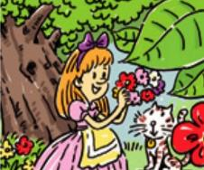
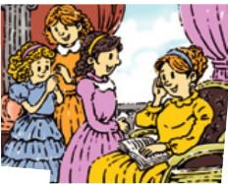
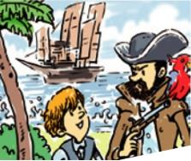
Lead-in
Can you guess the names of these books according to the pictures.
Alice in Wonderland
Little Women
Treasure Island

Slide 3
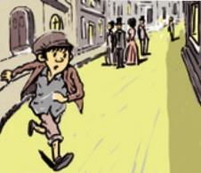
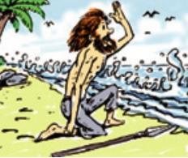
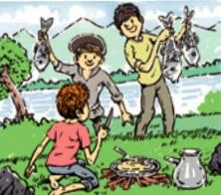
Oliver Twist
Robinson Crusoe
Tom Sawyer

Slide 4
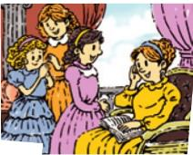
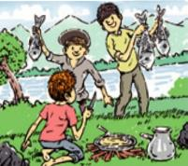
Who can say something about these books?

Slide 5
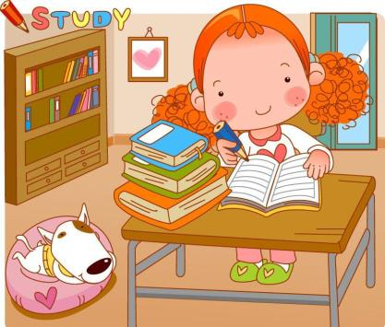

Slide 6
Have you heard of these book? Check (✔)
the ones you know.
1a
____ Alice in Wonderland ____ Little Women
____ Treasure Island ____ Oliver Twist
____ Robinson Crusoe ____ Tom Sawyer

Slide 7
1b
Listen and complete the chart.
Book title | Name | Have they read it? | What do they think of it?
 | Nick
 | Judy
 | Sandy
 | Alan
 | Kate
 | Harry
No
Treasure Island
Yes
exciting
Robinson Crusoe
No
Yes
wonderful
Little women
Yes
fantastic
No

Slide 8
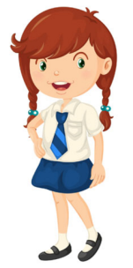
Practice the conversation. Then talk about the other books in 1a.
1c
Have you read Little Women yet?
No, I haven’t.
Have you?
Yes, I’ve already read it.
What’s it like?
It’s fantastic.

Slide 9
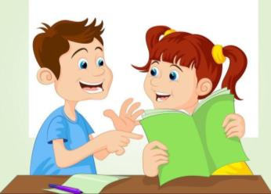
Have you read Robinson Crusoe
yet?
Yes. I have already read it.
It’s wonderful.
What’s it like?

Slide 10
Language points
1. Have you read Little Women yet?
你读过《小妇人》这本书吗？
（1）这是一个现在完成时的一般疑问句。
现在完成时的基本结构：
have/has +动词的过去分词
表示过去发生或已经完成的动作对现在造成的影响或结果。

Slide 11
现在完成时的一般疑问句形式是直接将助动词have/has提到句首。
例：Have you ever traveled to a foreign country？
你曾经去国外旅游过吗？
练：他爬过长城吗？
Has he visited the Great Wall yet？

Slide 12
（2）yet作副词，意为“已经；还”。通常用于否定句或疑问句中，且常用于现在完成时句子中。
例：Have you seen the film yet？
你已经看过那部电影了吗？
练：已经十点钟了，汤姆还没回来。
It’s already ten o’clock. Tom hasn’t come back yet.

Slide 13
辨析： yet，already与still
yet
already
still
意为“已经；还”，一般用于否定句或疑问句，用来谈论尚未发生但可能发生的事。
意为“已经”，用于肯定句，强调某事已经发生，也可用于疑问句中表示惊讶。
意为“还是；仍然”，用在肯定句或疑问句中，表示原有的状况没有改变。

Slide 14
选词填空。
yet already still
I haven’t received the gift _______.
My sister is ________ reading.
I have ________had dinner.
Is it 9 o’clock ________ ？
Is the soup ________ hot？
Has she gone to Wuhan _______？
yet
still
already
already
still
yet

Slide 15
Listen. Who has read these books? Circle the names.
2a
1. Treasure Island Mark / Tina
2. Olive Twist Mark / Tina
3. Robinson Crusoe Mark / Tina
4. Tom Sawyer Mark / Tina

Slide 16
Listen again and write T for true and F for false.
2b
1. Oliver Twist is about a boy who goes out to sea
and finds an island full of treasures. ( )
2. Robinson Crusoe is a classic. ( )
3. Tina thinks that Treasure Island is a fantastic
book. ( )
4. Tom Sawyer is about a boy who lives in the United Kingdom. ( )
F
be full of = be filled with
充满；装满
T
T
F

Slide 17
Use the information in 2a and 2b to talk about the books.
2c
Has Tina read Treasure Island?
Yes, she has. She thinks it’s fantastic.
What’s it about?
It’s about …

Slide 18
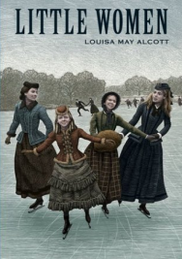
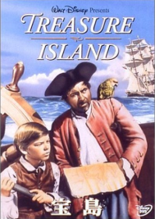
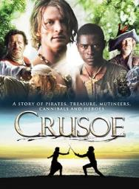
Have you ever read these books? What are they about?

Slide 19
2d
Role-play the conversation.
Listen and answer the questions.
1. Has Steve finished reading Little Women?
2. What does Steve think about Little Women ?
and what’s it about?
3. Which book did Amy choose? And has she
finished reading it？How does Amy like it?

Slide 20
1. Has Steve finished reading Little Women?
2. What does Steve think about Little Women ?
and what’s it about?
Yes, he has already finished reading it.
He thinks it is really good. It’s about four sisters
growing up.

Slide 21
3. Which book did Amy choose? And has she finished
reading it？how does Amy like it?
She chose Treasure Island. She hasn’t finished
reading it yet. In her opinion, it looks interesting.

Slide 22
Amy: Steve, have you decided yet which book to write
about for English class?
Steve: Yes, Little Women. I've already finished reading
it!
Amy: Wow, you’re fast! What’s it about?
Steve: It’s about four sisters growing up. It was really
good, so I couldn’t put it down. Which book did
you choose?
grow up 长大；
成熟；成长

Slide 23
Amy: I chose Treasure Island, but I haven’t finished
reading it yet. I’m only on page 25.
Steve: Have you at least read the back of the book to
see what it's about?
Amy: Yes, I have. It looks interesting.
Steve: You should hurry up. The book report is due in
two weeks.
Amy: Yes, I know. I’ll read quickly.
hurry up 赶快；(急忙)做某事

Slide 24
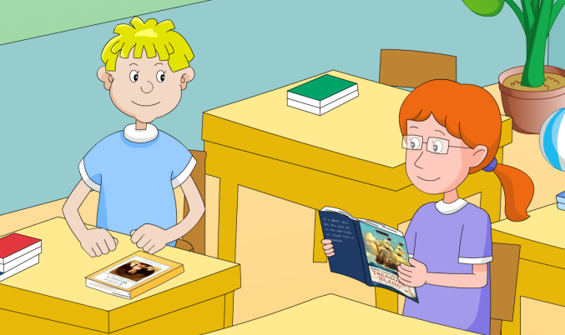

Slide 25
Language points
1. It was really good, so I couldn’t put it down.
这书真的很不错，因此我爱不释手。
put down意为“放下；记下；写下”
“动词+副词”型短语：
（1）宾语为代词，应放在put与down中间，
（2）宾语是名词，放在两者之间或down后面均可。

Slide 26
与put相关的短语：
put up 搭起；张贴 put out 伸出；扑灭
put up with 容忍 put off 推迟
put away 收起；攒钱 put on穿上
put back 放回；把（钟）拨慢；推迟

Slide 27
2. The book report is due in two weeks.
读书报告的上交期限是两周后。
此处due为形容词，意为“预期；预定”
常见搭配有：
be due to do sth./be due for sth.预期做某事。
例：我们预计明天动身。
We are due to leave tomorrow.

Slide 28
due to还可意为“由于；因为”，相当于because of。
例：Her success was due to her hard work.
她的成功是她努力工作的结果。
练：从某种程度上来说，这是由于世界的周围局
势所决定的。
To some extent, this is due to the nature of the world around it.

Slide 29
Exercise
单项选择。
1. The bottle is _____ water.
A. filled of B. full with
C. filled of D. full of
2. I ____ the book, and I know what it is____.
A. read; on B. am reading; about
C. have read; about D. had read; on
D
C

Slide 30
3. He has already finished his homework.
(改为否定句和一般疑问句及否定回答)
He ______ finished his homework _____.
______ he finished his homework _____?
No, he ______.
hasn’t
yet
Has
yet
hasn’t

