Slide 1
Unit 11
I like the Spring Festival best
WWW.PPT818.COM

Slide 2
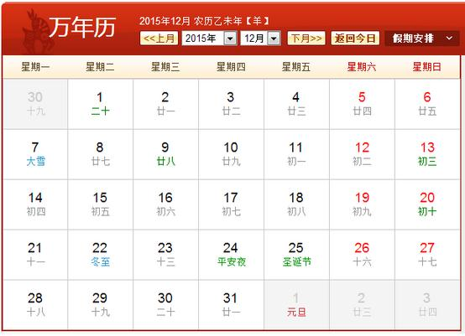
What‘s the date today？

Slide 3
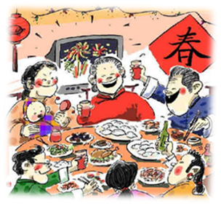
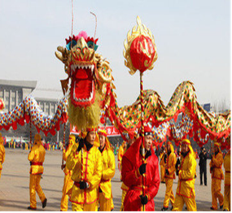
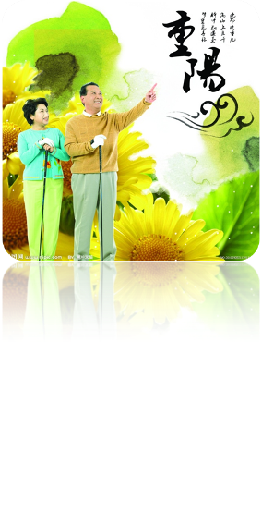
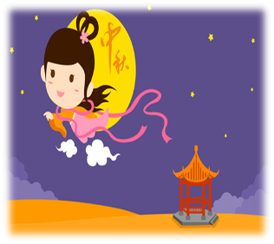
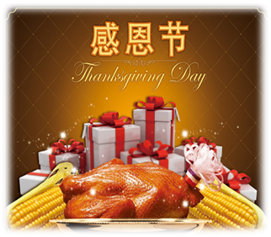
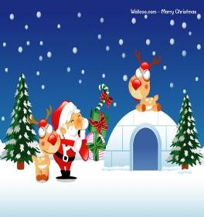
Module6
Festival

Slide 4


Brainstorm
What festivals do you know?

Slide 5
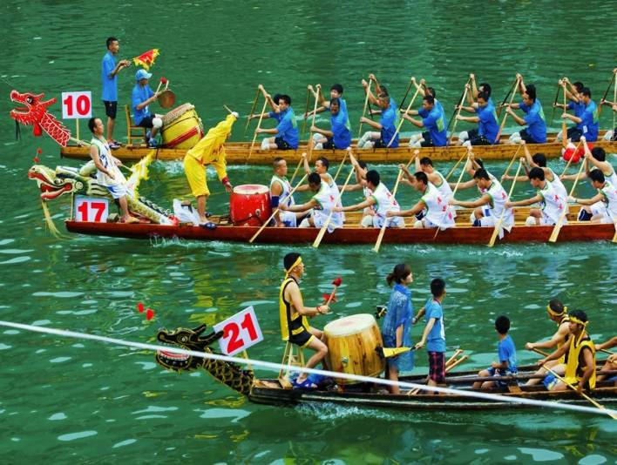
Dragon Boat Festival

Slide 6
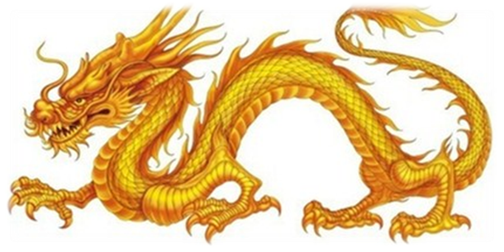
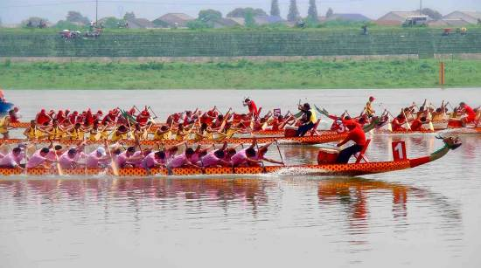
dragon
dragon boat races
race

Slide 7
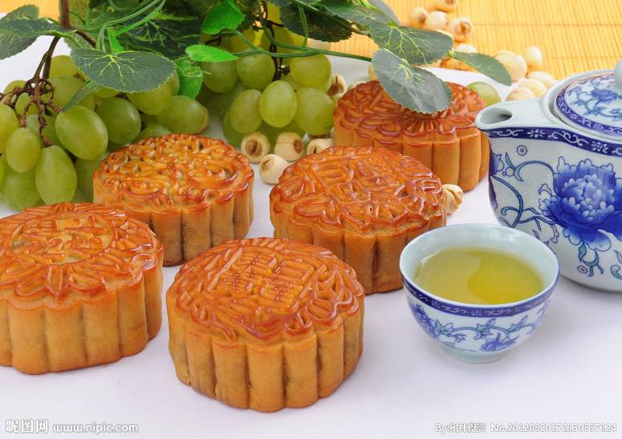


Slide 8
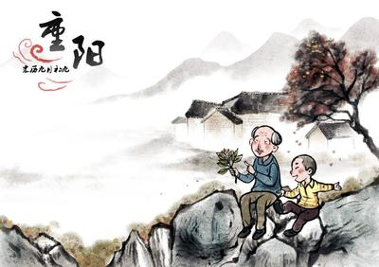


Slide 9
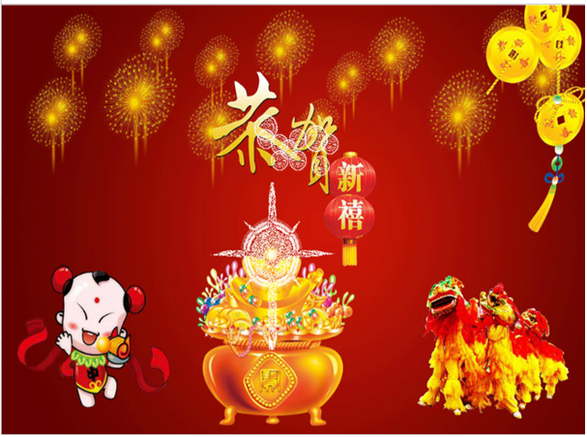
the Spring Festival

Slide 10
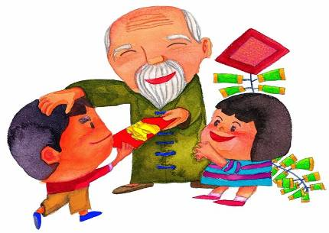
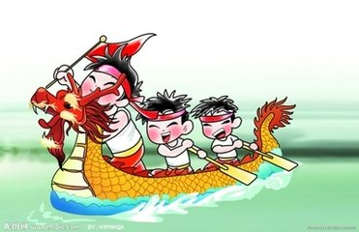
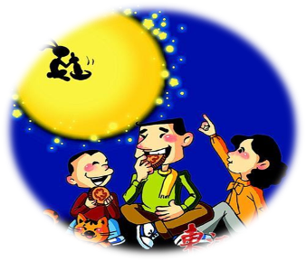
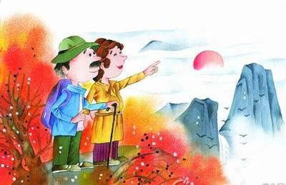
Discuss in group:What do people do during …?
Gragon Boat Festival
the Spring Festival
Mid-autumn Festival
Chongyang Festival

Slide 11
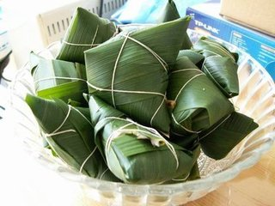
What do people do during Dragon Boat Festival?
eat zongji
watch the dragon boat races

Slide 12
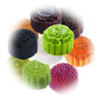
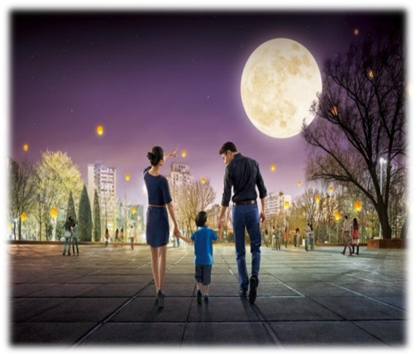
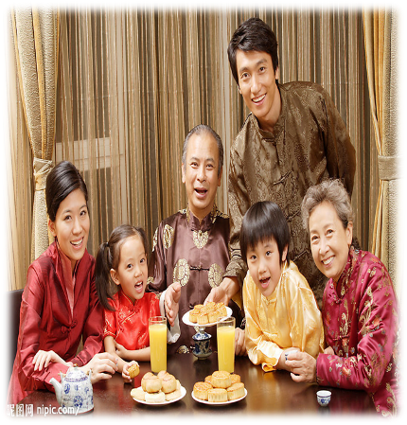
What do people do during Mid-autumn Festival?
moon
mooncake
eat mooncakes
watch the moon

Slide 13
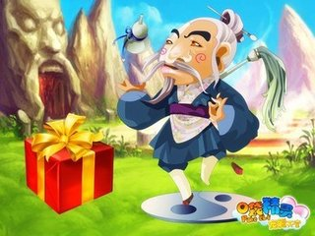
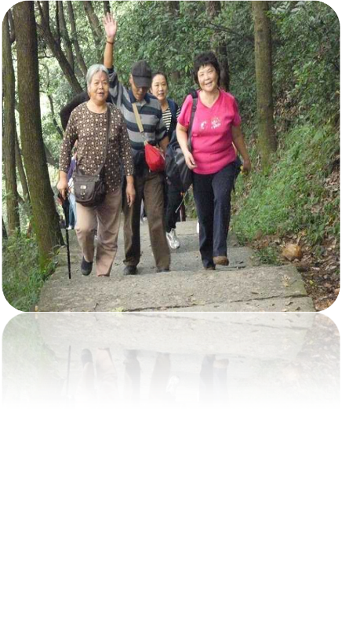
Give old people presents and climb the mountain
What do people do during Chongyang Festival?

Slide 14
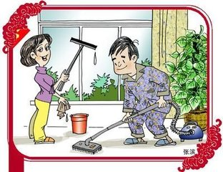

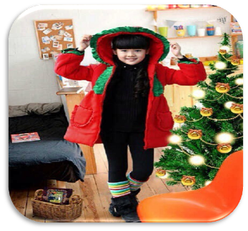
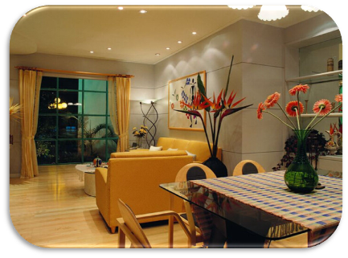
Before
the Spring Festival
clean the house
make everything new
and fresh
buy new clothes

Slide 15

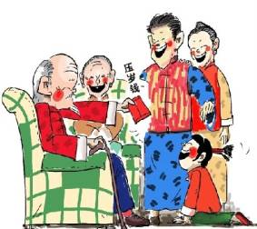
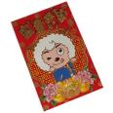
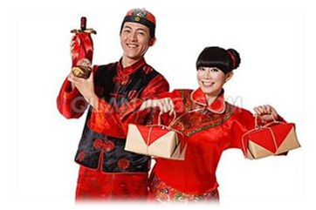
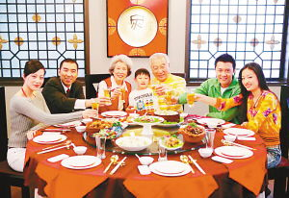
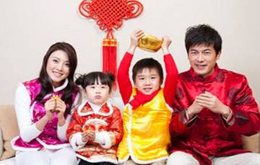
the Spring Festival
give some lucky money
give each other gifts
visit my family and wish them a happy Spring Festival
have a big dinner and
eat lots of delicious food

Slide 16
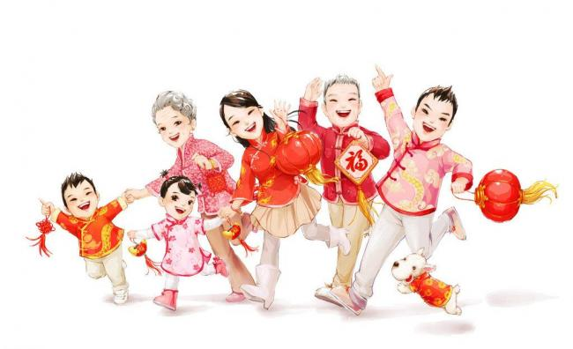
I like the Spring Festival best.
What is your favourite festival?

Slide 17
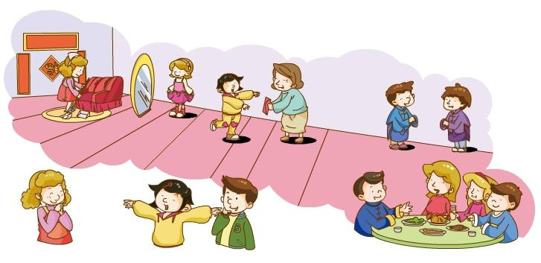
Let's listen
Xiaoling, Ben and Janet are talking about festival too.
Do you know what's their favourite festival?
Listen and answer :
What is Xiaoling's favourite festival?
Do people give each other gifts at this Festival?

Slide 18

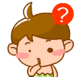



Listen again and choose.
1. People will ________during Spring Festival.
buy new clothes B. watch the moon
C. watch the dragon boat races on the river
2.People clean their houses to ____________.
A. buy new clothes B. give each other gifts
C. make everything new and fresh
3. The children can ________ from their parents.
A. get some sweets B. some new books
C. get some lucky money
4. Chinese people usually eat ______at Spring Festival.
A. noodles B. jiaozi C. cakes

Slide 19
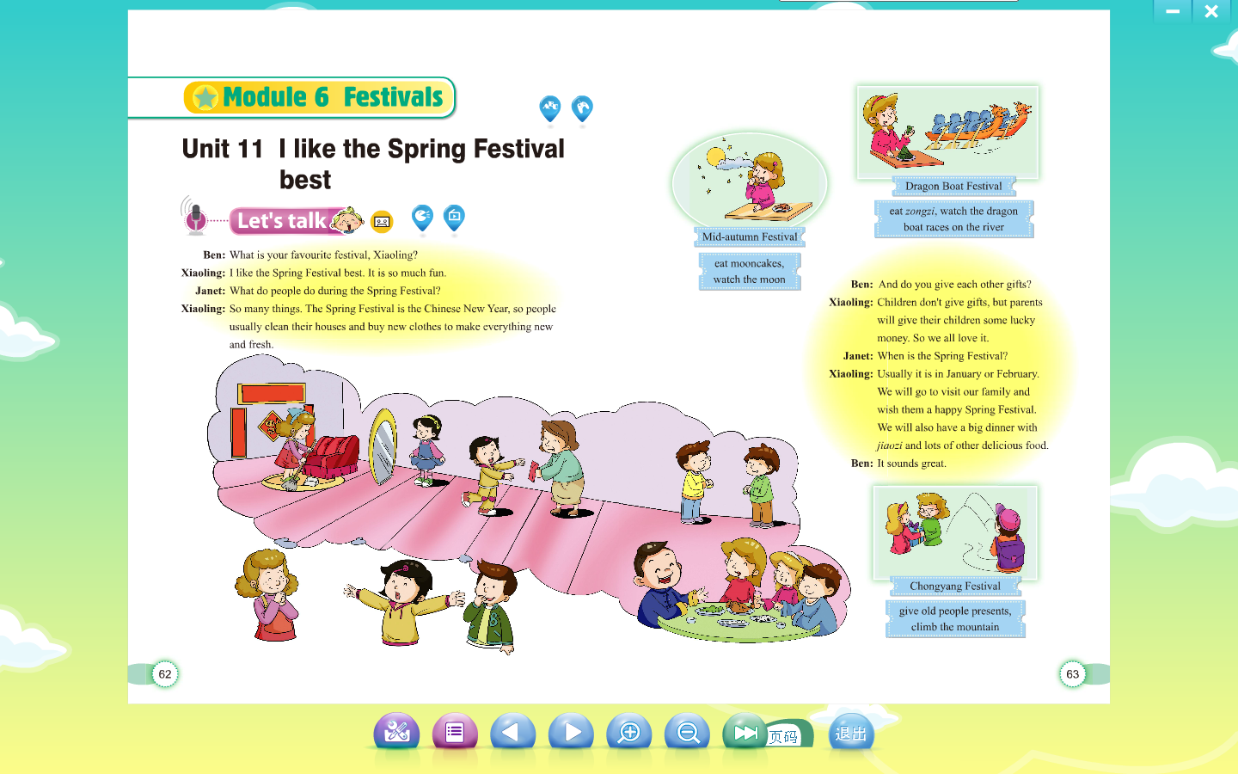
Book P 62: I can read after the dialogue.

Slide 20
Let's read
Read,underline and answer the following question.
Q1. When is the Spring Festival?
Q2.What do people do during the Spring Festival?
Q3.What will parents give the children at the Spring Festival?

Slide 21

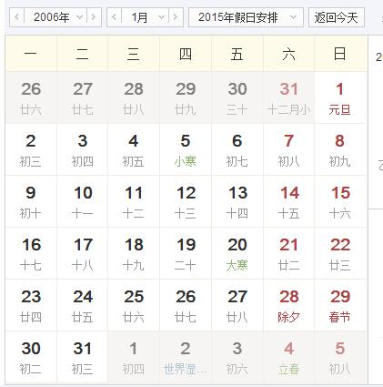
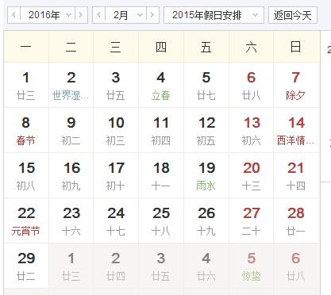
Let's answer
When is the Spring Festival?
  Usually it is in January or February.

Slide 22
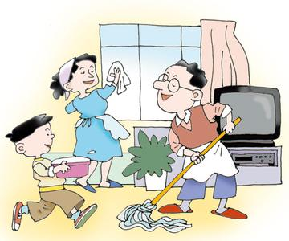
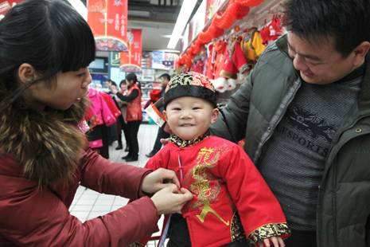
Let's answer
What do people do during the Spring Festival?
People usually clean their houses and buy new clothes to make everything new and fresh.

Slide 23
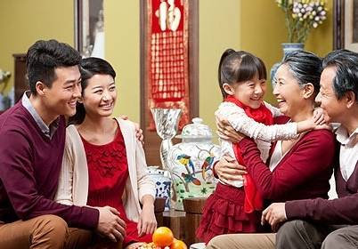
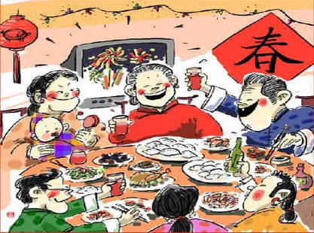
Let's answer
What do people do during the Spring Festival?
People will visit their family and wish each other a happy Spring festival.
People will also have a big dinner together with jiaozi and lots of other delicious food.

Slide 24
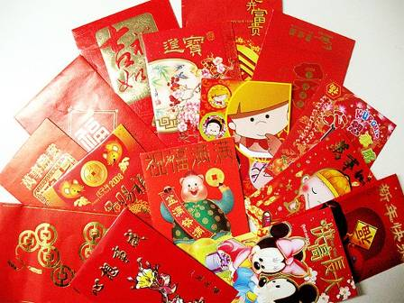
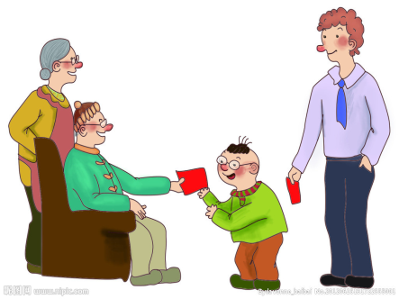
Let's answer
What will parents give the children at the Spring Festival?
Children don't give gifts, but parents will give their children some lucky money.

Slide 25
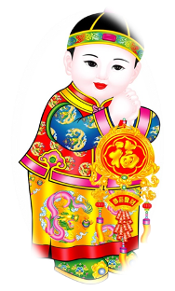
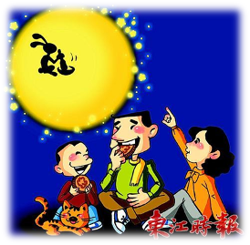
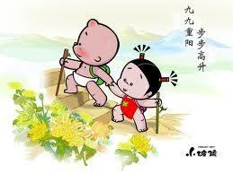
Practice in pairs:
A: What is your favourite festival?
B: I like the....best. It is so much fun.
A: What do you usually do during .... ?
B: So many things. I will/can....
A:It sounds great/wonderful....
When is ….
B: It is usually in…

Slide 26
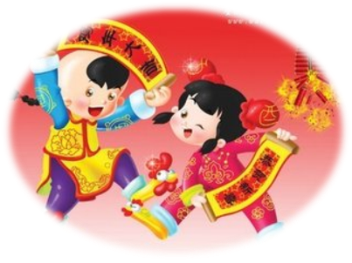
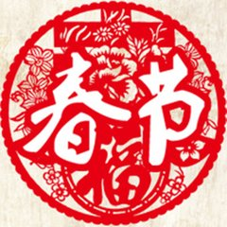
Read the text again and retell.
Xiaoling likes the ________ _______ best
The Spring Festival is the________ New Year.
Spring
Festival
Chinese

Slide 27
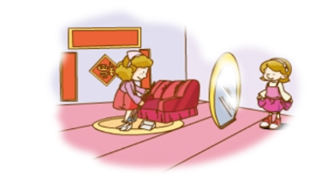
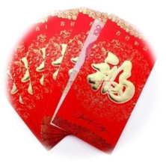



Let’s retell.
People usually clean…and buy …to make everything …and…
Parents give their children some…
They go to ________their family and…
In the evening, they have …with … and lots of …

Slide 28
Let’s retell.
Xiaoling likes the ________ _______ best. The Spring Festival is the________ New Year. People usually _______ their houses and ______ new clothes to make everything new and _______. Parents give their children some_______ ______. They go to ________their family and _______ them a happy Spring Festival. In the evening, they have a big dinner with ______ and lots of other delicious food.
Spring
Festival
Chinese
clean
buy
fresh
lucky
money
visit
wish
jiaozi

Slide 29

make +adj. (后面跟形容词，使得，让）
The teacher tried to make the children quiet.
The girl does everything to make her mother happy.

Slide 30


each other
When we are in trouble,we need to help each other.

Slide 31

will 表示习惯
People will have dragon boat races at Dragon Boat Festival.

Slide 32

wish somebody something 表示祝福
I wish you all a happy New Year.
Wish you a happy and healthy life!
Wish you good luck!

