Slide 1
Unit4 Do you like candy?
人教精通版三年级下册
WWW.PPT818.COM

Slide 2
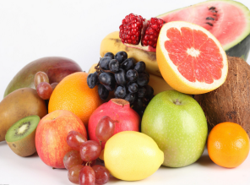
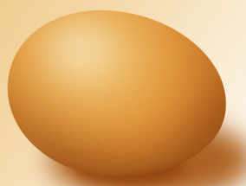
Review
Look and say
—Do you like …?
—Yes, …

Slide 3
Review
Look and say
你能看出下列图形中的字母吗？

Slide 4
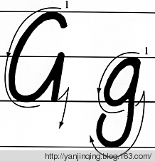
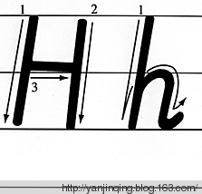
Presentation
Let’s learn

Slide 5
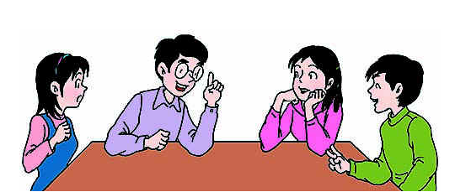
Presentation
Discussion
我们学过的哪些单词含有字母g或h呢？
girl grandfather
hi hello……

Slide 6
Presentation
Let’s learn
grapes
Do you like grapes?

Slide 7
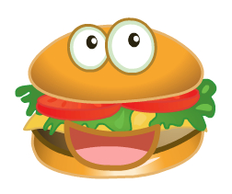
Presentation
Let’s learn
hamburger
Do you like hamburger?

Slide 8
Presentation
Let’s learn
honey
Do you like honey?

Slide 9
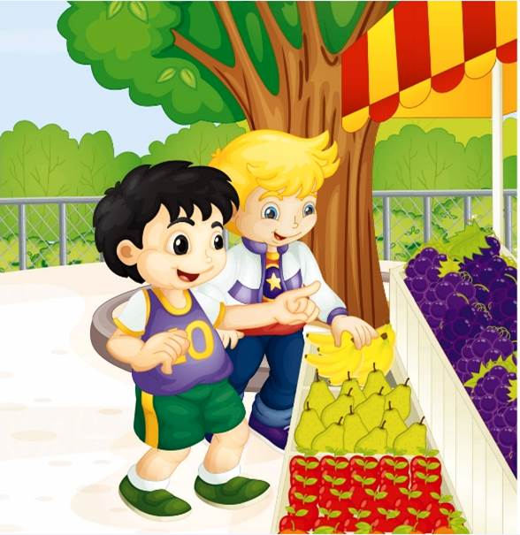
Presentation
Listen and say
1. Does Peter like grapes?
2. What does Peter like?
3. What does Gao Wei like?
No, he doesn’t.
He likes bananas.
He likes grapes.

Slide 10
Presentation
Let’s learn
No, I don’t. I like bananas. What about you?
Hi, Peter. Do you like grapes?
You like grapes. I like bananas.
I like grapes.

Slide 11
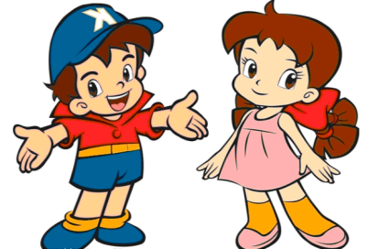
Practice
Role play
两人一组练习Just talk部分对话，随后表演出来吧！

Slide 12
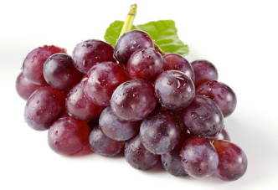
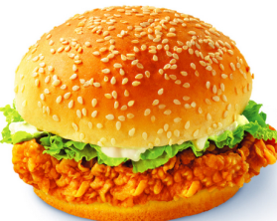
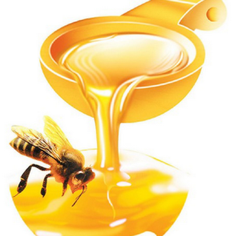
Practice
Let’s do
_am_ur_er
g
a
h
b
g
_r_p_s
e
h
_on_y
e

Slide 13
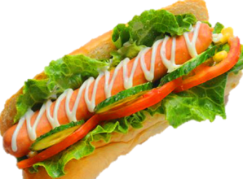
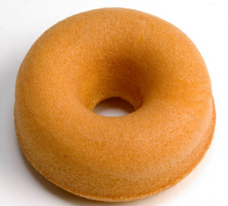
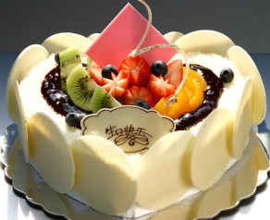
Practice
Ask and answer
—Do you like …?
—Yes, I do. / No, I don’t.

Slide 14
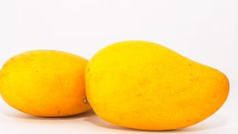
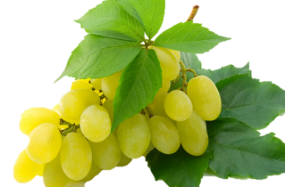
Practice
看图对话
A: I like _______. Do you like
mangoes?
B: No, ______. I like ______.
Do you like grapes?
A: Yes, _____.
mangoes
I don’t
grapes
I do

Slide 15
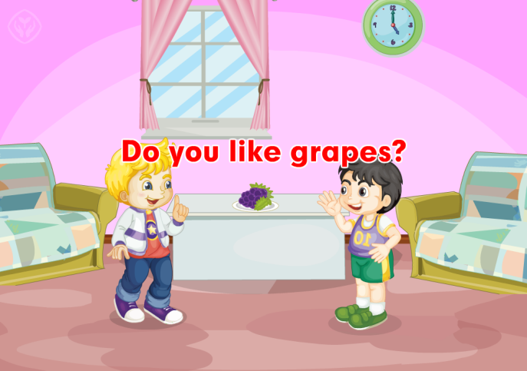
Practice
Let’s sing

Slide 16
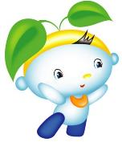
Summary
本课学到的重点单词：
grapes hamburger honey
本课学到的重点句型：
—Do you like grapes?
—No, I don’t.

Slide 17
Homework
1. 跟读课文Just talk部分的录音，注意语音、语调。
2. 用“Do you like …?”询问你的家人或朋友喜欢什么食品，做好调查记录。
3. 预习本单元Lesson 23的内容。
Close

