Slide 1
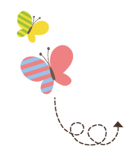
Unit 1 Sports
六年级下册
Lesson 3 Let’s play
WWW.PPT818.COM

Slide 2
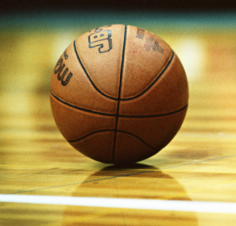
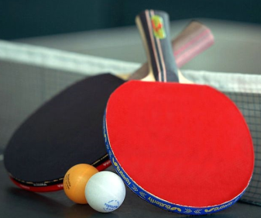
What are these?

Slide 3
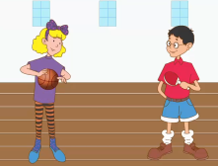
1. Playing basketball
Jenny: Are you ready to learn to play basketball, Li Ming?
Li Ming: Yes! Are you ready to learn to play ping­-pong?
Danny: I want to learn, too!
Li Ming: Let me try. Here I go! I’m throwing the basketball!
Li Ming: Danny! Catch the basketball!
Danny: Ouch!
Danny: Ouch! The ball is heavy!
Jenny: Throw the basketball, Danny!
Danny: This is too difficult! The ball is too heavy!
Danny: This ball is light! I can throw it. This is easy!
Danny: The basketball is heavy. The ping-pong ball is light.

Slide 4
知识点 1
Are you ready to learn to play basketball, Li Ming?
询问某人是否准备好做某事
句型结构：
It’s half past eight. 八点半了。
Are you ready to go?你准备好走了吗？
—Is he ready to leave?他准备好离开了吗？
—Yes, he is.是的，他准备好了。
例句：

Slide 5
be ready to do sth. 准备好做某事
I’m ready to fly a kite. 我准备好放风筝了。
例句：
get ready to do sth.
同义短语：
短语辨析：
be ready to do sth. | 准备好做某事 | I’m ready to play football. 我准备好踢足球了。
be ready for sth. | 为某事做好准备 | I’m ready for class. 我为上课做好了准备。

Slide 6
—Are you ready ________ a bike to school?
—Yes, I am.
A. ride B. riding C. to ride
典例
C

Slide 7
basketball /'bɑːskɪtbɔːl/ n. 篮球（四会）
My favourite sport is basketball.
我最喜欢的运动是篮球。
例句：
basket(篮子) ＋ ball(球)＝basketball
加法记忆法：
play basketball 打篮球
短语：
魔法记忆:
投进篮筐（basket）的球（ball）就是篮球（basketball）。

Slide 8
根据汉语提示完成句子。
Look, the boys ____________________(正打篮球) on the playground.
典例
are playing basketball

Slide 9
知识点 2
try/traɪ/ v. 试；尝试 （四会）
—May I try on the hat?我能试戴这顶帽子吗？
—Sure! 当然可以！
例句：
try(原形) →tries(第三人称单数) →tried (过去式) → trying (现在分词)
词形变化：
cry v. 哭
形近词记忆法：

Slide 10
try to do sth.尽力做某事
try doing sth.尝试做某事
try one’s best to do sth.
尽某人最大的努力去做某事
短语：
try还可作名词，构成短语have a try“试一试”。
拓展

Slide 11
知识点 3
heavy /'hevi/ adj. 重的 【四会】
The boy is heavy. 这个男孩很重。
例句：
light adj. 轻的
反义词：
The elephant is very ________.
A. heavy B. light C. short
典例
A

Slide 12
知识点 4
difficult /'dɪfɪkəlt/ adj. 困难的；费力的
I think English is difficult. 我认为英语很难。
例句：
easy adj. 容易的
对应词记忆法：
hard adj. 困难的
近义词：

Slide 13
知识点 5
easy /'iːzi / adj. 容易的【四会】
I think math is easy. 我认为数学很容易。
例句：
east n. 东方
形近词记忆法：
difficult adj. 困难的；费力的
反义词：
easy(adj.) → easily(adv.)
词性变化：
I like to play ping­-pong. I think it’s ________.
A. easy B. difficult C. heavy
典例
A

Slide 14
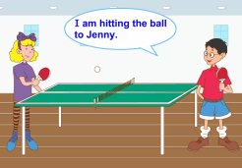
2. Playing ping-­pong
Li Ming: I am hitting the ball to Jenny.
Li Ming: Can you hit the ball to Jenny?
Danny: I think I can!
Danny: Ouch! I hit my hand!
Jenny: Li Ming hits the ball, but Danny hits his hand! Poor Danny!

Slide 15
知识点 6
hand /hænd/ n. 手 【四会】
例句：
What’s in your hand? 你的手里有什么？
head n. 头
形近词：
加法记忆法：
h＋ and(和)＝hand
歌谣记忆法记身体部位：
face脸蛋儿红又红，眼睛eyes亮晶晶，head脑袋大又灵，鼻子nose像山峰，mouth小嘴把歌唱，耳朵ears仔细听，feet双脚能行走，leg是腿跑得快，脚丫foot白又胖，arm胳膊真有劲，小手hand 洗衣裳。
魔法记忆：

Slide 16
I write with my left ________.
A. arms B. hand C. legs
典例
B

Slide 17
3. Let’s do it!
heavy
light
teaching
learning

Slide 18
2. Let’s do it!
this
that
easy
difficult

Slide 19
一、单项选择。
1. _____ you ready to play football?
A. Is B. Are C. Do
2. I am ready _____ the meeting.
A. to B. in C. for
B
C

Slide 20
二、用所给单词的正确形式填空。
1. I have two ___________ (basketball) .
2. The boy is ready __________(play) with the toy car.
basketballs
to play

Slide 21
三、反义词对对碰。
1. heavy A. difficult
2. far B. near
3. easy C. that
4. this D. these
5. those E. teach
6. learn F. light

Slide 22
本节课我们学习了以下知识，请同学们一定加强巩固，以便能和同学们进行灵活交流哦！
重点词汇：basketball, try, heavy, difficult, easy, hand
重点句式：Are you ready to learn to play basketball, Li Ming?

Slide 23
1 熟记本节课所学的句型、短语和单词，必须会听、说、读、写。
2 将Playing basketball的对话朗读流利。
3 完成配套的课后作业。

