Slide 1
The food festival is now open!
Unit 7 Topic 3
Section B
WWW.PPT818.COM

Slide 2
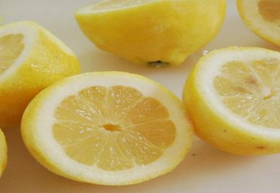
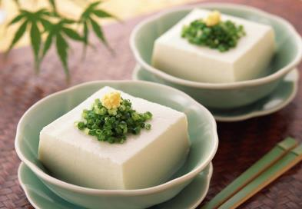
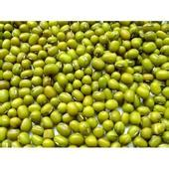
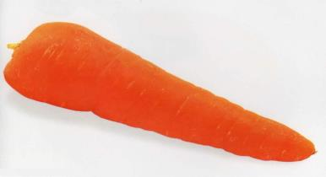
lemon
n.柠檬
tofu
n.豆腐
bean
n.豆
carrot
n.胡萝卜

Slide 3
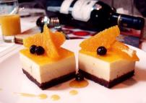
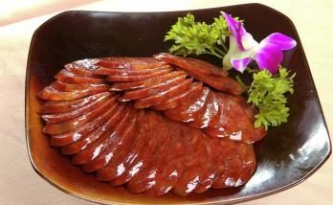
dessert
n.甜点，甜食
wine
n.酒
sausage n. 香肠

Slide 4
Main courses
beef curry
sausage
roast chicken
chicken curry
Italian pizza
fish curry
Beijing Roast Duck

Slide 5
Staples
meat pie
sushi
noodles
rice
fried rice
hamburger

Slide 6
Soups
bone soup
tofu soup
chicken soup
vegetable soup
tomato and egg soup

Slide 7
_______
cheese
pie
biscuit
cookie
ice cream
pancake
corn salad
fruit salad

Slide 8
_____
lemon tea
coffee
wine
beer
juice
tea
Coke
milk

Slide 9
Interview your partner about the food and drinks he or she likes. Then complete the word map.
1c
main course
soup
FOOD
desert
staple
drink

Slide 10
1b
Read the menu above. Then listen to 1a and complete the table.
International Food Festival Order
Name
Address
Order | soup |  | dessert
 | staple |  | drink
 | main course
Mr.Zhao
No.62 on Beisihuan Road
\
\
fried rice
a bottle of lemon tea
roast chicken

Slide 11
Key Points of 1a
1.Could I order a meal by phone?我可以通过电话订餐吗？
(1)order 定购，点（菜）
E.g:他点了一盘鱼。
He ordered a plate of fish.
(2)by+n./v.-ing （表示方法、手段）用；由
E.g:她靠卖花赚钱。She makes money by selling flowers.
2.That's all.就这些了。
3.We’ll send the food to you in thirty minutes.
三十分钟后，我们会把食物送到。
(1) send...to... 把......送到......
E.g:他昨天给我捎来一个消息。
He sent the message to me yesterday.
(2)in+ 一段时间，意为“......之后”，用于一般将来时，用How soon提问。
E.g:李先生什么时候回来？ 他三小时后回来。
—How soon will Mr.Li come back?
—He will come back in three hours.

Slide 12
Read 1a again ,then try to retell it.
You may retell the dialog like this:
Mr. Zhao knows that the students in Beijing International School are holding a food festival.But he is busy these days, so he can't come to the food festival.He ordered a meal by phone. He ordered fried rice, roast chicken and a bottle of lemon tea. And he told Kangkang that his office is at No.62 on Beisihuan Road. Kangkang's classmate will send the food in thirty minutes.

Slide 13
Place an order by following the examples with the words of foods in 1a.
2
Example:
A: Hello. Could I order a meal by phone?
B: Sure. What would you like?
A: I’d like…
B: OK. Where shall I send the meal?
A: My address is…
B: OK. We’ll send your meal in 20 minutes.
A: Bye.
Example:
A: Welcome to our restaurant! Please have a seat.
B: Thank you. May I have the menu, please?
A: OK. Here it is. May I take your order, sir / madam?
B: Sure. I’ll have…
n.座位，座处
have a seat 请坐

Slide 14
Project
Helen’s father plans to set up a restaurant.
Please make a menu for him.
Restaurant Menu
SOUPS
STAPLES
DESSERTS
…

Slide 15
3a
Read the pairs of words aloud,paying attention to the sounds of the underlined letters.Then listen and try to imitate.
so——saw older——order coal——call
soap——soup chose——choose coal——cool

Slide 16
Listen and read the conversation,paying attention to the intonation, pause and liaison.Then practice with your partner.
3b
A:Hello ! May I take your order,sir?
B:Certainly. I'd like fried rice,roast chicken and a bottle of lemon tea.
A:Anything else?
B:No more.Thank you.
You should use the rising tone when you list things before the "and" in the sentence.

Slide 17
Exercises in class
单项选择。
( ) 1. He often ______ photos ____ his friends by email.
A. buy;for B.send;to C.sent;to D.sends;to
( ) 2. Mr. Lee went to Beijing last Sunday. He will come back____
three days.
A. after B. in C. on D. when
( ) 3. The students are planning to hold a sports meet by themselves.
Let’s wish them ____.
A. succeed B. success C. successfully D. successful
( ) 4. The boss ____ a worker ____ a computer for him yesterday.
A. order; to order B. ordered; ordered
C. ordered; ordering D. ordered; to order
( ) 5. Now people can go shopping_______phone.
A. at B.in C.by D.for
D
B
B
D
C

Slide 18
Summary
We learn:
◆ Some new words and a phrase:
lemon,tofu,bean,carrot,wine,
sausage,dessert,seat,have a seat
We can:
1.Order and offer food and drinks:
Could I order a meal by phone?
What would you like?
That's all.
We’ll send the food to you in thirty minutes.
May I have the menu,please?
2.Make a menu in English.

Slide 19
Homework
1.Write a composition about the food festival.
2.Read 1a aloud,try to repeat.
3.Finish Section B in your workbook.
4.Preview Section C.

