Slide 1
Unit 2
Can you swim?
WWW.PPT818.COM

Slide 2
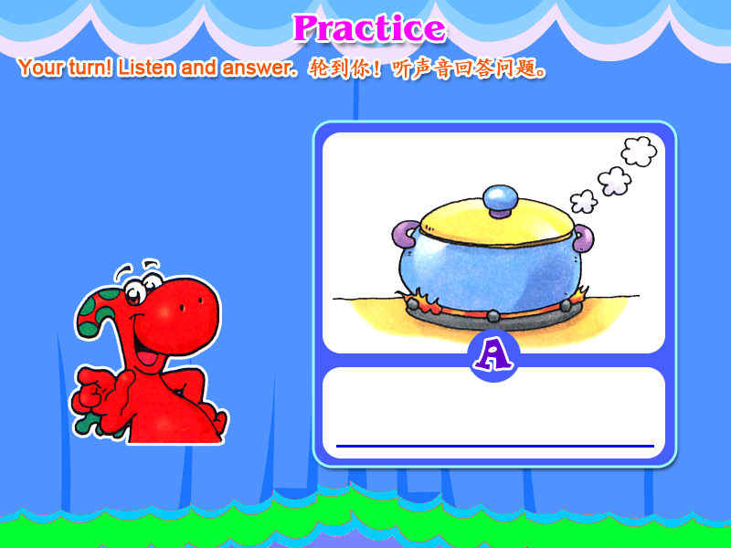
run

Slide 3
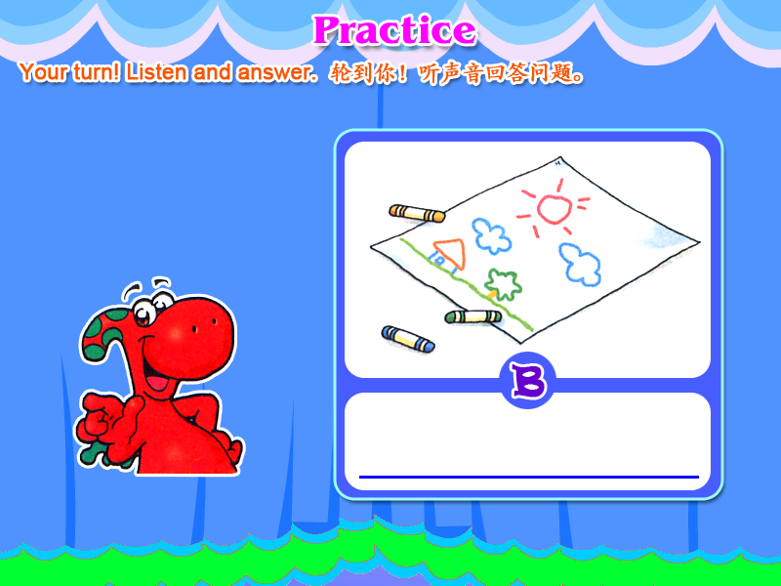
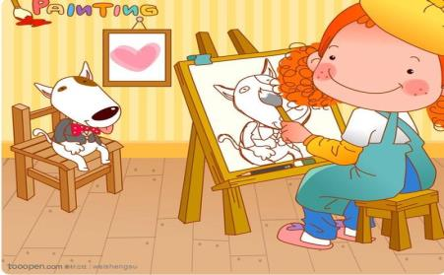
draw

Slide 4
write

Slide 5
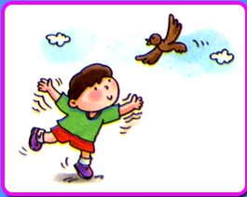
fly

Slide 6
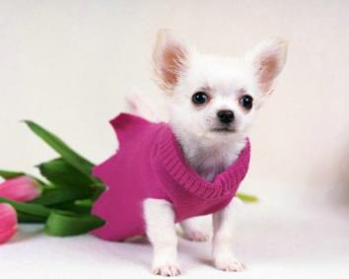
woof

Slide 7
welcome

Slide 8
jump

Slide 9
fast 快地;迅速地;
快的
but 但是

Slide 10
Supergirl can run fast.
Supergirl can swim.
can（能，会） 否定形式为
can’t=can not(不能，不会).
can can’t都是情态动词，后+动词原形。

Slide 11
Supergirl can fly.
Supergirl cannot draw.
cannot=can’t

Slide 12
Supergirl is great!
She can swim.

Slide 13
Can you swim,Alice?
Yes,I can.
can you …?你会… …？
是以情态动词can开头的一般疑问句，回答用Yes，I can.或No, I can’t。

Slide 14
Can you swim,Kitty?
No,I can't.

Slide 15
What can you do?
I can draw.
什么
会
你
做
What “什么”特殊疑问词

Slide 16
Hello!Woof!Woof!
What can you do，Supergirl?
I can swim and fly.

Slide 17
I can …
I cannot…
Can you …？
Yes, I can.
No,I can't.
fly
read
swim
sing
draw
write

Slide 18
Good evening.I'm Kitty.
Welcome to Super Show.
Here are our friends---Supergirl and Superdog.
welcome to +地点
“ 欢迎来到… …”

Slide 19
Can Superdog fly too?
Yes,he can,but he can't write his name.
Woof!
too放在句尾“也”的意思

Slide 20
Thank you,Supergirl and Superdog!
Thank you.
Thank you=Thanks 谢谢

Slide 21
homework
听：Unit2每天一次并跟读
读：所有学过的课文+单词+笔记每天一次
背：Unit2的课文+笔记
写：unit1.2单词三次并听写

Slide 22
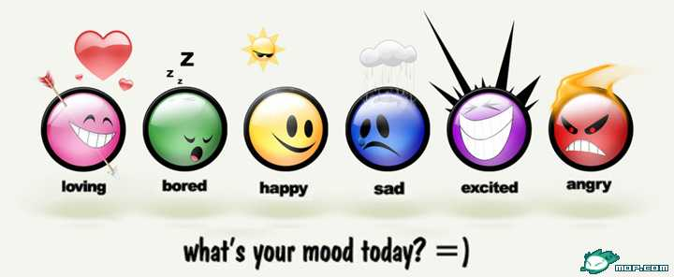
Bye-Bye!

