Slide 1
Unit 3 Where is my car?
WWW.PPT818.COM

Slide 2

My Little Cat
Cat,cat,my little cat
Where's my little cat?
On the bed,on the bed.
It is on the bed.

Slide 3
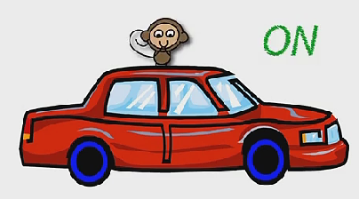
Where is the monkey？
Let’s go to play,OK?
Is it …?
Yes, it is.
No, it isn’t.

Slide 4
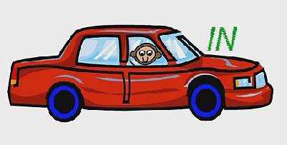
Where is the monkey？
Is it …?
Yes, it is.
No, it isn’t.

Slide 5
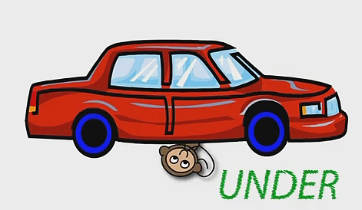
Where is the monkey？
Is it …?
Yes, it is.
No, it isn’t.

Slide 6

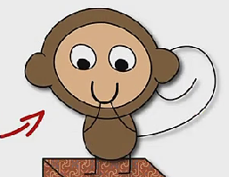
Where is the monkey？
Is it …?
Yes, it is.
No, it isn’t.
It’s near the car.

Slide 7
n
ear
The monkey is near the car.

Slide 8

behind
The monkey is behind the car.

Slide 9

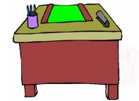

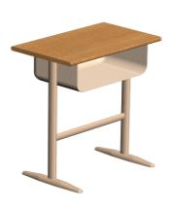
In, in, in the bag .
On, on, on the desk.
Under,under,under the bed.
Behind,behind,behind the desk.

Slide 10

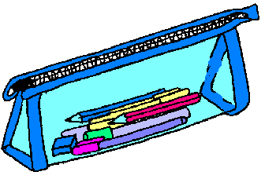


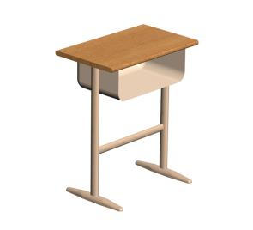


A:Where’s the … ？
B:It’s … the …
near
behind
under
on
in

Slide 11
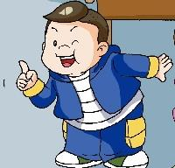


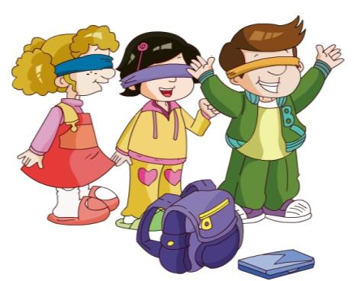
Where is my car?
Jiamin, Ben, Janet and Xiaoling are playing.
观看金太阳，并回答Where is Jiamin’s car?。

Slide 12
Where is my car?
Jiamin, Ben, Janet and Xiaoling are playing.
观看完金太阳，并呈现答案。
It’s on the table.

Slide 13
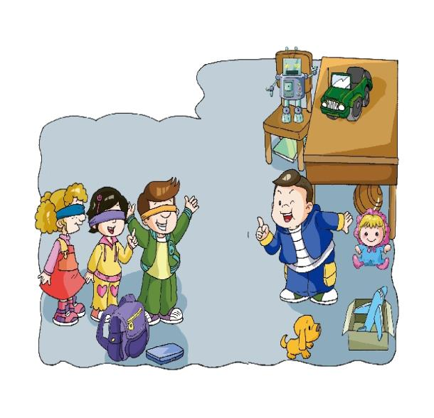



Let's talk.
play a game
Let’s__________. Where is my car?
Is it _________?
No, it isn’t.
Is it ____________?
No, it isn’t.
Is it ___________?
Yes, it is.
in the box
under the chair
on the table
通过图画，帮助学生复述课文句子。
Notes:
13

Slide 14

Let's spell.
Where's my car?
in
A: Is it _______the box?
B: _____, it isn’t.
A: Is it the chair?
B: No, it .
A: Is it the table?
B: Yes, it .
A: ______ you.
No
under
isn’t
on
is
Thank
填写所缺的单词，可以分组或同位的方式，边背课文边拼读单词。

Slide 15
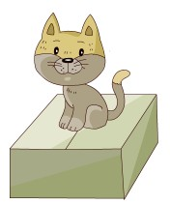
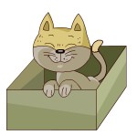
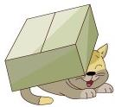
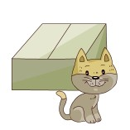
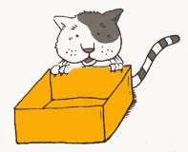
Where’s my cat?
It’s ...
用此图片将学生的注意力集中到Where's ...？这个句型。
in
under
on
near
behind

Slide 16
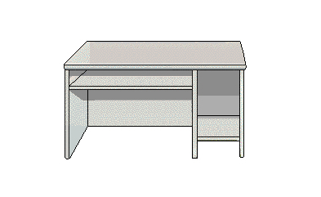






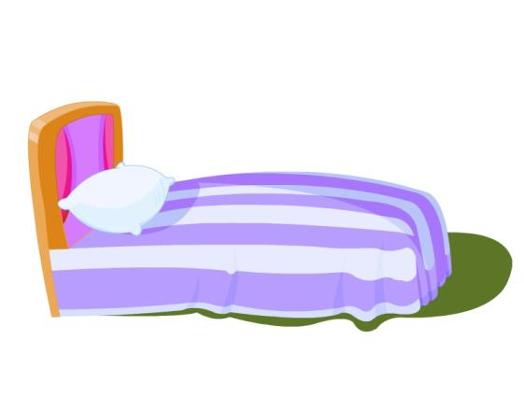




Where is the pencil?
Where is the ball?
Where is the book?
Where is the bag?
Where is the pencil-box?
Where is the ruler?
Where is the doll?
It’s near the box.

