Slide 1
Unit 5 Art world
Reading (Ⅰ)
WWW.PPT818.COM

Slide 2
Revision
令人愉快的事情
举行艺术节
音乐才能
不同的艺术形式
流行音乐之王
一幅令人惊叹的绘画
比金钱更重要的事情
something pleasant
have an art festival
musical talent
different art forms
the King of Pop
an amazing painting
something more
important than money

Slide 3
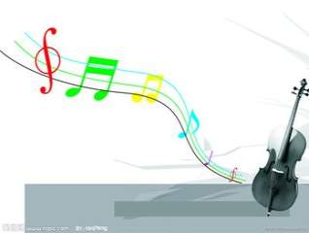
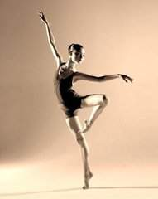
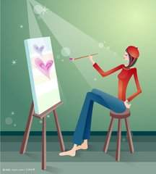
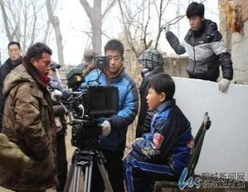
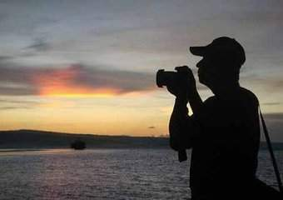
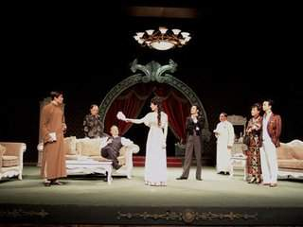
What art form do you like best? Why?

Slide 4
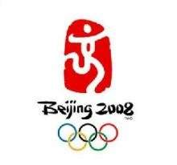
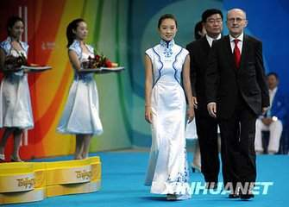
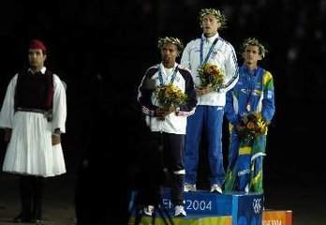
Have you heard of this piece of music?

Slide 5
Pre – reading
Task 1 :Go through the text quickly and answer some easy questions
1. Who is the article about?
2. What is he?
3. What is he famous for?
Tan Dun.
A composer.
Music.

Slide 6
Task 2: Read the article again and pick out Tan Dun’s music works as quickly as you can
Crouching Tiger, Hidden Dragon (Para. 3)
Music called Water (Para. 4)
Award music for the Beijing Olympics (Para. 1,5)

Slide 7
Page 68 B1
f
1. present (line 1) ______ a. a dividing line
2. composer (line 5) ______ b. not special
3. central ( line 6) _______ c. make something work
in the way you want
4. common ( line 11) ______ d. a person who writes
music
5. control (line 20) _______ e. in the centre of an area
6. boundary ( line 28) ________ f. give something to
someone especially at
an important event
d
e
b
c
a

Slide 8
While – reading
Task1: Listen to the tape and then match
Para.1
a. Role and achievements.
Para.2
b. Education.
Para.3
c. His music--without musical instruments.
Para.4
d. Special interest in music.
e. An introduction to Tan Dun.
Para.5-6

Slide 9
Task2: Read the second paragraph carefully and
answer three questions
What did Tan show interest in when he was very young?
Music.
2. Where does Tan Dun think the best music
come from?
He thinks the best music comes from nature.
3. What did Tan Dun make music with when he had no musical instruments?
He made music with common objects like
stones and paper.

Slide 10
Task3: Read the third paragraph carefully and say
something about his education
studied at the Central Conservatory
of Music in Beijing
Education
went on to study in the USA
Eastern and Western music
Won an Oscar
Crouching Tiger, Hidden Dragon
Eastern and Western music

Slide 11
Task4: Read the fourth and fifth paragraph carefully and do True or False questions
His piece of music Water uses many musical
instruments.
Tan makes over 50 sounds from water by
controlling the speed of water flow.
3.Tan has helped build a bridge between the
North and the South.
4. The music for the Beijing Olympics is in a
Chinese style.
does not use
T
West
East
Western

Slide 12
Task5: Help Sandy fill in the card according to
your memory
Tan Dun
Year of birth: (1)________
Place of birth: (2)____________________
Interest (s): (3)________
Job: (4)__________
Education: studied music at a university in (5) _________
went on to study in (6)_______
Best known for: winning an (7)______ for the music in a film
His music: uses (8) ______________________ a lot
builds a bridge (9)________________________
in 1958
in central Hunan, China
music
a composer
Beijing
the USA
Oscar
the sounds of nature
between the East and the West

Slide 13
Task6: Finish their conversation according to the text
Daniel: Tan Dun is one of the greatest___________ in the world.
Could you tell me more about him?
Sandy: Sure. He wrote the________ music for the Beijing 2008 Olympic Games.
Daniel: I know he loves the sounds of_________. Have they influenced his works?
Sandy: Yes. He uses them a lot in his music, and in one of his works, Water,
he doesn’t use any musical____________.
Daniel: Really? How does he make music, then?
Sandy: He makes over 50 sounds from water by__________ the speed of water______.
Daniel: That’s really amazing!
Sandy: Yes. When he was young, he used to make music with__________
objects like stones and paper.
Daniel: Wow! His music for the Beijing Olympics must be very special.
Sandy: Yes. It uses_________ Chinese music and an_________ Chinese bell, but it’s
in a_________ style.
composers
award
nature
instruments
controlling
flow
common
traditional
ancient
Western

Slide 14
Post- reading: Finish the summary of the text
Tan Dun, one of the world’s greatest _________, was
born in China in 1958. He has been _______ in music
since he was very young.
In 1978, Tan Dun entered the Central Conservatory
of Music in Beijing. Eight years later, he went on to
_____ in the USA.
Tan Dun uses a lot of sounds of _____ in his works. It is ______ that his piece of music Water doesn’t use any musical instruments. The sounds all come from nature and they create different _______ in different
minds. His music for the Beijing Olympics uses_______
Chinese music and the sounds of an ancient Chinese bell,
though it is in a ________ style.
Tan Dun’s music has successfully ______ Chinese and Western music together and helped build a ____
between the East and the West.
composers
interested
study
nature
amazing
pictures
traditional
Western
brought
bridge

Slide 15
Homework
1.Get more information about Tan Dun and his
works after class
2. Recite the new words and phrases
3. Read the text again and again until
you can retell

