Slide 1
七年级英语（JJ下）教学课件
Baseball Season
WWW.PPT818.COM

Slide 2
Learning targets
➢Key words & phrases:
baseball, snack, pop, if, ever, root, shame,
play against, take … out, get back
➢Key sentences:
1. On weekends，we will often play against other teams.
2. My family and friends will come and watch me play.
3. If they don't win, it's a shame.

Slide 3
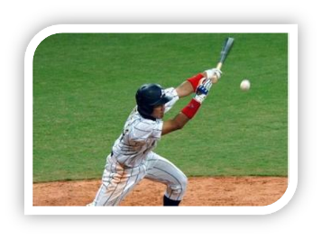
Lead in
Free Talk
Do you know baseball?
Can you tell something about it?
A baseball is a ball used in the sport of the
same name, baseball.
About baseball

Slide 4
Baseball is a bat-and-ball game played between two opposing teams who take turns batting (击球) and fielding (投球) . The game proceeds when a player on the fielding team(防守队) , called the pitcher, throws a ball which a player on the batting team (进攻队) tries to hit with a bat. The objectives of the batting team are to hit the ball into the field of play, and to run the bases — having its runners advance counter-clockwise around four bases to score what are called "runs".

Slide 5
A run is scored when a runner legally advances around the bases in order and touches home plate (the place where the player started as a batter). The team that scores the most runs by the end of the game is the winner.
Baseball evolved from(由……演变而来) older bat-and-ball games already being played in England by the mid-18th century. This game was brought by immigrants to North America.

Slide 6
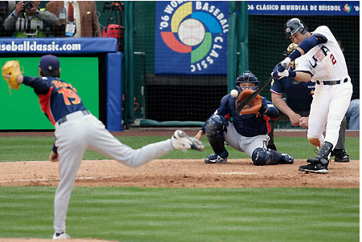
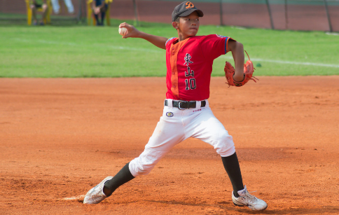
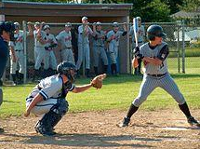
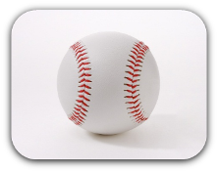
Some pictures about baseball.

Slide 7
Words and expressions
baseball n. 棒球
snack n.点心；小吃
pop n. 汽水
If conj.如果；假若
ever adv.曾经；究竟；到底
root n.& v. 加油
shame n. 羞愧；惭愧

Slide 8
1.与…比赛__________ 2.带……出去_________
3为…加油，为…打气 ____________ 4回来__________
5.打棒球___________ 6.效力于… _____________
7. …的名字__________ 8.最喜欢的运动_____
9. 在周末___________ 10.零食和汽水_________
11.一些热狗
12. 许多 13.很遗憾__________
14.主队___________ 15.棒球迷 _________
16.一项有趣的运动 ___________
17.一个关于棒球的流行的歌曲
______________________________
play against
take … out
root for…
get back
play baseball
play for…
the name of…
favourite sport
On weekends
snacks and pop
some hot dogs
a lots of
It ‘s a shame
the home team
baseball fan
a fun sport
a popular song about baseball

Slide 9
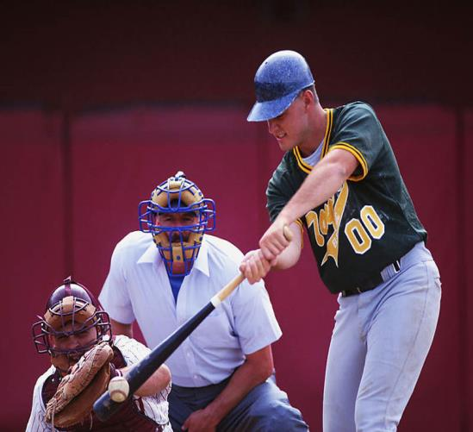
baseball

Slide 10
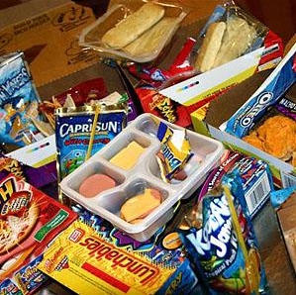
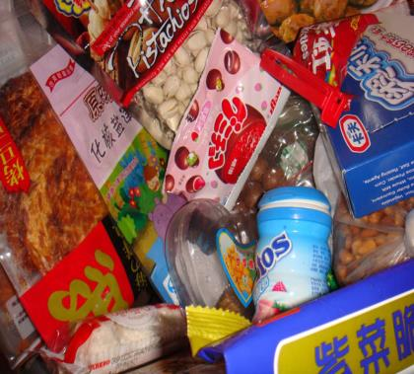
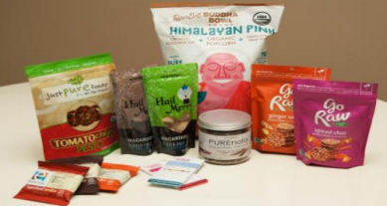
snack

Slide 11
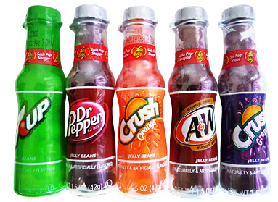
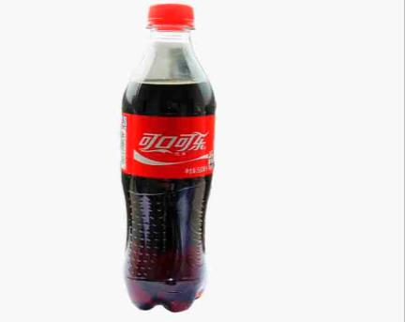
pop

Slide 12
Presentation
Read the lesson and complete the task.
Hello！My name is Greg.This summer I am going to play baseball for the Tigers. “Tigers” is the name of my team. Baseball is my favourite sport. My team and I will usually practice in the morning. And some evenings，we will play just for fun. On weekends，we will often play against other teams.

Slide 13
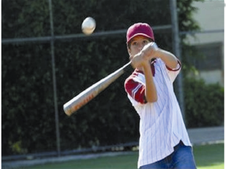
My family and friends will come and watch me play. They'll all sing “Take Me Out to the Ball Game” and they'll buy snacks and pop at the game. Baseball is a fun sport for everyone. I love baseball season!

Slide 14
I can sing!
Take me out to the ball game. 带我去看棒球赛。
Take me out to the fair！带我去集市！
Buy me some hot dogs and lots of snacks. 给我买一些
热狗和许多零食。
I don't care if I ever get back，我不在乎我是否回来，
For it's root toot toot for the home team. 因为这是给主
场队的打气声。
If they don't win，it's a shame，如果他们没有赢，
这是一种耻辱，
For it's one，two，three and you're out，一振，二振，
你们三振出局
At the old ball game！在这熟悉的球赛里！

Slide 15
Listen and write true (T) or false (F).
( ) 1. Greg’s favourite sport is football.
( ) 2. On weekends, they will often play against
other teams.
( ) 3. Greg’s family will often watch him play
baseball.
F
T
T

Slide 16
Culture Tip
Baseball is the national sport of the US. It became very popular there in the 1840's. “Take Me Out to the Ball Game” is a popular song about baseball. Almost every baseball fan can sing this song. Jack Norworth wrote the words in 1908. But he never went to a baseball game before he wrote the song.

Slide 17
Let’s Do It!
1. Read the lesson and answer the questions.
1. What is Greg going to do this summer?
He is going to play baseball for the Tigers
this summer.
2. What’s the “Tigers”?
“Tigers” is the name of my team.
3. What’s Greg’s favourite sport?
Baseball is his favourite sport.

Slide 18
4. When will Greg’s team practice and when will they
play against other teams?
His team will usually practice in the morning.
On weekends, they will often play against
other teams.
5. Who will come and watch Greg play?
His family and friends will come and watch him play.

Slide 19
2. Listen to the chant and fill in the blanks.
Will you come to my _______ game?
Will you come and watch me ______?
I’m playing for the Tigers.
I’m going to practice every day.
Will you come to my baseball game?
Will you sing songs and buy a snack?
Look for my team on the baseball _______.
Our uniforms are ______ and black.
ball
play
field
orange

Slide 20
3. Fill in the blanks using “will” or “be going
to”.
They ______________ have a party on Tuesday.
She ______________ watch a movie this weekend.
I can’t talk now. I ______________ call you later.
We ______________ be on the same team this year.
What ______________ you do this summer?
will/ are going to
will/ is going to
will
will/ are going to
are going to

Slide 21
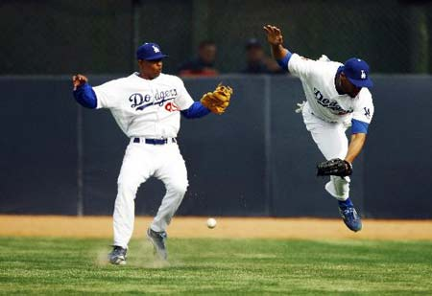
4. Baseball is a big part of American culture.
Many common sayings come from baseball.
What do the following sayings mean？Match
the sayings with their meanings.

Slide 22
play ball
合作
one step at a time
一步一个脚印
do business or work together with someone
和某人一起做生意或工作
drop the ball
犯错；失职
home run
本垒打
make a mistake or do something wrong
犯错误或做错了某事
play softball
打垒球
ask easy questions
问容易的问题
one base at a time
一次一垒
do something very well，to be a winner某事做得很好，是获胜者

Slide 23
Language points
1. On weekends，we will often play against other teams.
play against... 意思是“与……打对抗赛”。其中，
against作介词，意为“违反；反对；靠着”。
例：What team did you play against in the final
match？在决赛当中你们队和哪个队进行比赛？
We're playing against that team next week.
下周我们要和那个队打比赛。

Slide 24
中考链接
When you play sport，you need to guard ________ accidents. (辽宁沈阳中考)
A．over B．against C．with D．at
解析 句意：当你做运动的时候，你需要防护以免
发生事故。guard against 警戒，避免，提防。
解题方法 句意分析法、语法判定法

Slide 25
2. My family and friends will come and watch me play.
watch 作及物动词时，意为“观看；注视，注意”。
常用搭配：watch sb. do sth. 意为“观看某人做某事”，强调看见整个过程。例：He often watches her daughter dance. 他经常看他女儿跳舞。
【拓展】watch sb. doing sth. 意为“看见某人正在做某事”，强调看见某个动作正在进行。
例：I watched a girl dancing in the park. 我看到一个女孩正在公园里跳舞。

Slide 26
【辨析】watch、look、与 see
① watch “观看，注视”。指较长时间集中注意力去看电视或比赛等，后面可以直接加宾语。
② Look 表示主动地，有意识的看，侧重看的动作，常用作不及物动词，接宾语时，其前加 at。
③see 通常指看的结果，意思为“看见，看到” 。也用于“看电影” see a film 。
例：The man _________ his daughter with love.
Bob __________ football game on TV.
He_________ around but _____noting.
watches
watches
looked
saw

Slide 27
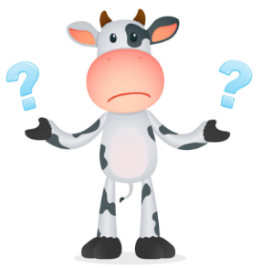
学以致用
①我看见他在操场打篮球了。
I watch him _________ basketball on
the playground.
②—What were you doing in the garden?
—I watched my father _________ his old
motorbike.
A. repair B. repairing
C. repaired D. to repair
play

Slide 28
3. If they don't win, it's a shame.
(1) if 意为“如果”引导条件状语从句。主句用一般
将来时，从句用一般现在时。例：I will call you if he comes back. 如果他回来我会给你打电话的。
if | 词义 | 用途 | 结构用法
 | 如果 | 引导条件状语从句 | 主句使用一般将来时,从句常用一般现在时
 | 是否 | 引导宾语从句(=whether) | 主句是一般现在时,从句根据具体情况使用相应时态;主句是一般过去时,从句使用相对应的过去时态

Slide 29
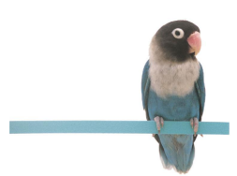
中考链接
1. —Can students go online during lessons?
—They can __________ it is for that lesson.(2018江西)
A. if B.or C. or D. but
2. We'll stay at home________ it rains tomorrow.
(天津)
A．and B．if C．but D．so

Slide 30
4. It became very popular there in the 1840's.
in the 1840's 意为“在19世纪40年代”。当表示
“在……世纪或……年代”时，用“in the＋年份's/
年份s” 结构。
例：This kind of mobile phone was created in the
1990's/1990s.
这款手机制造于20世纪90年代。
The man was born in the 1950s.
这位男士生于20世纪50年代。

Slide 31
一、根据首字母或汉语提示填空。
Exercises
My favourite sport is _________(棒球).
2. Do you like to eat ________ (小吃) at home?
3. I won’t go to the park ________(如果) it rains.
4. It’s a great _______ (羞愧) for me not to win the game.
5. Have you _______ (曾经) read this storybook?
baseball
snacks
if
shame
ever

Slide 32
二、单项选择。
1. Job played basketball ______ the Tigers last year.
A. on B. for C. with D. of
2. My uncle will come to see me if he _____ free
this Sunday.
A. be B. will be C. is D. was
3. I don't think that they will fail. But it's OK if you
______ with me.
A. disagree B. disagrees C. not disagree

Slide 33
4. The old man often watches the children ________ in
the park.
A. play B. playing C. to play D. plays
5. Everyone in our class _______ our English teacher.
A. like B. likes C. liking D. to like
6. When you play basketball，you should guard
________ unnecessary hurt.
A. over B. against C. with D．at

Slide 34
Summary
1. We learnt some new words and phrases:
baseball, snack, pop, if, ever, root, shame,
play against, take… out, root for…, get back
2. Sentences：
(1) ARG takes care of pets without a home.
(2) Sometimes，people move away and they can't
take their pets with them.
(3) His family left him alone in a field.

Slide 35
Homework
1.Review and recite the important
points of Lesson 45.
2. Try to find out more information about Baseball and then talk with your partners.

