Slide 1
Unit7 What did you do yesterday?
WWW.PPT818.COM

Slide 2
What day was yesteray?

Slide 3
1/16/2023

Slide 4
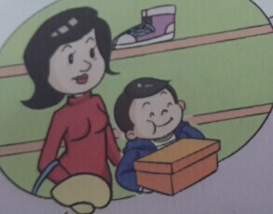
Guessing game!
What did Jiamin do?
He went shopping with his mother.

Slide 5
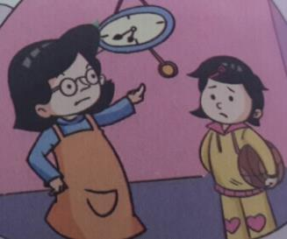
What did Xiaoling do?
He played basketball at the park.

Slide 6
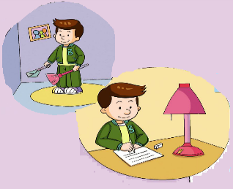
What did Ben do?
He stayed at home all day.

Slide 7
Teaching aims：
1. 能理解并学习动词词组的过去式；
2. 能准确、流利地朗读课文；
3. 能就过去发生的事情进行简单的问答。

Slide 8
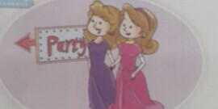
have a party with my friends

Slide 9
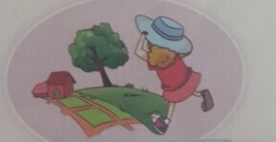
go to the country

Slide 10
read a story book

Slide 11
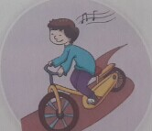
ride my bike

Slide 12
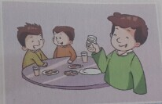
eat at a restaurant

Slide 13
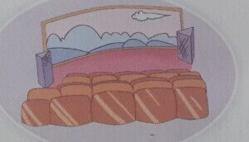
see a film

Slide 14
Bingo

Slide 15
Homework
1. 听读课文20分钟。
2. 抄写生词并背诵家听。
1/16/2023

