Slide 1
Unit 3
Asking the way
第一课时
WWW.PPT818.COM

Slide 2
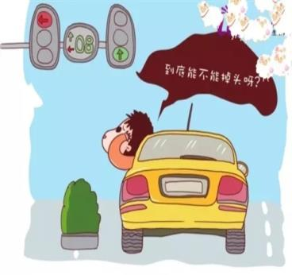
Introduce
-- How do I get to the supermarket?
-- Go along Mango Street.
Turn left at the first traffic light.
Then go along Apple Street.

Slide 3
Words
find [faɪnd]
作动词，意为“找到”。
eg：Linda can’t find his new dress. 杨玲找不到她得新裙子。
小练习：汉译英：找到我的家
find my home
拓展：look for强调寻找的过程，
find则是强调寻找的结果。
eg：I am looking for my little dog, but I can not find it.
我正在寻找我的小狗，但是我找不到它。

Slide 4
Words
turn [tɜ:n]
作动词，意为转动。
eg：turn left 向左转
小练习：汉译英：向右转。
Turn right.
拓展：（1）turn to sb./ sth.意为“转向某人或某物”。
（2）turn作动词，意为“变成”。
（3）turn作名词，意为“机会”。

Slide 5
Words
right [raɪt]
作形容词，意为“正确的。”
eg：Turn right. 向右转。
拓展：right的另一层意思：正确的。
例如：You’re right. 你是正确的。
当right的意思为:正确 right的反义词:wrong.
当right的意思为:右边 right的反义词:left.

Slide 6
Words
see [si:]
作动词，意为：“看到，看见”，表结果。
eg：I see some boys in the playground. 我看到一些男孩在操场上。
B
小练习：He is looking outside ,but he can’t_____ anything.
A. look B.see
拓展： look指集中注意力地看，是有意的，强调“看”的动作，要和at连用。
watch强调“专注地看”，有欣赏的意味，常用于看电视、看球赛等。
read指“看”时实指“阅读”，常用于看书、看报等。

Slide 7
Expressions
Yang Ling comes out from City Library Station. 杨玲从城市图书馆站台走出来。
come out为固定短语，意为出来。come out from...意为“从...出来”。
eg:Come out from the plane. 从飞机里出来。
小练习：汉译英：从火车里出来
come out from the train

Slide 8
Expressions
She asks a policeman for help. 她请求一位警察帮忙。
ask sb. for help 为固定短语，意为“向某人寻求帮助 ”。
for
小练习：选择合适的介词填空：I ask my mum____(for, on)help.
拓展：（1）ask sb about sth.问某人关于某事
例如：ask him about his health 询问他的健康状况。
（2）ask sb. to do sth. 要求某人做某事。
例如：My mun asks me to finish my homework first.
我的妈妈要求我先完成我的作业

Slide 9
Expressions
Go along this street.沿着这条街道走
go along为固定词组，意为“沿着...”。
eg：Go along this way 沿着这条路走。
小练习：选择合适的介词填空：
Go _____(along , to) this street.
along
拓展：walk along...意为“沿着...走”
run along...意为“沿着... 跑”

Slide 10
Expressions
Turn right at the traffic lights. 在红绿灯处右拐
注意介词at的用法。at 可以表示“在...”
小练习：汉译英：在第三个十字路口
at the third crossing
拓展：(1)to ：可以跟在很多词组后面或者动词后面，表示“到...”。
(2)for ：一般表示“为了”, 还可以表示直接的原因。
(3)of ：是指“...的”,翻译时有的时候也可以省略.
(4)in ：的意思是在“在...中，在...里”一般是指在某个空间里。

Slide 11
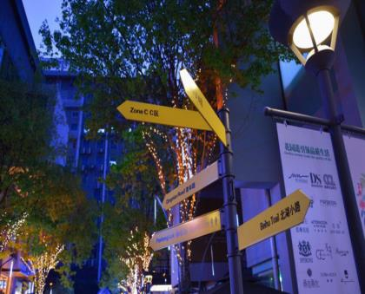
Dialogue
Yang Ling comes out from City Library Station.
杨玲从城市图书馆站台走出来。
She is on Sun Street.
她在阳光街道。
She cannot find the bookshop.
她找不到书店。
She asks a policeman for help.
她请求一位警察帮忙。

Slide 12
Dialogue
Yang Ling: Excuse me, how do I get to the bookshop on Moon Street?
杨玲：打扰一下，我怎样才能到达月亮街道的书店？
Policeman: Go along this street. Turn right at the traffic lights. Then, go along Moon Street. You can see the bookshop on your right.
警察：沿着这条街走，在红绿灯边右拐。然后，沿着月亮街走，你能够看到书店在你的右侧。
Yang Ling:Thank you.
杨玲：谢谢。

Slide 13
Expand
国外巧问路
在国外，人生地不熟，免不了要问路，问路并非一件难事，有的时候通过问路还能让你体会不同国家的不同文化，不同种族的不同性格。 在英语国家问路要比在非英语国家方便一些，只是英语国家的人讲英语语速比较快，所以对英语的要求比较高一些。听不懂的时候千万不要不好意思，干脆就要求对方讲慢一点。其实在国外问路也不要过分担心，只要你问路的时候抓住最主要的地名，哪怕是问路时仅仅使用中文对方也能猜到你的意思。

Slide 14
Summary
find
turn
right
see
She asks a policeman for help.

Slide 15
Exercise
1.出来____________2.从图书馆车站出来________________________
3.在太阳街道_________________4.找不到书店_____________________
5.寻求帮助___________________6.到达图书馆___________________
7.沿着这条街道走___________________8.左转____________________
come out
come out from Library Station
on Sun Street
cannot find the library
ask for help
get to the library
go along this street
turn left

Slide 16
Exercise
Once there lived a wolf in the forest. Everyday he went up to look for food. There were many sheep and deer in the forest. They were all afraid of him.
One day the wolf saw a group of sheep. He tried to catch them to eat. The father sheep and mother sheep stood together to fight him. So the wolf could do nothing.
Later the sheep had a quarrel. They went away each. When the wolf saw this, he was happy.
He caught them to eat one by one. At last he ate all the sheep.

Slide 17
Exercise
（ ）1. The wolf looked for food everyday.
（ ）2. The elephants were afraid of the wolf.
（ ）3. All the sheep fought with the wolf.
（ ）4. The wolf was sad when the sheep had a quarrel.
（ ）5. The moral is that unity is strength.
T
F
F
F
T

Slide 18
Homework
Make up a conversation about locations.

