Slide 1
Unit 9
Have you ever been to a museum?
R 八年级下册
第3课时
WWW.PPT818.COM

Slide 2
Review
照相机；摄像机；摄影机 （n.） _________________
难以置信的；不真实的 (adj.) _________________
进步；进展 (v.&n.) _________________
迅速的；快速的 (adj.) _________________
特别的；不寻常的 (adj.) _________________
坐便器；厕所 （n.） _________________
camera
unbelievable
progress
rapid
unusual
toilet

Slide 3
鼓励 （v.） _________________
社会的 (adj.) _________________
和平的；安宁的 (adj.) _________________
完美的；完全的 (adj.) _________________
它自己的 (pron.) _________________
收集；采集 (v.) _________________
省份 (n.) _________________
encourage
social
peaceful
perfect
itself
collect
province

Slide 4
游乐场 ________________ 导致 _________________
搭起 ________________ 考虑 _________________
沏茶 ________________ 茶艺 _________________
茶具 ________________ 兜风 _________________
两个；一对；几个 ________________
amusement park
lead to
put up
think about
make tea
tea art
tea set
take a ride
a couple of

Slide 5
1.你曾去过科学博物馆吗？
______ you ______ ______ _____a science museum?
2.我去过游乐园两次。
I _____ _____ ______ the amusement park _____.
3.它真的很有趣，不是吗？
______ really interesting, ________?
Have ever been to
have been to twice
It’s isn’t it

Slide 6
3.— 我从来没有去过水上公园。
I _____ ______ ______ _____ a water park.
— 我也没去过。
_____ _______.
4.茶艺表演展示了如何用漂亮的茶具沏出一杯完美的茶。
_____ ______ performances show ____ ___ _____ a
perfect cup of tea with beautiful tea sets.
have never been to
Me neither
Tea art how to make

Slide 7
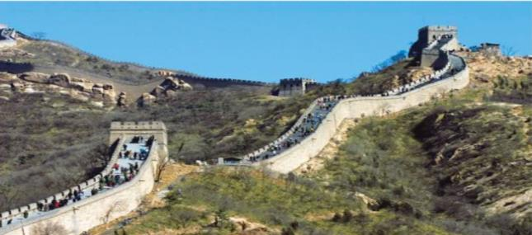
1a
Match the pictures with the names.
a
the Great Wall

Slide 8
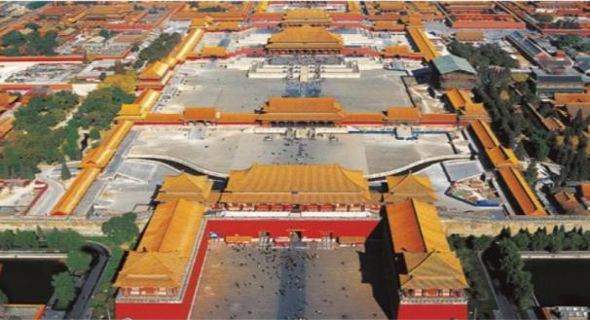
b
the Palace Museum

Slide 9
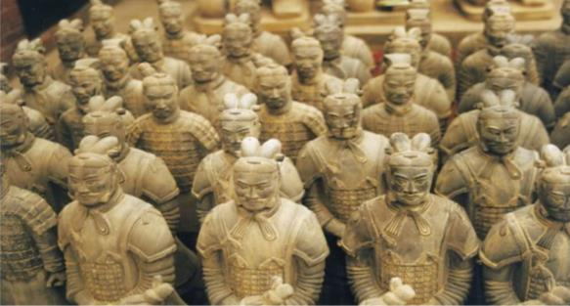
c
the Terracotta Army

Slide 10
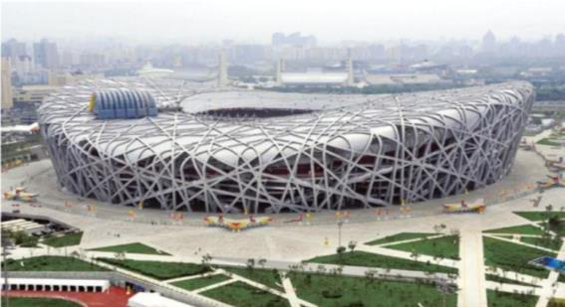
d
the Bird’s Nest

Slide 11
Listen to a student interviewing a foreign
student. Check (√) the questions you hear.
1b
____ Have you visited the Palace Museum?
____ Have you been to the Great Wall?
____ Have you been to the Bird’s Nest?
____ Have you seen the Terracotta Army?
____ Have you tried Chinese food?
√
√
√

Slide 12
1c
Listen again and take notes.
Name: ________________________________________
Country: ______________________________________
How long in China: _____________________________
Places visited: __________________________________
______________________________________________
Food: _________________________________________
Peter
Australia
two weeks
the Palace Museum, the Great Wall, the Bird’s Nest, the Terracotta Army
Beijing Duck

Slide 13
1d
What places have you been to? Ask your partner.
Have you visited ...?
Have you been to...?
Have you seen ....?
Have you tried ...?

Slide 14
Exercise
1. — Where _____ you _____ (be)?
— I __________ (be) to the library.
2. — How many times _____ you ____ (be) to Beijing?
— Twice.
3. Daniel _____ never _____ (be) to Australia.
He wants to go there with Mike.
have
been
have been
have
been
has
been

Slide 15
4. —I’ve bought a new MP4.
—Where _____ you _____ it? (buy)
—In a shopping mall near here.
5. —Where is your mother?
—She _________(go) to Shanghai with Uncle Li.
She ___________ (come) back in three days.
did buy
has gone
will come

Slide 16
6. We ______________(finish, not) our homework yet.
Will you wait a minute?
7. John _____________ (come, not) yet. He will be back in a minute.
8. Fast food ______ (it) isn’t always bad for you, but too much of it is not good.
haven’t finished
hasn’t come
itself

Slide 17
9. Jessica’s parents always encourage her ___out her
opinions.
A. speak B. speaking C. to speak D. will speak
10. — He hasn’t watched the movie So Young, has he?
— _____. He told me it was very moving and
interesting; he’d like to watch it again.
A. Yes, he has B. No, he hasn’t
C. Yes, he hasn’t D. No, he has
C
A

Slide 18
11. The First Huaguoshan International Golf Open was______ success that we enjoyed ourselves very
much.
A. such a great B. a such great
C. so a great D. a so great
B

