Slide 1
Module 1 Getting to know you
Unit 2
2
My summer holiday
WWW.PPT818.COM

Slide 2
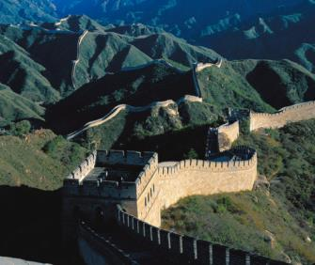
The Great Wall is very long.
It is over 12,000 li.
It is about 2,000 years old.
One who fails to reach the Great Wall is not a true man.
the Great Wall

Slide 3
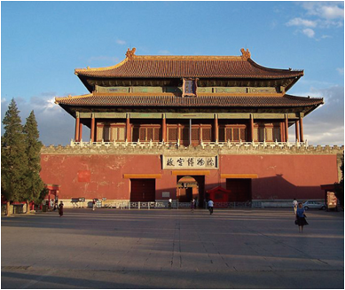
The Palace Museum is the head of the world’s top five palaces. It took 14 years to build. It is very big. It measures 961 metres from north to south and 753 metres from east to west. It has four gates and three famous halls. It is the home of many treasures.
the Palace Museum

Slide 4
Tian’anmen Square is one of the largest city squares in the world. It is in the centre of Beijing. People from all over China visit Tian’anmen Square to see the flag-raising ceremony early in the morning. It is the front door of the Palace Museum. West of the square is the Great Hall of the People. It is a place for meetings.
Tian’anmen Square

Slide 5
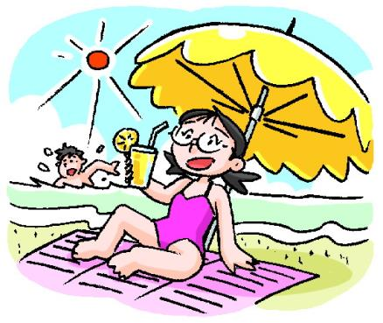
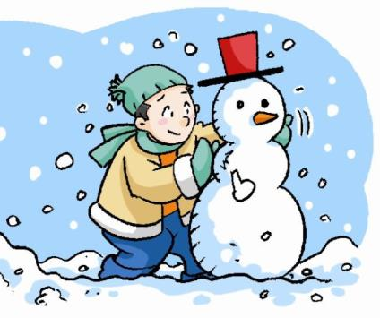
Which one do you like
你喜欢哪一个？
summer holiday
暑假
winter holiday
寒假

Slide 6
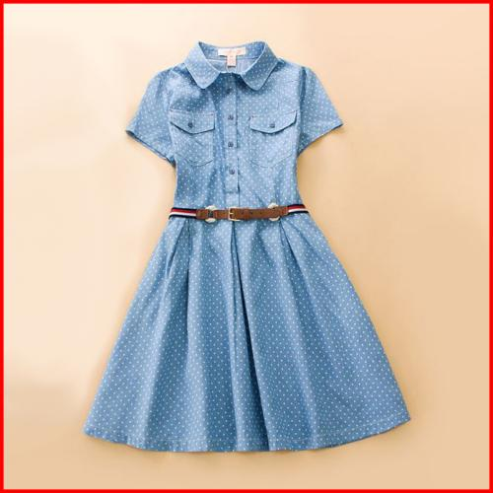
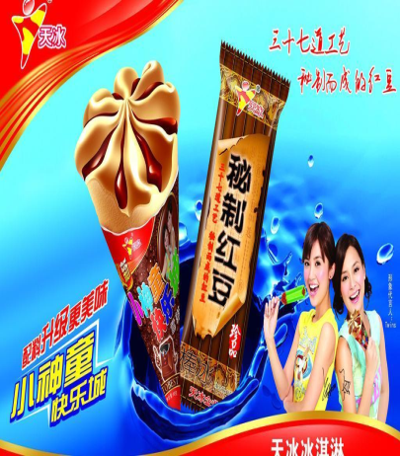
I like summer holiday.
beautiful dress
ice-cream

Slide 7
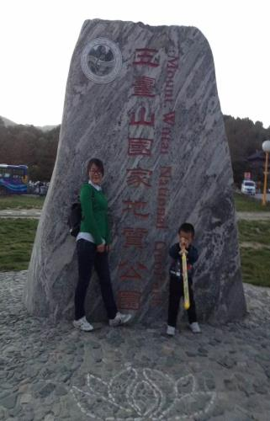
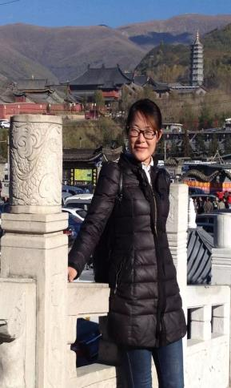
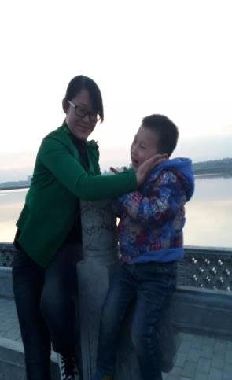
My summer holiday
go to
I went to
Wutai Mountain.
It was
Wonderful.
Beijing.
not good.

Slide 8
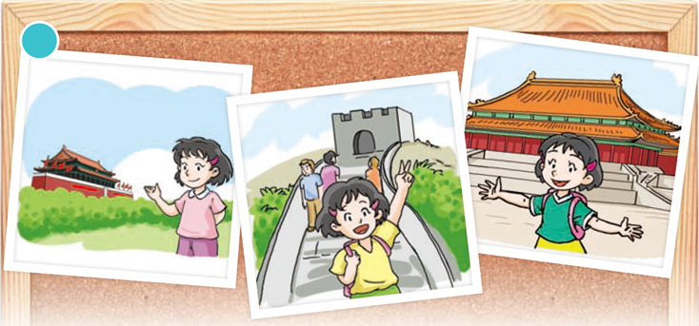
--- How was your holiday?
--- It was wonderful. I went to the Great Wall,
the Palace Museum and Tian’anmen Square.

Slide 9
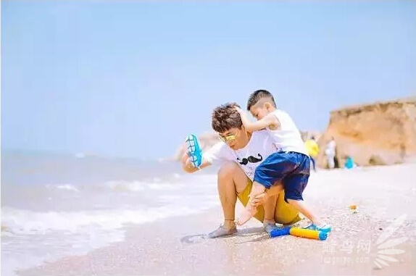
In your summer holiday,
enjoy yourselves!

Slide 10
这节课，你学到什么？

