Slide 1
Unit 6 Topic 2
Who is your favorite character in literature?
Section A
WWW.PPT818.COM

Slide 2
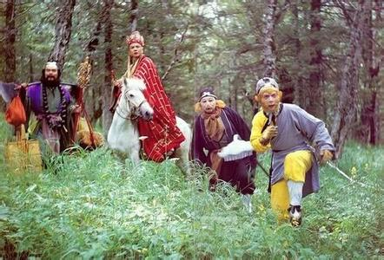
Do you know the name of the following TV play?

Slide 3
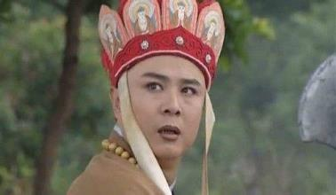
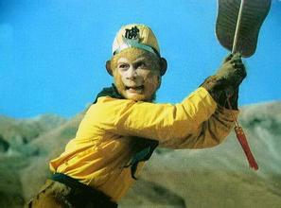
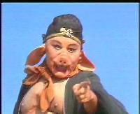
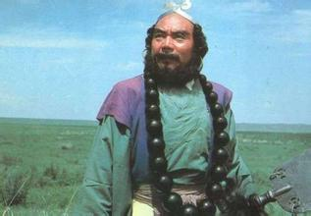
Do you know the name of the following TV play? Who is your favorite character in it？Describe him with some key words.

Slide 4
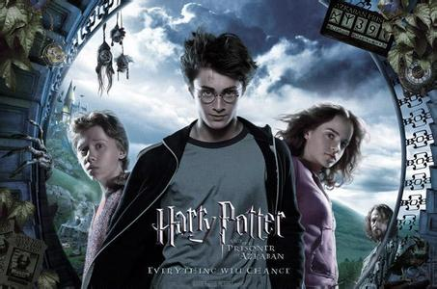
Do you know the name of the following movie?

Slide 5
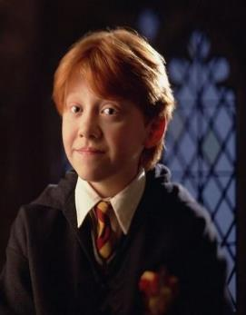
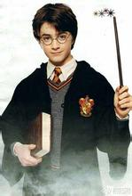
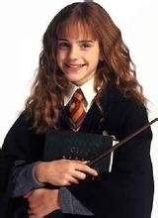
Do you know the name of the above movie? Who is your favorite character in it？Describe him/her with some key words.

Slide 6
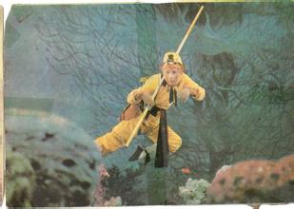
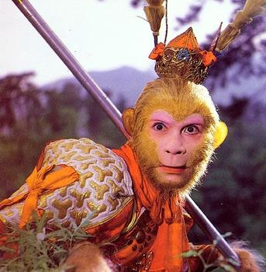
the Monkey King battle friends
enemies brave

Slide 7
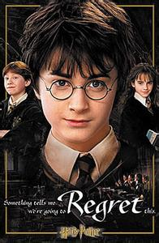
Harry Potter hero clever
funny discovered

Slide 8
1b Listen to 1a and fill in the blanks with the given words.
the Monkey King battle friends enemies brave
Harry Potter hero clever funny discovered
1. Kangkang’s favorite character in literature is _____________ because he is _____ and _____. Michael’s favorite character in literature is __________ because he is very _____.
2. In the novel, Journey to the West, it was Sandy and Pigsy who helped the Monkey King to win every______. In the story of Harry Potter, his friends read many books and ________ the best way to help him to defeat their _______. Therefore, neither the Monkey King nor Harry Potter would become a ____ without the help of their______.
the Monkey King
funny
clever
Harry Potter
brave
battle
discovered
enemies
hero
friends

Slide 9
Key points
1. literature n. 文学；文学作品
2. in one’s view 在某人看来
3. He is a hero in one of the four classic novels of Chinese literature.
他是中国古典文学四大名著之一中一位主人公。

Slide 10
Key points
4. In fact, it was Sandy and Pigsy who helped the Monkey King win every battle.
实际上，是沙僧和猪八戒帮助孙悟空赢得了每次战斗。
5. In my view, neither the Monkey King nor Harry Potter would become a hero without the help of their friends.
在我看来，没有朋友的帮助，孙悟空和哈利波特都不能成为英雄。

Slide 11
Discuss in groups and try to recite the two characters.
the Monkey King battle friends enemies brave Harry Potter hero clever funny discovered

Slide 12
Pair work
2. Can you describe your favorite character in literature? Try to tell your partner.

Slide 13
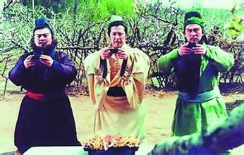
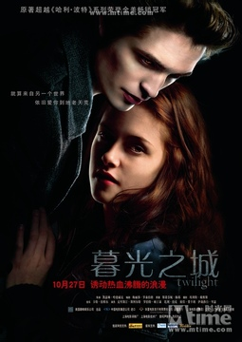
My favorite character:_______________________
Key words about him/ her: ___________________

Slide 14
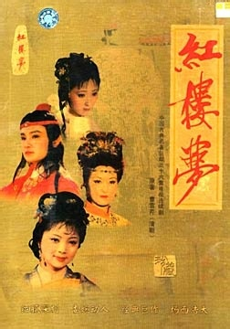
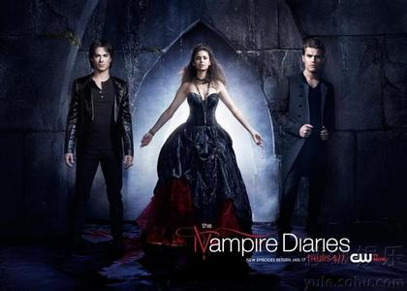
My favorite character:_______________________
Key words about him/ her: ___________________

Slide 15
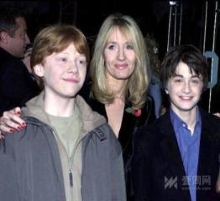
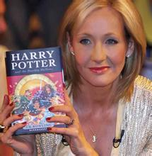
Who is the writer of Harry Potter?
Its writer is J.K. Rowling.
2. Where is he/ she from?
She is from England.
3. When did he/she finish his/her first
story, Rabbit?
At the age of six, she finished her first story, Rabbit.

Slide 16
3b. Listen again and choose the correct answers.
( )1. J. K. Rowling wanted to be a writer_________.
A. when she was six years old
B. when she was young
C. when she began to write
( )2. Her first novel is _________.
A. Rabbit B. Harry Potter C. not mentioned
( )3. When did J. K. Rowling get the idea of writing Harry Potter?
A. When she met a boy on a train.
B. When she read a novel full of interesting characters.
C. When she decided to overcome all her difficulties and
became a famous writer.
B
A
A

Slide 17
( )4. How was her marriage?
A. Happy. B. Unhappy. C. Not mentioned.
( )5. Which of the following statements about J.K.Rowling is
not true?
A. She kept on writing even when she was in bad condition.
B. She is much richer now and well-known throughout the
world.
C. She has forgotten her past and seldom helps others.
B
C

Slide 18
Try to introduce J. K. Rowling with five English sentences.

Slide 19
1. literature n. 文学；文学作品
2. in one’s view 在某人看来
eg. In my view, he is a hero in one of the four classic novels of
Chinese literature.
他是中国古典文学四大名著之一中的一位主人公。
3. In fact, it was Sandy and Pigsy who helped the Monkey King win every battle.
实际上，是沙僧和猪八戒帮助孙悟空赢得了每次战斗。
4. In my view, neither the Monkey King nor Harry Potter would become a hero without the help of their friends.
在我看来，没有朋友的帮助，孙悟空和哈利波特都不能成为英雄。
Summary

Slide 20
中考链接
（ ） — To achieve a bright future, we should _____ study
hard _____ keep in good health.
— I agree with you. (2014云南)
A. not; but B. not only; but also
C. neither; nor D. either; or
B

Slide 21
Homework
Search on TV or Internet for some poets
and poems, then talk about it.

