Slide 1
陕旅版英语六年级上册
Unit4 Let’s Go on a Picnic
第3课时
WWW.PPT818.COM

Slide 2
教学目标：
1. 能在短文的语境下正确理解并能灵活运用The children would like to… Would you like some ...? Shall we…? 等功能句。了解在短文中，可借助引号直接以说话人的语气引用他人的话。
2. 能读懂Let’s learn more部分的短文，准确理解并能快速找出针对课文设计的问题的答案。

Slide 3
Free talk
What’s the weather like today?
What kind of weather do you like?
sunny
cloudy
rainy
snowy

Slide 4
Are you free tomorrow? It’s Saturday. Shall we go on a picnic?
What shall we take?
When and where shall we meet?

Slide 5
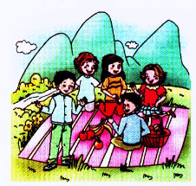
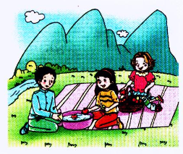
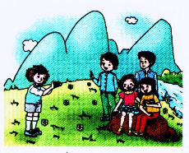
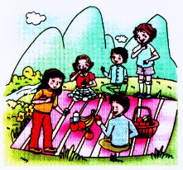
New class
仔细观察图片，并带着问题听课文录音

Slide 6
Questions:
1. What will the children do?
2. Would Su Tai like some chicken?
3. Where will they take a photo?

Slide 7
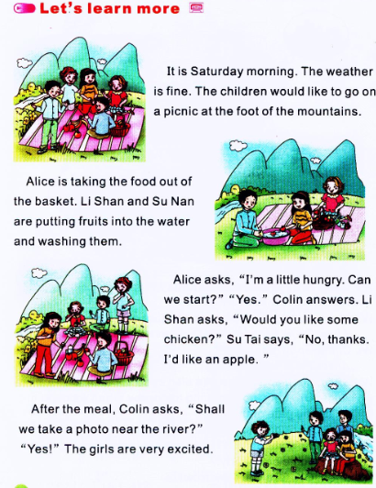

Slide 8
阅读理解一
对划线部分提问
It is Saturday morning. The weather is fine. The children would like to go on a picnic at the foot of the mountains.
答案

Slide 9
The weather is fine.
Answer：What’s the weather like?
The children would like to go on a picnic at the foot of the mountains.
Answer ：What would the children like to do at the foot of the mountains?

Slide 10
句型：The children would like to…
孩子们想……
此句型常用来表示“某人想要做某事”，
如：
—What would you like to do after school?
—I’d like to play ping-pong. And Li Shan would like to go skating.

Slide 11
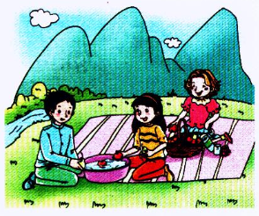
阅读理解二
去e加-ing
Alice is taking the food out of the basket. Li Shan and Su Nan are putting fruits into the water and washing them.
双写末尾字母t加-ing

Slide 12
回答问题：
1. What’s Alice doing?
2. What about Li Shan and Su Nan?

Slide 13
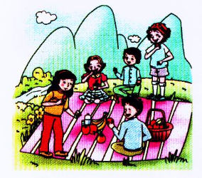
阅读理解三
Alice asks, “I’m a little hungry. Can we start?” “Yes.” Colin answers. Li Shan asks, “Would you like some chicken?” Su Tai says, “No, thanks. I’d like an apple.”

Slide 14
在文中画出下面问题的答案：
1. What does Alice ask?
2. What does Li Shan ask?
3. What does Su Tai say?
答案

Slide 15
Alice asks, “I’m a little hungry. Can we start?” “Yes.” Colin answers. Li Shan asks, “Would you like some chicken?” Su Tai says, “No, thanks. I’d like an apple.”

Slide 16
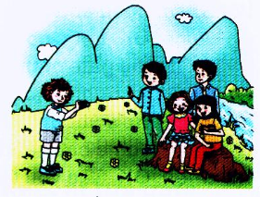
阅读理解四
shall用于第一人称的疑问形式表示提出建议和征求意见。
After the meal, Colin asks, “Shall we take a photo near the river?” “Yes!” The girls are very excited.

Slide 17
回答问题：
What does Colin ask?
Answer:
Colin asks, “Shall we take a photo near the river?”

Slide 18
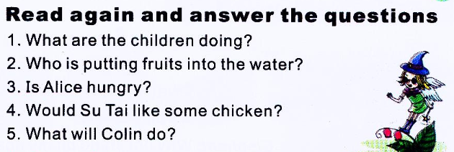
.
1. They’re going on a picnic.
2. Li Shan and Su Nan.
3. Yes, she is.
4. No.
5. He’ll take a picture for his friends.

Slide 19
Role play
同学们把三、四段中直接引用的对话重新组织，分组分角色表演对话。
.

Slide 20
.
3
6
4
5
2

