Slide 1
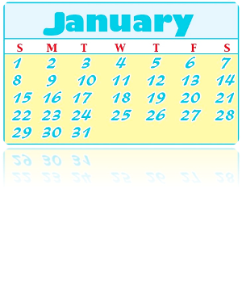
Unit4 January is the first month
精通版
六年级上册
WWW.PPT818.COM

Slide 2
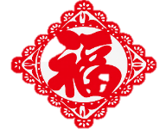
新
春
快
乐
传统节日春节介绍

Slide 3
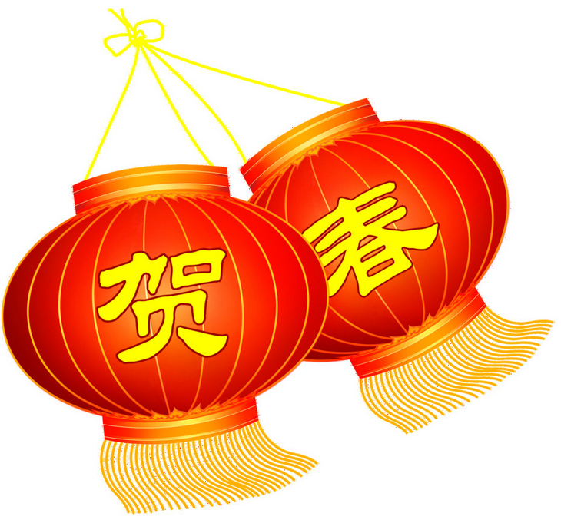
春节俗称“年节”，是中华民族最隆重的传统佳节。
中国传统节日——春节

Slide 4
春节习俗
吃饺子
讨压岁钱
贴春联 穿唐装
敲钟祈福

Slide 5
今天我们就来一起学习中国的春节在西方国家如何表达

Slide 6
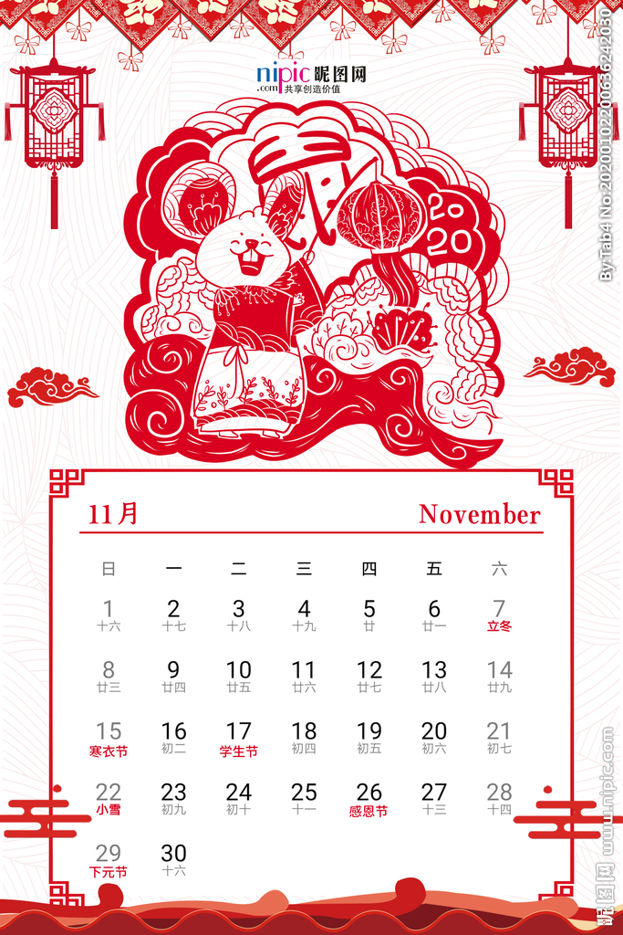
Lead-in
How many days are there in a week?
seven days

Slide 7
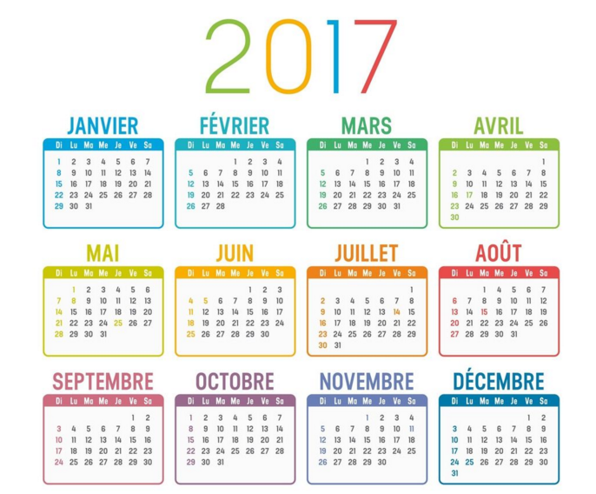
How many months are there in a year?
twelve months

Slide 8
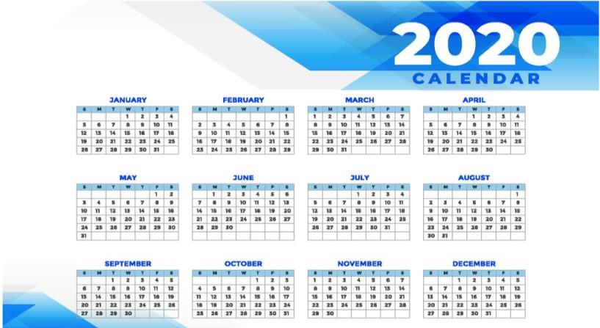
>>Presentation
Look and say
What is the first month of the year?
January

Slide 9
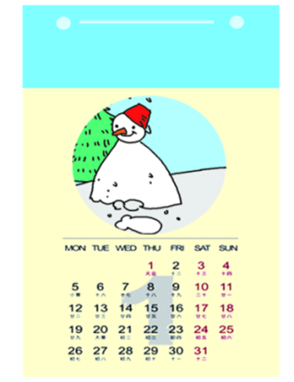
New words
January
一月
January is the first month of the year.

Slide 10
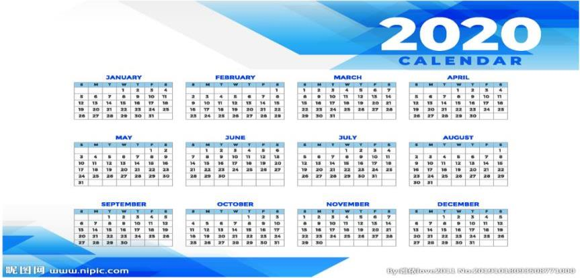
>>Presentation
Look and say
What is the next month ?
February
second
February is the ______ month of the year.

Slide 11
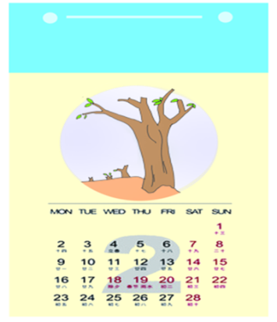
February
二月
February is the second month of the year.

Slide 12
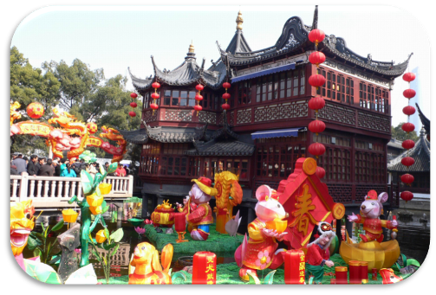
>>Presentation
Look and say
Spring Festival
In China, ______________ is usually in January or February.

Slide 13
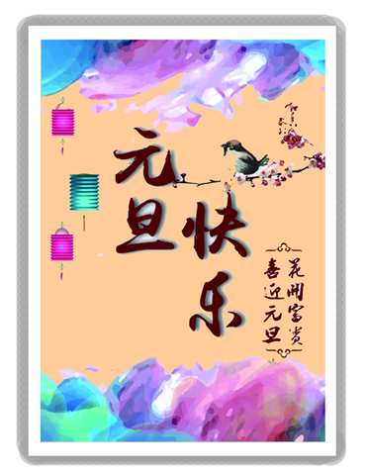
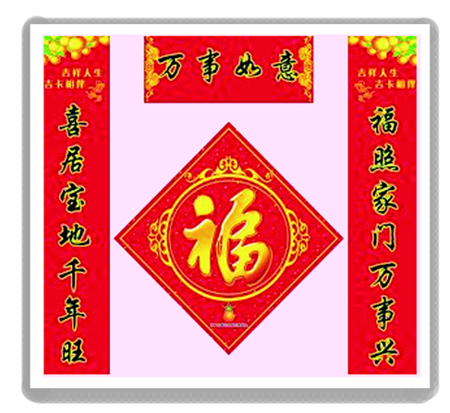
New Year’s Day
Spring Festival
元旦
春节

Slide 14
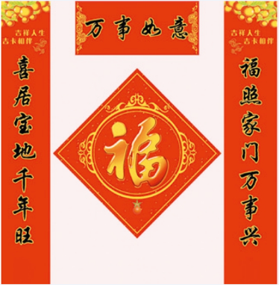
>>Presentation
Look and say
Spring Festival is also called ___________.
Chinese New Year
People have a holiday and they celebrate New Year’s Day.

Slide 15
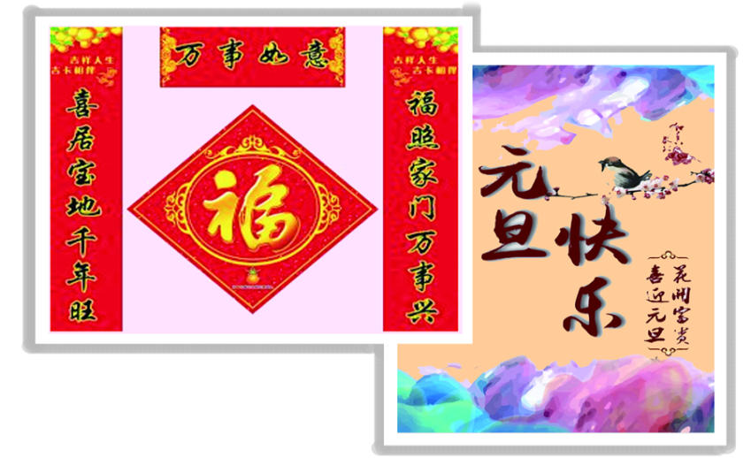
Just read and talk

Slide 16
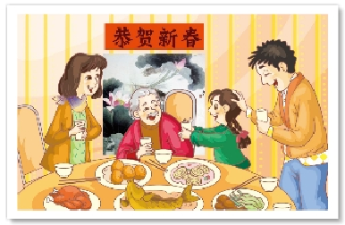
Let’s learn
go back home

Slide 17
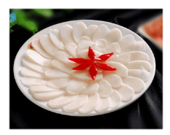
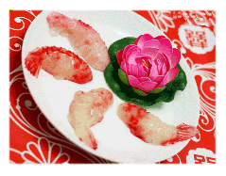
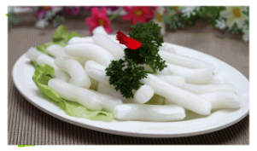
>>Presentation
Let’s learn
rice cakes

Slide 18
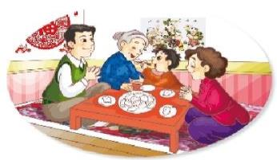
>>Presentation
>>Presentation
Look and say
What do people do on Chinese New Year?
They go back home to celebrate the festival with their families.
People usually have dumplings. People in the south of China have rice cakes.

Slide 19
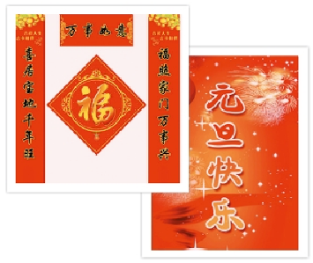
>>Practice
repeat
There are twelve months in a year. January is the first month. The first day, January 1st, is called New Year’s Day. People have a holiday and they celebrate New Year’s Day!

Slide 20
>>Practice
repeat
February is the second month of the year. In China, Spring Festival is usually in January or February. Now people call it Chinese New Year. For Chinese New Year, all people in China have a holiday. They go back home to celebrate the festival with their families.

Slide 21
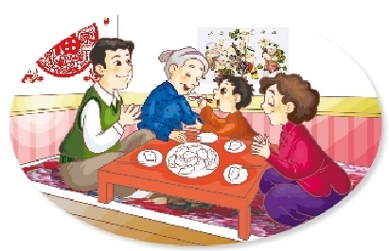
>>Practice
repeat
On the eve of the festival, people usually have dumplings. People in the south of China have rice cakes. They all enjoy the festival at home.

Slide 22
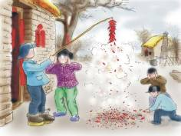
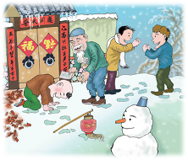
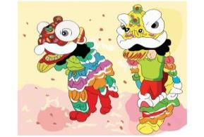
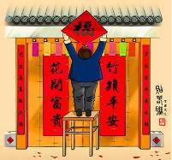
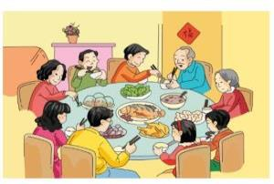
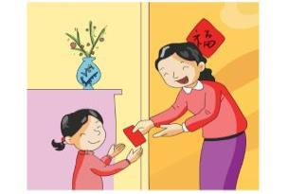
Just practise
How do you celebrate the Spring Festival?

Slide 23
>>Practice
Just practise
_______ is the first month of the year.
January

Slide 24
>>Practice
Just practise
The first day, January 1st, is called ___________
New Year's Day

Slide 25
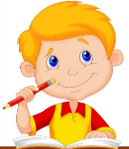
>>Practice
Just practise
People have a _______ and they ________ New Year’s Day!
holiday
celebrate

Slide 26
>>Practice
Look and write
________ is the second month of the year.
February

Slide 27
>>Practice
Look and write
____________ is usually in January or February.
Spring Festival

Slide 28
>>Practice
They _______ home to celebrate the festival with their families.
go back

Slide 29
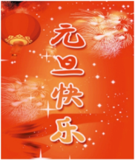
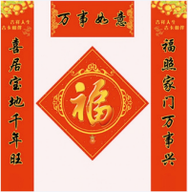
>>Summary
Summary
本课学习主要学习的月份和节日有哪些？
January
February
New Year’s Day
Spring Festival

Slide 30
Homework
1.Read the text and share with your parents.
2.Finish the exercise.
3.Make a mind map about Spring Festival.

Slide 31
Thank you !

