Slide 1
初中英语外研版八年级下
Module2 Experiences
Unit1 I’ve also entered lots of speaking competitions.
WWW.PPT818.COM

Slide 2
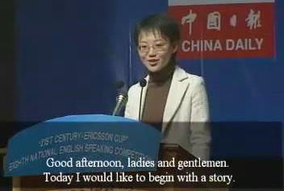
Warm-up
Ask and answer
What’s this picture about?
It’s about a speaking competition.

Slide 3
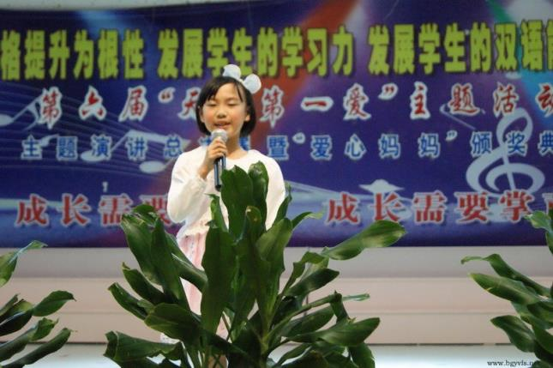
Did you see the speaking competition before?
Yes, I did. / No, I didn’t.

Slide 4
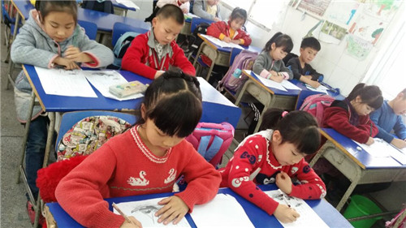
Are they entering the writing competition?
Yes, they are.

Slide 5
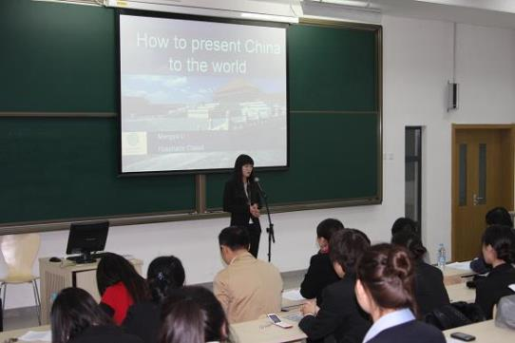
Are you interested in the speaking competition?
Yes, I am. / No, I am not.

Slide 6
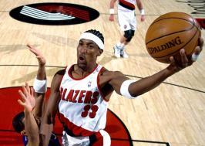
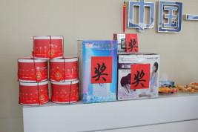
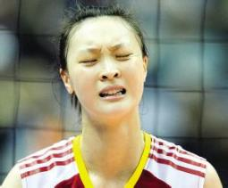
Learn some new words
Presentation
competition n.
比赛，竞赛
prize n. 奖品，奖项
first prize一等奖
pity n. 可惜，遗憾

Slide 7
ever adv.曾经，从来，在任何时候
enter v.(使)参加（使）报名
dream n.梦，梦想
v.做梦，梦到，梦想
afford v.买得起，付得起
write about编写，写作
wake up编写，创作
invite v.邀请

Slide 8
1
Listen and number the words as you hear them
ever
1
exciting
4
tired
5
visit
2
wonderful
3

Slide 9
2
Listen again and choose the correct answer
1. Lingling has visited / hasn’t ever
visited the US.
2. Betty has asked / hasn’t asked her
parents.
3. Lingling has travelled / hasn’t
travelled by plane.

Slide 10
3
Listen and read, Answer the questions
1. What is Lingling entering?
She is entering a speaking competition.
2. Who is going to enter the writing
competition?
Tony.

Slide 11
看哪组在对话中所找的含有现在完成时的句子最多。
1. Have you ever won any prizes before?
2. I’ve always wanted to go on a dream holiday.
3. I’ve also entered lots of speaking competitions,
but haven’t won any prizes.
4. I’ve stopped trying now.
5. Have you ever thought about other kinds of
competitions?
6. But I haven’t travelled much.

Slide 12
Now check (√) what Lingling and Tony have or have not done.
Name | Experiences | Yes | No
Lingling | has won some prizes.
 | has always wanted to go on a dream holiday.
Tony | has entered lots of speaking competitions.
 | has won some prizes.
 | has travelled a lot.
√
√
√
√
√

Slide 13
5
Complete the sentences with the correct form of the words in the box.
afford competition dream invite pity prize
dream
Her _______ was to study at a good
university one day.
2. When I was in school, I won many ______
for my writing.
3. You must enter the music ___________!
You will beat everybody.
prizes
competition

Slide 14
afford competition dream invite pity prize
4. My family cannot ______ to buy a ticket for
the match.
5. It is a(n) _____ that you did not come to see
the film with us.
6. John ________ his new friends to his birthday
party last week.
afford
pity
invited

Slide 15
Language points
I am entering a competition.
enter表示“参加，报名”。还表示“进入”。
例 Several of the world’s finest runners
have entered the race. 几名世界最优秀
的运动员已报名参加比赛。
The thieves entered the building by the
back door. 小偷从后门进入大楼。

Slide 16
2. The first prize is “My dream holiday”.
dream n. 梦；梦想（只用于名词前）梦寐以求的
v. dreamed, dreamed/dreamt, dreamt 做梦，梦到，梦想
e.g. I had a strange dream last night.
我昨晚做了个奇怪的梦。
I dreamt I was flying to the moon at
this time of yesterday.
昨晚的这个时候我梦见我正飞往月球。

Slide 17
3. Have you ever won any prizes before?
ever表示“曾经”。是现在完成时的标志。通常
用于一般疑问句中。
“have/has sb. ever + 过去分词”，用于询问某
人过去的经历。
e.g. —Have you ever been to Paris?
—No, never. / Yes, I have.
—你去过巴黎吗？ — 没有/ 去过。

Slide 18
afford v. （有财力）付得起，买得起常与can, could, able to 连用。
e.g. I just can’t afford the time. 我花不起这个时间。
我已经不再尝试了。
stop doing sth. 表示“停止正在做的事情”
stop to do sth. 表示“停下正在做的事去做另件事”
4. But I can’t afford it.
5. I’ve stopped trying now.

Slide 19
例 The two girls stopped talking when they saw
me.
那两个女孩一见到我就停止了讲话。
The two girls stopped to talk to me when they
saw me.
那两个女孩一见到我就停下来和我讲话。

Slide 20
6. That’s a pity.
pity表示“遗憾，可惜”。
That’s a pity. = It’s a pity.= What a pity!
7. You can make it up.
make up 表示“编造；组成”。
例 The whole story is made up.
整个故事是虚构出来的。

Slide 21
8. I will invite you to come with me.
invite sb. to do sth.表示“邀请某人去做某事”。
例 Jane invited me to go fishing last week.
简上周邀请我去钓鱼了。

Slide 22
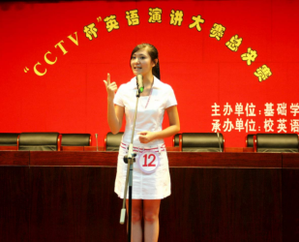
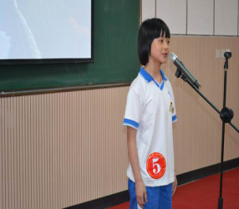
Homework:
编写一个对话，介绍你参加的比赛或竞赛。

