Slide 1
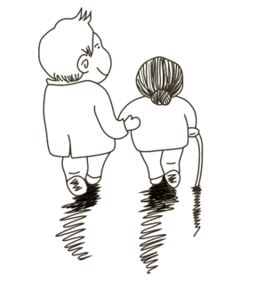
20XX.03.30

Slide 2
目 录
01
单击此处添加标题
02
单击此处添加标题
03
单击此处添加标题
04
单击此处添加标题

Slide 3
MONTHER DAY
PART ONE
单击此处添加标题
20XX.03.30

Slide 4
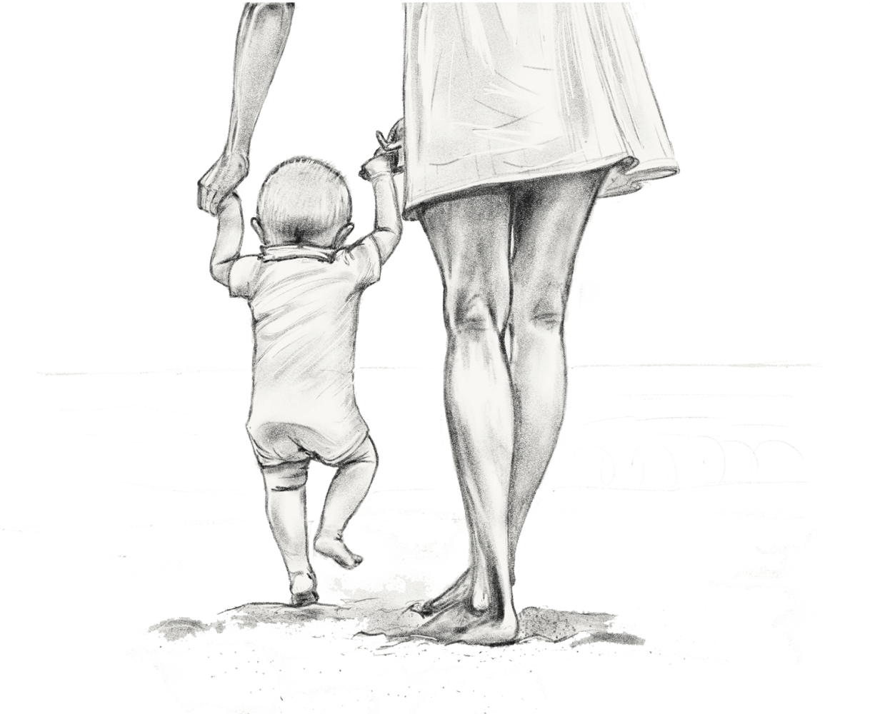
PART ONE
节日介绍
母亲节（Mother's Day），是一个感谢母亲的节日，这个节日最早出现在古希腊；而现代的母亲节起源于美国，是每年5月的第二个星期日。

Slide 5
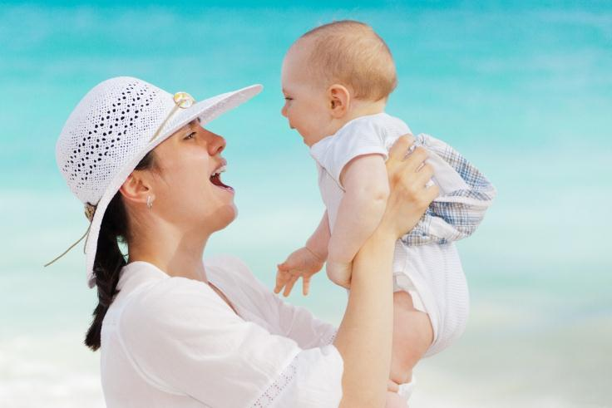
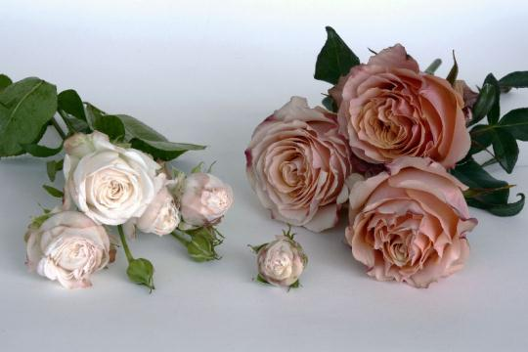
PART ONE
Click here to add words Click here to add words Click here to add words Click here to add words
Click here to add words Click here to add words Click here to add words Click here to add words Click here to add words Click here to add words Click here to add words Click here

Slide 6
PART ONE
添加标题
添加标题
Click here to add words
Click here to add words
Click here to add words
Click here to add words
添加标题
添加标题
Click here to add words
Click here to add words
Click here to add words
Click here to add words

Slide 7
PART ONE
节日介绍
母亲节（Mother's Day），是一个感谢母亲的节日，这个节日最早出现在古希腊；而现代的母亲节起源于美国，是每年5月的第二个星期日。

Slide 8
MONTHER DAY
PART TWO
单击此处添加标题
20XX.03.30

Slide 9
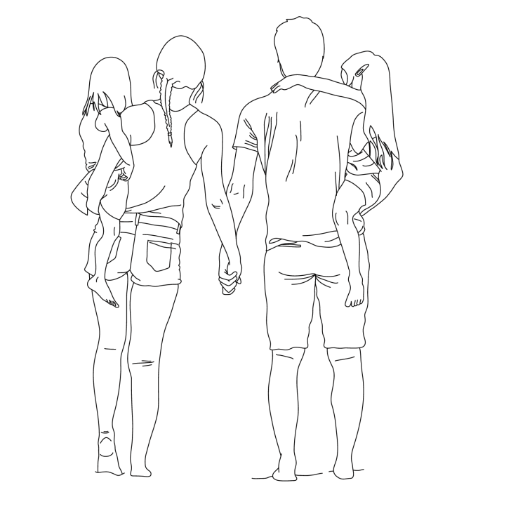
PART TWO
节日介绍
母亲节（Mother's Day），是一个感谢母亲的节日，这个节日最早出现在古希腊；而现代的母亲节起源于美国，是每年5月的第二个星期日。

Slide 10
PART TWO
点击此处添加标题
点击此处添加标题
添加标题
添加标题
添加标题
添加标题
Click here to add words
Click here to add words
Click here to add words
Click here to add words
点击此处添加标题
点击此处添加标题

Slide 11
PART TWO
Click here to add words Click here to add words Click here to add words Click here to add words
Click here to add words Click here to add words Click here to add words Click here to add words Click here to add words Click here to add words Click here to add words Click here

Slide 12
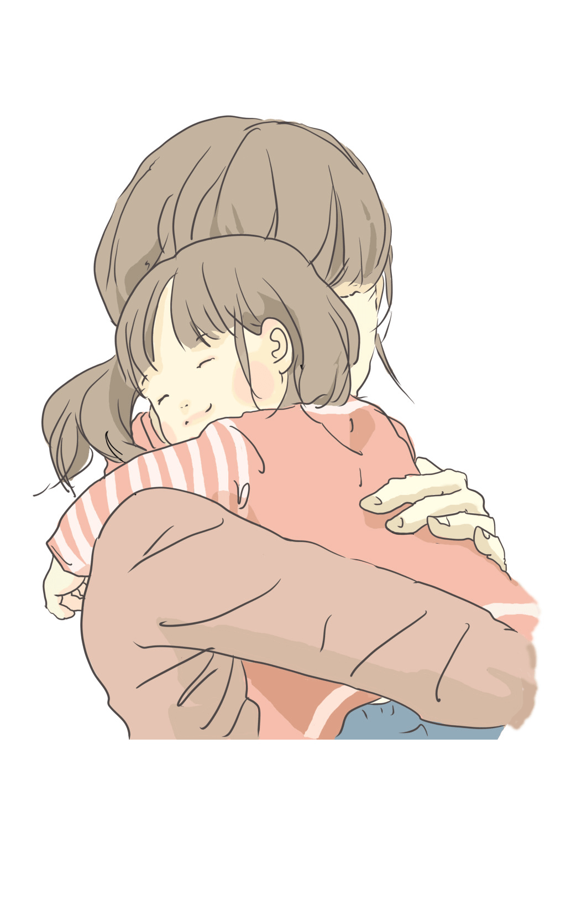
PART TWO
添加标题
Click here to add words
Click here to add words
添加标题
Click here to add words
Click here to add words

Slide 13
MONTHER DAY
PART THREE
单击此处添加标题
20XX.03.30

Slide 14
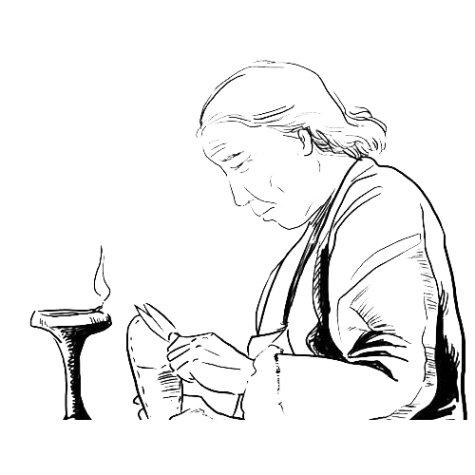
PART THREE
节日介绍
母亲节（Mother's Day），是一个感谢母亲的节日，这个节日最早出现在古希腊；而现代的母亲节起源于美国，是每年5月的第二个星期日。

Slide 15
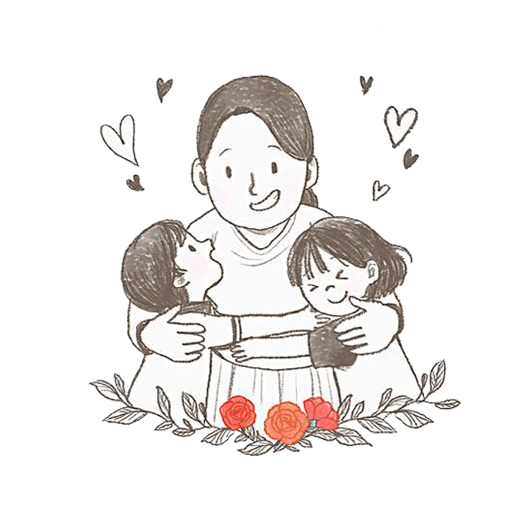
PART THREE
添加标题
添加标题
Click here to add words
Click here to add words
Click here to add words
Click here to add words
添加标题
添加标题
Click here to add words
Click here to add words
Click here to add words
Click here to add words

Slide 16
PART THREE
添加标题
02
Click here to add words
Click here to add words
03
添加标题
01
Click here to add words
Click here to add words
添加标题
Click here to add words
Click here to add words

Slide 17
PART THREE
Click here to add words Click here to add words Click here to add words Click here to add words

Slide 18
MONTHER DAY
PART FOUR
单击此处添加标题
20XX.03.30

Slide 19
PART FOUR
节日介绍
母亲节（Mother's Day），是一个感谢母亲的节日，这个节日最早出现在古希腊；而现代的母亲节起源于美国，是每年5月的第二个星期日。

Slide 20
PART FOUR
Click here to add words Click here to add words Click here to add words Click here to add words Click here add words Click here

Slide 21
PART FOUR
添加标题
Click here to add words
Click here to add words
添加标题
Click here to add words
Click here to add words

Slide 22
PART FOUR
添加标题
Click here to add words
添加标题
Click here to add words
Click here to add words
Click here to add words
添加标题
Click here to add words
添加标题
Click here to add words
Click here to add words
Click here to add words

Slide 23
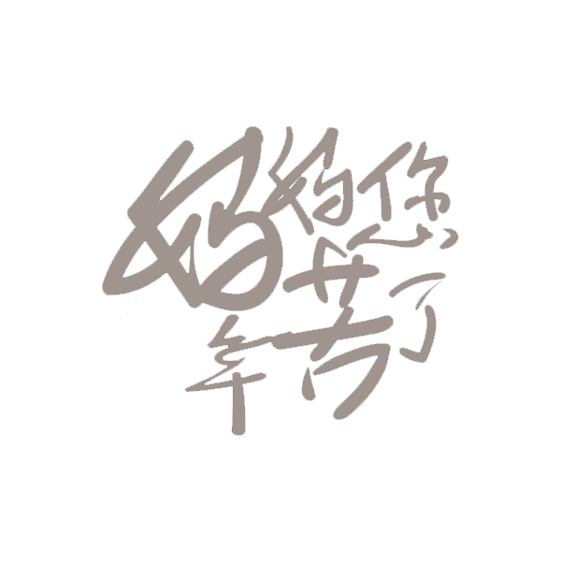
20XX.03.30

