Slide 1
Unit6 What Subjects Do They Have This Morning? 第1课时
陕旅版四年级上册
WWW.PPT818.COM

Slide 2
Let’s sing—In the music room

Slide 3
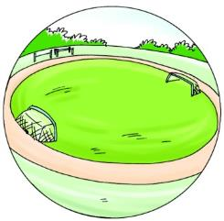
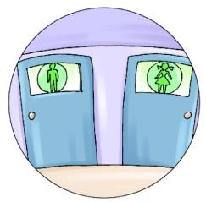
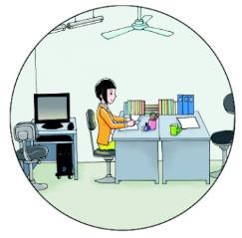
Review：看图说单词

Slide 4
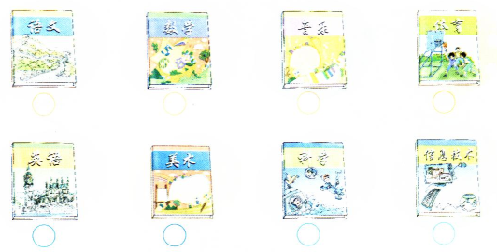
Tick the books you have

Slide 5
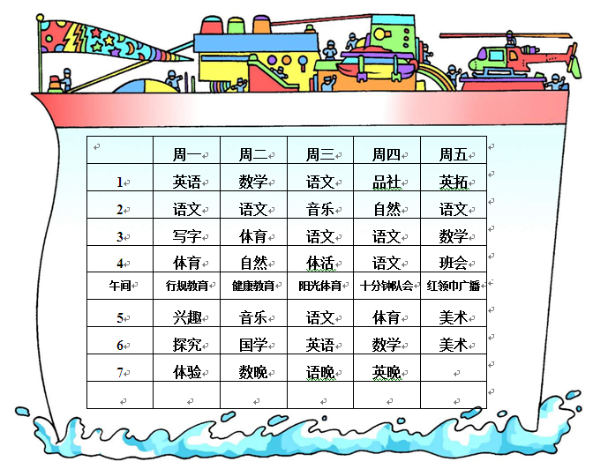
同学们你最喜欢哪个学科？你知道你所学的学科怎么用英语表达吗？

Slide 6
Let’s learn
Math

Slide 7
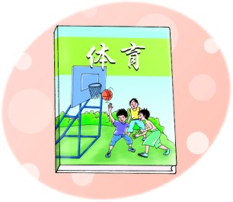
PE

Slide 8
Music

Slide 9
Chinese

Slide 10
English

Slide 11
Tips
Chinese和English不仅可以解释为“中文”和“英语”，还可以解释为“中国人”和“英国人”。这些单词作为学科来用的时候，开头字母要大写。

Slide 12
Art

Slide 13
Science

Slide 14
Gold finger
Math PE English Science Music Art Chinese

Slide 15
Now tell me what subjects do you have this morning?
There are…subjects this morning. They are…

