Slide 1
汇报人：XXX

Slide 2
Enter text

Slide 3
Enter Text
图标标题
THE CHART TITLE
Enter text
Enter text
Enter text

Slide 4
Enter Text
1
2
Enter text
Enter text
A
Albert Einstein: Logic will get you from A to B. Imagination will take you everywhere.
Albert Einstein: Logic will get you from A to B. Imagination will take you everywhere.
3
4
Enter text
Enter text
Albert Einstein: Logic will get you from A to B. Imagination will take you everywhere.
Albert Einstein: Logic will get you from A to B. Imagination will take you everywhere.

Slide 5
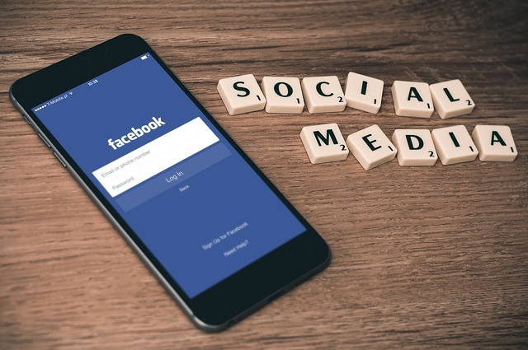
Enter Text
Enter text
Albert Einstein: Logic will get you from A to B. Imagination will take you everywhere.

Slide 6
B
Enter text

Slide 7
Enter Text
图标标题
THE CHART TITLE
¥
Enter text
Enter text

Slide 8
Enter Text
Enter
Text
Enter
Text
Albert Einstein: Logic will get you from A to B. Imagination will take you everywhere.
Albert Einstein: Logic will get you from A to B. Imagination will take you everywhere.
Albert Einstein: Logic will get you from A to B. Imagination will take you everywhere.
Albert Einstein: Logic will get you from A to B. Imagination will take you everywhere.
Enter
Text
Enter
Text

Slide 9
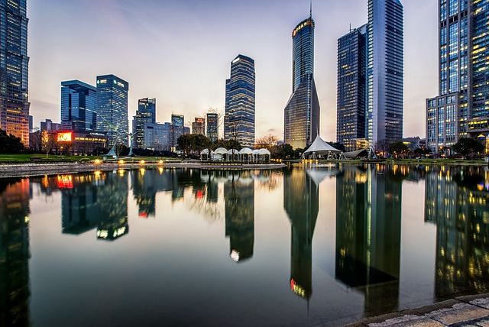
Enter Text
Enter text
Albert Einstein: Logic will get you from A to B. Imagination will take you everywhere.

Slide 10
Enter text

Slide 11
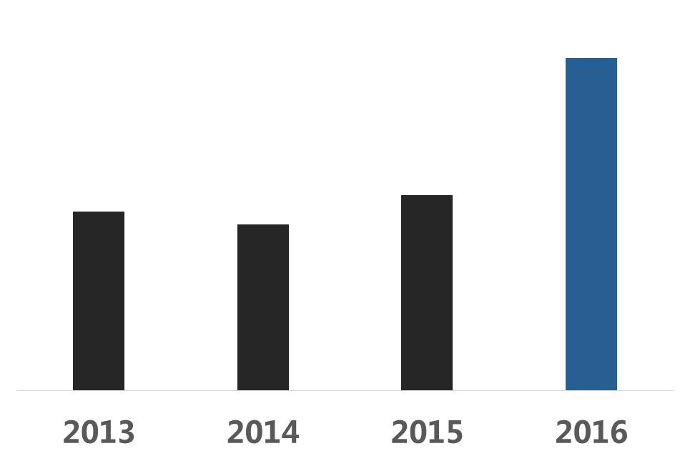
8000
Enter Text
Albert Einstein: Logic will get you from A to B. Imagination will take you everywhere.

Slide 12
Enter Text
Albert Einstein: Logic will get you from A to B. Imagination will take you everywhere.
Enter Text
Enter Text
Albert Einstein: Logic will get you from A to B. Imagination will take you everywhere.

Slide 13
Enter Text
Enter Text
Enter Text
Albert Einstein: Logic will get you from A to B. Imagination will take you everywhere.
Albert Einstein: Logic will get you from A to B. Imagination will take you everywhere.

Slide 14
Enter text

Slide 15
Enter Text
Albert Einstein: Logic will get you from A to B. Imagination will take you everywhere.

Slide 16
Enter Text
Enter Text

Slide 17
Enter Text
Enter Text
Albert Einstein: Logic will get you from A to B. Imagination will take you everywhere.

