Slide 1
Unit 8
Is there a post office near here?
第2课时
WWW.PPT818.COM

Slide 2
第2课时分层训练
课内基础自测
Ⅰ. 用适当的介词或连词填空
1. There is a school just across ________ our house.
2. The post office is between the library________ the supermarket.
3. There is a park ________ town.
4. —Is there a bank _____________ here?
—Yes, there is.
5. He walks ________ the bridge and goes away.
from
and
in
near/around
across

Slide 3
第2课时分层训练
6. I can walk to the restaurant ________ you.
7. Kate sits behind me. I'm ________ front ________ her.
8. Classes begin ________ 8 o'clock every day.
9. The Blue Sky Hotel is ________ George Street.
10. Our classroom is ________ ________their classroom. There is a wall ________ the two classrooms.
with
in
of
at
on
next to
between

Slide 4
第2课时分层训练
Ⅱ.用所给单词的适当形式填空
1．Many ________ (hotel) in town are very clean.
2．Where ________(be) the pay phones?
3．There ________ (be) a book and some pens in my bag.
4．________(be) there any shops near here?
5．Look! The police______________ (run) after a thief(小偷)．
hotels
are
is
Are
are running

Slide 5
第2课时分层训练
Ⅲ.根据汉语意思完成句子，每空一词
1．我们学校在邮局对面。
Our school is ________ ________ the post office.
2．动物园前面有一个付费电话。
There is a pay phone ________ ________ ________ the zoo.
across from
in front of

Slide 6
第2课时分层训练
3．那家服装店在图书馆和超市之间。
That clothes store is ________ the library ________ the supermarket.
4．公园离这儿不远，你可以走着去那儿。
The park is not ________ ________ here. You can walk there.
5．紧挨着医院有一家超市。
________ ________ the hospital, there is a supermarket.
between
and
far from
Next to

Slide 7
第2课时分层训练
课后巩固提升
Ⅰ.单项填空
( )1.—________. Is there a bank near here?
—________， I don't know.
A．Excuse me; Sorry B．Sorry; Excuse me
C．Excuse me; Excuse me D．Sorry; Sorry
A
【解析】 excuse me意为“打扰一下”；sorry意为“抱歉”，根据语境可知选A。

Slide 8
第2课时分层训练
( )2.2018·柳州—Where is Kate?
—She is sitting next ________ Lily.
A．to B．in C．on
A

Slide 9
第2课时分层训练
( )3.The park is ________ the school.
A．across from B．across
C．cross D．from
A
【解析】 across from是一个表方位的介词短语，意为“在……的对面”；across是介词，意为“穿过”；cross为动词，意为“穿过”；from意为“来自”。句意：公园在学校对面。由句意可知选A。

Slide 10
第2课时分层训练
( )4.The post office is ________ the school ________ the hotel.
A．between; and B．between; or
C．behind; in front D．between; with
A
【解析】between…and…意为“在……和……之间”。

Slide 11
第2课时分层训练
( )5. There __________ many people __________ the building and they're planting trees.
A. is; in the front of B. are; in front of
C. have; in front of D. be; before
B
【解析】there be 结构表示“存在”； have表示“拥有”； in front of 意为“在……的前面”； in the front of 意为“在……的前部”。第一空前有There ，应是there be句型。故选B。

Slide 12
第2课时分层训练
Ⅱ. 句型转换
1．There is a post office on New Street.(改为一般疑问句)
________ ________ a post office on New Street?
2. Are there two shops near here？(作否定回答)
________， ________ ________．
Is there
No there aren't

Slide 13
第2课时分层训练
3．Lucy sits on Susan's left and George's right.(改为同义句)
Lucy sits________ Susan ________ George.
4. My backpack is behind the chair.(改为同义句)
The backpack________ ________ ________ is ________.
5．The library is near her house．(对画线部分提问)
________ ________ the library?
between
and
behind the chair
mine
Where is

Slide 14
第2课时分层训练
Ⅲ. 完形填空
Tom __1__ near the sea. Their house is not very big, but it is beautiful. There __2__ big trees and a small garden in front __3__ their house. They plant flowers in the garden. Some are red, some are white __4__ others are blue. Tom and his family love __5__ garden very much.

Slide 15
第2课时分层训练
__6__ Tom and his sister go to school __7__ bus. After school, they sometimes help their mom __8__ some shopping at the Shopping Center, and sometimes help their dad in the garden. At weekends, they often take some photos by the sea. __9__ summer, they often go swimming __10__ their parents.

Slide 16
第2课时分层训练
( )1.A.lives B．lived C．living D．to live
( )2.A.are B．is C．was D．be
( )3.A.to B．for C．at D．of
( )4.A.but B．or C．at D．and
( )5.A.they B．them C．their D．theirs
A
A
D
D
C

Slide 17
第2课时分层训练
( )6.A.All B．Both C．Some D．Two
( )7.A.on B．by C．take D．sit
( )8.A.do B．doing C．does D．did
( )9.A.In B．On C．At D．To
( )10.A.and B．for C．of D．with
B
B
A
A
D

Slide 18
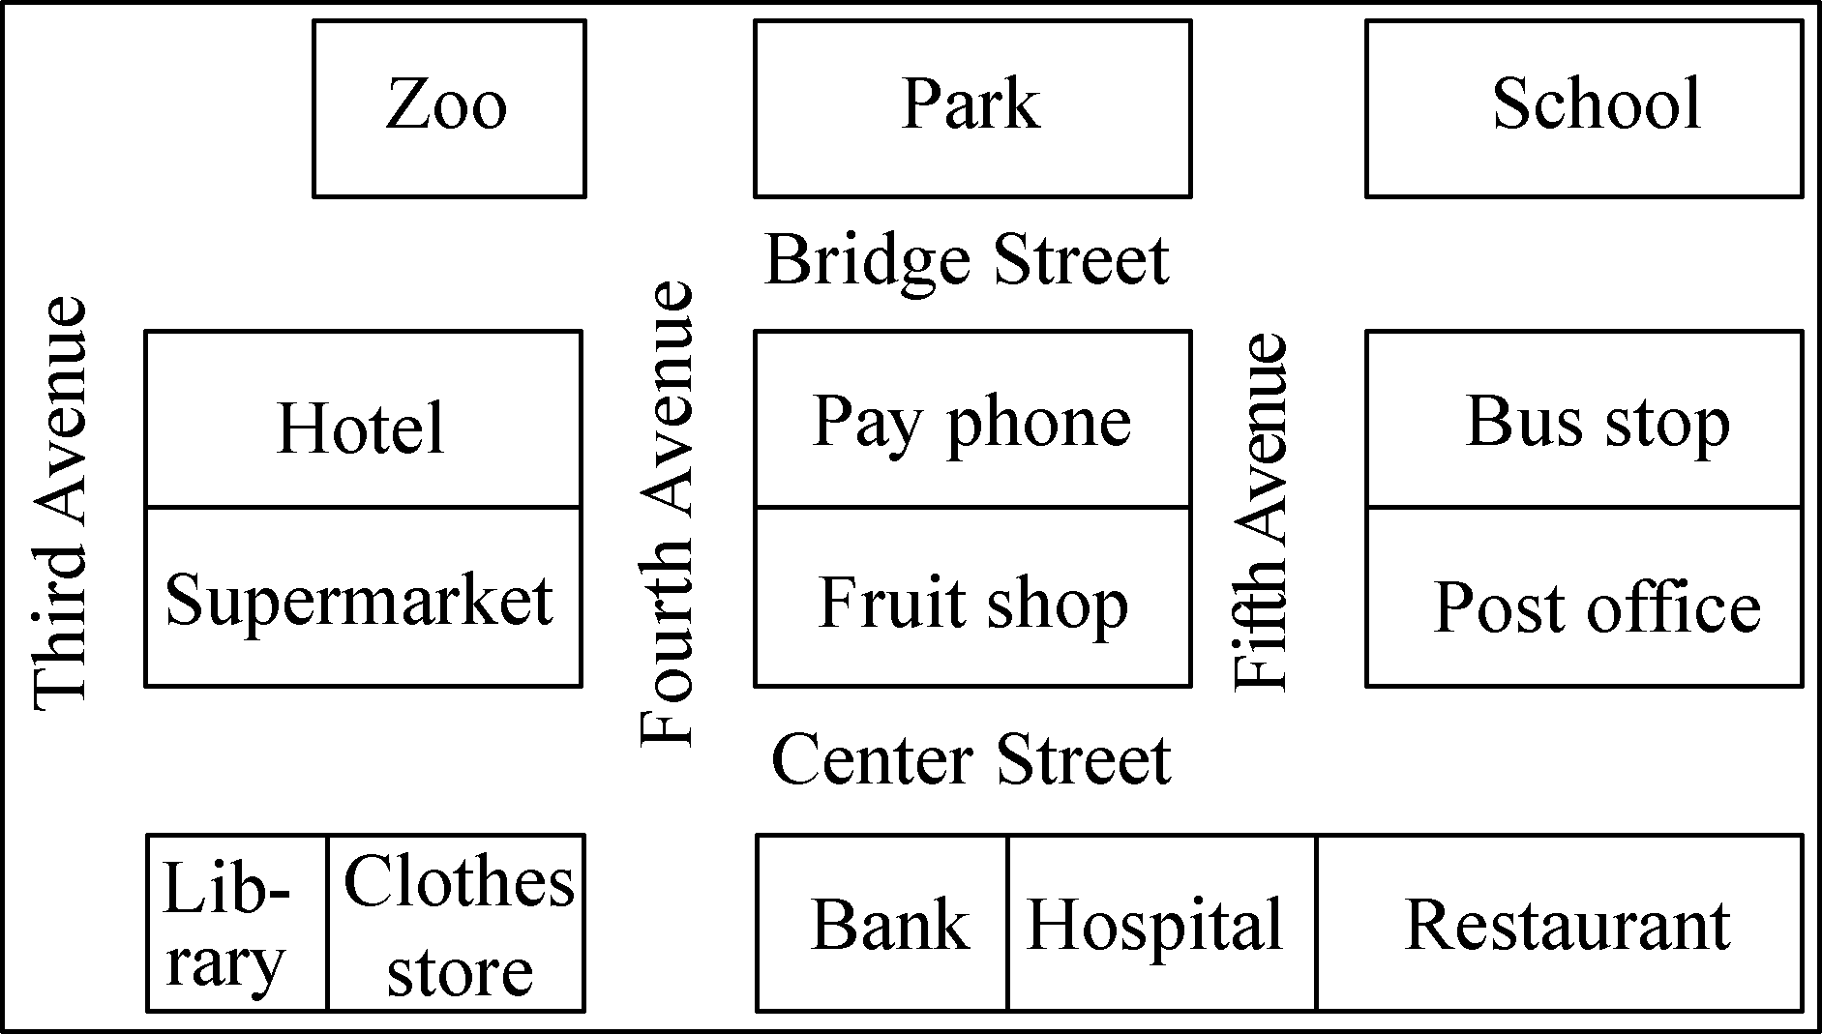
第2课时分层训练
Ⅳ.阅读理解
A

Slide 19
第2课时分层训练
( )1.There is a ________ across from the park.
A．clothes store B．bus stop
C．pay phone D．post office
( )2.Where is the hospital?
A．It's next to the library.
B．It's across from the hotel.
C．It's on Bridge Street.
D．It's between the bank and the restaurant.
C
D

Slide 20
第2课时分层训练
( )3.How can Tom get to the post office from the hotel?
A．Walk along Bridge Street and turn right at the first crossing.
B．Walk along Bridge Street and turn right at the second crossing.
C．Walk along Bridge Street and turn left at the first crossing.
D．Walk along Bridge Street and turn left at the second crossing.
B

Slide 21
第2课时分层训练
( )4.Walk along Center Street and turn left on Fifth Avenue. Then walk on and turn right at the first crossing, and then you can see a ________ on your left.
A．bus stop B．park
C．school D．hotel
C

Slide 22
第2课时分层训练
( )5.Which of the following is NOT true?
A．There is a supermarket next to the hotel.
B．The fruit shop is across from the bank.
C．The restaurant is on Center Street.
D．You can see a clothes store on Fifth Avenue.
D

Slide 23
第2课时分层训练
B
Today is Sunday. My friends are talking happily.
Sue: My dream neighborhood(街区) has a underwater(水下的) library. We can walk to the library through a tunnel(隧道). We can watch all kinds of fish when we are reading in the library.

Slide 24
第2课时分层训练
Leo: My dream neighborhood has a very big garden. I can play games and climb trees with my dad in the garden. In summer, I can sit under a big tree and read my favorite book. In winter, I can make snowmen with my brothers in it. There are different kinds of flowers in the garden, too.
Sam: In my dream neighborhood, there is a great restaurant. In the restaurant, I can taste food from all over the world. And if I want, I can make meals with my mom in the restaurant.

Slide 25
第2课时分层训练
David: I like watching movies. In my dream neighborhood, there is a big cinema(电影院). I can watch many old movies in the cinema and the movies are all free. Of course, I can watch many new movies there, too.

Slide 26
第2课时分层训练
( )6.When Sue reads in the library, she wants to ________．
A．watch fish
B．listen to music
C．drink some milk
D．talk with her friends
A

Slide 27
第2课时分层训练
( )7.What does Leo want to do in the garden?
①play games ②climb trees
③do some reading ④drink tea
⑤make snowmen
A．①②③④ B．①③④⑤
C．①②③⑤ D．②③④⑤
C

Slide 28
第2课时分层训练
( )8.What do we know about Sam?
A．He lives in a good neighborhood.
B．He often helps his mom make meals.
C．He has a great restaurant in his neighborhood.
D．He wants to taste food from all over the world.
D

Slide 29
第2课时分层训练
( )9.Which of the following is TRUE?
A．Sue wants to go to the library by boat.
B．Leo wants to make snowmen with his cousins.
C．Sam wants the restaurant to be big and beautiful.
D．David hopes he can watch free movies in the cinema.
D

Slide 30
第2课时分层训练
( )10.What are the writer's friends talking about?
A．Their dream neighborhood.
B．Their favorite place.
C．Their weekend.
D．Their life.
A

