Slide 1
Unit 3 Topic 3
What were you doing at this
time yesterday?
Section C
WWW.PPT818.COM

Slide 2
Do you like reading stories ?
Which kind of story do you like best ?
Let’s enjoy a story.

Slide 3
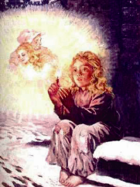
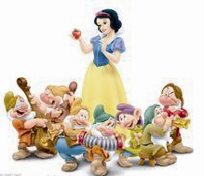
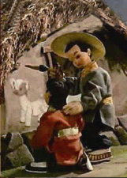
1a
Read and understand .
Match the following pictures with the titles of stories. Then
share the story you like best with the class.
Snow White B. the Little Match Girl
C.Black Cat Sir D. Ma Liang and His Magic Brush
( )
C
( )
( )
D
B
( )
A

Slide 4
Watch the flash of 1a, then answer the following questions.
When did the story happen ?
What did the poor girl sell ?
Did the girl have a big Christmas meal ?
On a new year’s Eve.
Matches.
No, she didn’t.

Slide 5
Listen and read the story, then underline the phrases below and guess their meanings.
in a low voice
pass by
fall down
be afraid to do
warm sb. up
a fourth match
hold sb. in one’s arms
低声地
经过
落下
害怕做……
温暖某人
划了第四根火柴
把某人搂在怀里
a / an +序数词 “再一；又一”

Slide 6
1b
Read 1a again and complete the table.
Time | It was snowy and dark ____________________ .
Place | A poor girl was walking _____________________ __________.
Weather | The wind ______________ strongly and the snow _________________ on her long hair.
What the little girl did | The little girl was selling ____________ in the streets. She _____________ any matches , and she felt ________ and ____________ . She lighted matches and saw a warm ______, a delicious ____________, a beautiful _____________ and her kind _____________. 4. She _____________ against the wall the next morning and was ________ .
on a new year’s Eve
in the streets with
no shoes
was blowing
was falling down
matches
didn’t sell
cold
hungry
stove
roast goose
Christmas tree
grandmother
was lying
dead

Slide 7
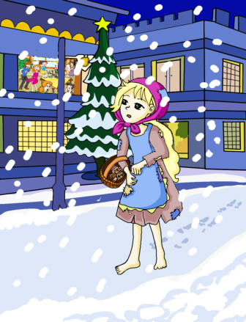
1c
Read again and write the key words for each picture. Then rewrite the story.
1
____________

Slide 8
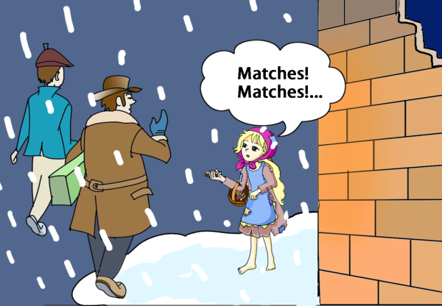
2
____________

Slide 9
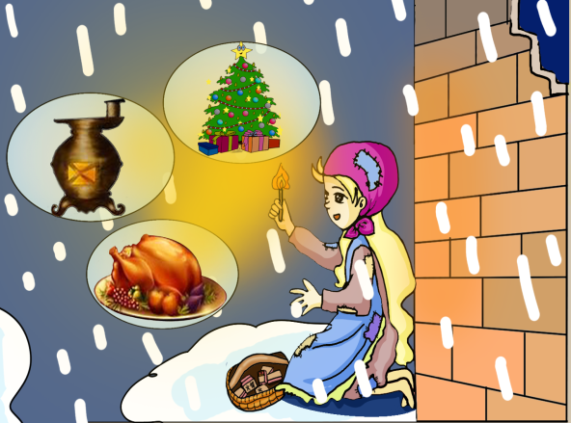
3
____________

Slide 10
4
____________

Slide 11
5
____________

Slide 12
Do you think Tom and Jerry are good friends?

Slide 13
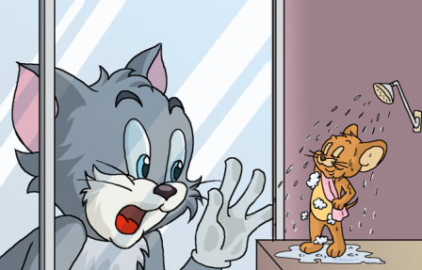
Look at the pictures and fill in the blanks with the correct forms of the key words.
2
1
knock at / take a shower
1. When the cat knocked at the door the mouse _____________________ .
was taking a shower

Slide 14
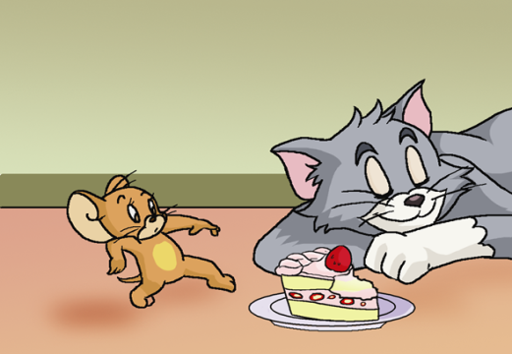
2
come out / sleep
2. The mouse was hungry. When he
__________ of the bathroom to look
for food, the cat ______________ .
came out
was sleeping

Slide 15
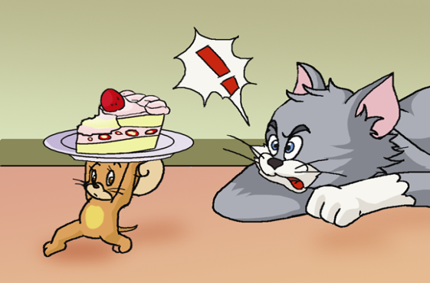
3
wake up / carry
When the cat woke up, the
mouse ______________ his cake.
was carrying

Slide 16
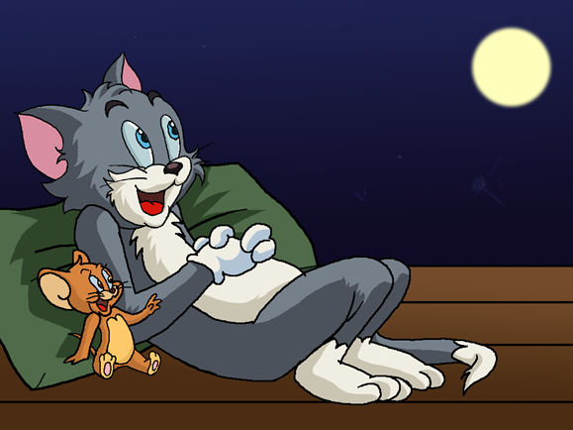
4
enjoy / chat
The mouse and the cat
_______________ happily while they were enjoying the moon.
were chatting

Slide 17
Make sentences with the following phrases.
in a low voice
1. _________________________ .
pass by
2. _________________________ .
fall down
3. _________________________.
be afraid to do
4. _________________________ .
warm sb. up
5. _________________________ .

Slide 18
summary
We learn the phrases.
in a low voice
pass by
fall down
be afraid to do
warm sb. up
a fourth match
hold sb. in one’s arms
低声地
经过
落下
害怕做……
温暖某人
第四根火柴
把某人搂在怀里

Slide 19
Homework
收集几个童话故事，在班里与同学交流。

