Slide 1
陕旅版四年级下册
Unit1 Our New House
WWW.PPT818.COM

Slide 2
Magic fingers
dining room study bedroom
kitchen bathroom living room

Slide 3
I can say
I have …
There is …

Slide 4
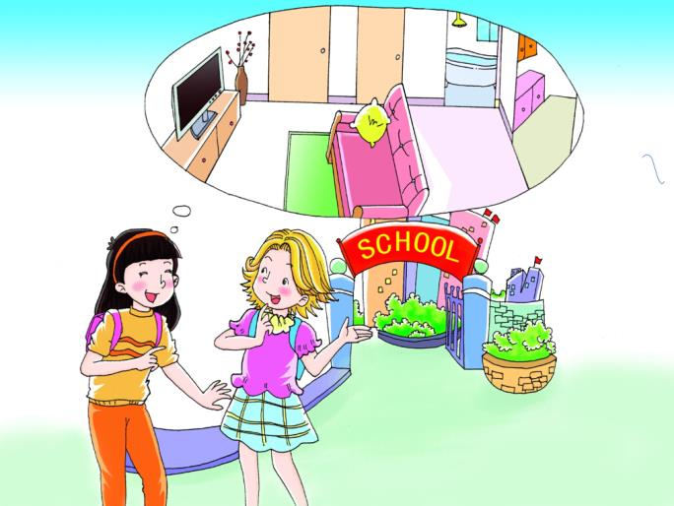
Look and say

Slide 5
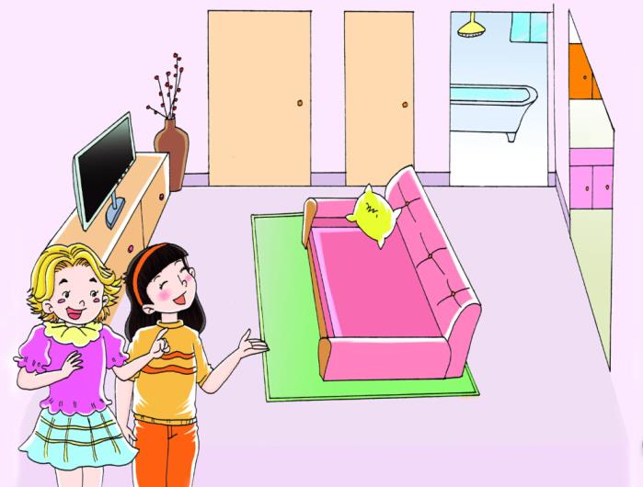
Look and say

Slide 6
Let’s talk
I have a new house..
What’s in your new house?
There are two bedrooms, a living room, a kitchen and a bathroom.

Slide 7
Let’s talk
Thank you..
Welcome to my home, Alice..
My house is not very big.
But it’s beautiful.

Slide 8
Read it by yourselves for one minute .
自读课文一分钟。
一分钟倒计时
60
Learning tip :
50
10
当你自己朗读时，遇到不会读或不明白意思的单词或句子，可以把它圈起来，请教同学或老师！
20
40
30
开始

Slide 9
Read in groups
以小组为单位，选择一种喜欢的方式读一读课文。
Read together.
(齐读)
Read in pictures.
(分图读)
Read your favorite
picture.(自己选一幅读)

Slide 10
Let’s act
Tips for actors
（演员考核标准）
Tips for actors
Read fluently
流利地朗读
Act fluently
流利地表演
Act it out with emotions
有感情地表演

Slide 11
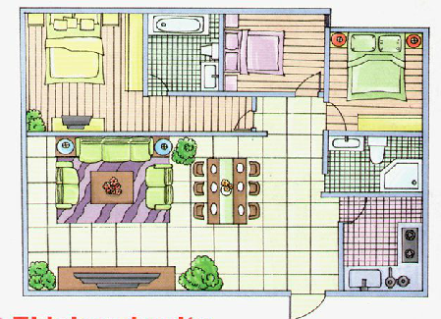
Look and say

Slide 12
You can use: This is … There is … It’s …
There are … They’re …

Slide 13
如何用句型讨论住所的特点？
(1) -What’s in your new house?
-There is a …/There are …
(2) –My house is not very big.
-But it’s beautiful.

Slide 14
1.听课文录音并跟读，按照正确的语音、语调朗读并表演课文对话。 2.创编对话：同伴2人一组，仿照课文Let’s talk创编课文对话。
3.预习B Let’s learn morn。

