Slide 1
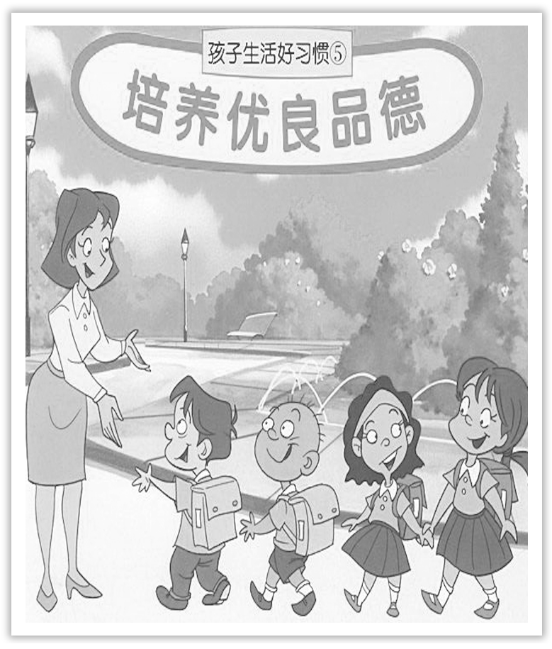
Unit 2 Morals and Virtues
Section Ⅳ Discovering Useful Structures——动词-ing形式(2)
WWW.PPT818.COM

Slide 2
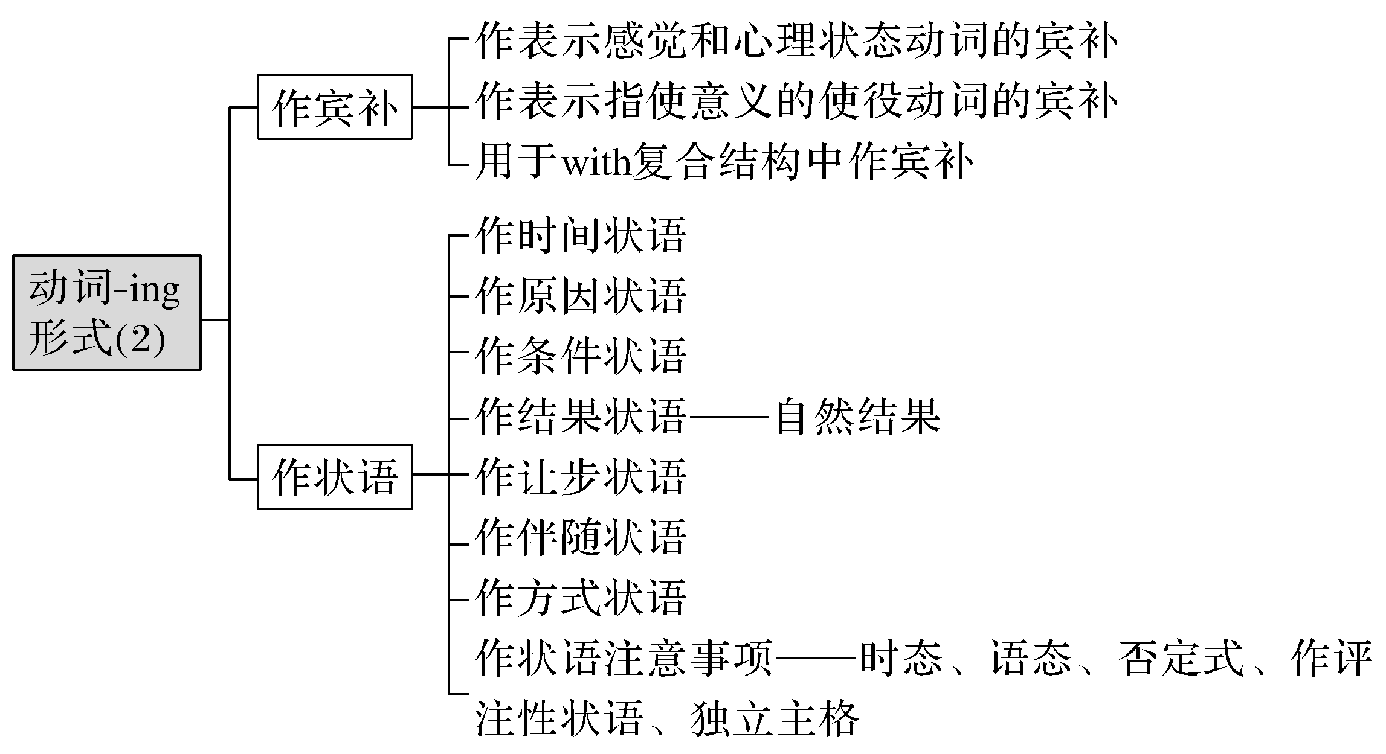

Slide 3
一、动词-ing形式作宾语补足语
动词-ing形式作宾语补足语时，与宾语之间是主谓关系，即宾语是其逻辑上的主语。它主要用于以下两类动词后作宾语补足语。
[合作探究1]
When we returned，we found a stranger standing in front of the house.
我们回来的时候，发现一个陌生人站在房子前。
Suddenly we heard someone knocking gently on the window.
忽然我们听见有人在轻轻地敲窗户。

Slide 4
[自主发现1]
感觉和心理状态
表示________________的动词(词组)，如see，hear，feel，smell，watch，find，listen to，look at，notice，observe等。
[名师提醒] 在see，hear，feel，watch 等感官动词后，既可用动词-ing形式作宾语补足语，也可用省略to 的不定式作宾语补足语。用动词-ing形式时，表示动作正在进行；用省略to 的不定式时，表示动作经过从开始到结束的全过程。
I saw a boy getting on the bus.(表示动作正在进行)
我看见一个男孩在上公共汽车。
I saw a boy get on the bus.(表示动作完成了)
我看见一个男孩上了公共汽车。

Slide 5
[合作探究2]
We kept the fire burning all night long.我们让火整夜燃烧着。
I won’t have you running about in the room.我不允许你在房间里跑来跑去。
[自主发现2]
指使意义
表示____________的使役动词，常见的有：have，let，keep，get，leave 等。

Slide 6
[合作探究3]
I couldn’t do my homework with the noise going on.
由于噪音不断，我没法做家庭作业。
With so many people looking at her，she felt nervous.
这么多人看着她，她感到很紧张。
[自主发现3]
with
用于____________复合结构中。

Slide 7
二、动词-ing形式作状语
[合作探究]
①Hearing the news，he couldn’t help laughing.
＝When he heard the news，he couldn’t help laughing.
一听到那个消息，他禁不住大笑起来。
②Not knowing her address，I had better telephone her to come over.
＝As I don’t know her address，I had better telephone her to come over.
由于不知道她的地址，我还是打电话让她过来为好。

Slide 8
③Working hard，you’ll surely succeed.
＝If you work hard，you’ll surely succeed.
如果努力工作，你就一定会成功。
④The child slipped and fell，hitting his head against the door.
＝The child slipped and fell，and hit his head against the door.
那个男孩滑了一跤，摔倒了，头撞到了门上。
⑤Having been told many times，he still didn’t learn these rules by heart.
＝Although he had been told many times，he still didn’t learn these rules by heart.
尽管被告知了很多次，他还是没把这些规定记住。

Slide 9
⑥Morris lay on the grass，staring at the sky for a long time.
＝Morris lay on the grass and stared at the sky for a long time.
莫里斯躺在草地上，长时间地望着天空。
⑦He came running back to tell me the news.
他跑回来告诉我这个消息。

Slide 10
[自主发现]
时间
原因
条件
①作____________状语；②作____________状语；③作____________状语；④作____________状语；⑤作____________状语；⑥作____________状语；⑦作____________状语。
结果
让步
伴随
方式

Slide 11
[名师提醒]
(1)动词-ing形式作结果状语，是随着谓语动词的发生而产生的自然结果，而不定式作结果状语时常表示出乎意料的结果，有时前面可以加only。
I hurried to school，only to find it was Sunday.
我匆忙赶到学校，结果发现是星期天。
(2)动词-ing形式作状语时，相当于与之对应的状语从句，但是当作伴随状语及结果状语时，可转化为并列谓语。

Slide 12
三、动词-ing形式作状语注意事项
1.动词-ing形式的时态
动词-ing形式作状语时，要注意其时间性，是用一般式(doing)，还是用完成式(having done)。

Slide 13
[合作探究1]
Walking in the street，I met an old friend of mine.
我正在大街上行走时，遇到了一位老朋友。(walking和谓语动词met同时发生)
Having finished the letter，he went to post it.
他写完信后就把它寄了出去。(having finished是先发生的，went是后发生的)
[自主发现1]
一般
(1)当动词-ing形式的动作与谓语动词的动作同时发生时，用____________式。
(2)当动词-ing形式的动作先发生，而谓语动词的动作后发生时，用____________式。
完成

Slide 14
2.动词-ing形式的语态
[合作探究2]
Having been shown around the factory，they were very happy.(现在分词的被动式)
被领着参观了工厂后，他们很高兴。
Having finished his homework，he went to bed.(现在分词的主动式)
完成了作业后，他上床睡觉。
[自主发现2]
使用动词-ing形式的主动式还是被动式，这主要取决于动词-ing形式和句子____________之间的关系。句子的主语就是动词-ing形式的逻辑主语。
主语

Slide 15
3.动词-ing形式的否定式
[合作探究3]
Not knowing this，he didn’t come.他不知道这件事，所以没来。
Not having made full preparations，we put off the sports meeting.
因为没有做好充分的准备，我们把运动会延期了。
[自主发现3]
not
not
动词-ing形式的否定式为____________＋v.-ing；____________＋having v.-ed

Slide 16
4.动词-ing形式作评注性状语
[合作探究4]
Judging from his behaviour，he must be mad.
从他的行为来判断，他一定是疯了。
[自主发现4]
有些动词-ing形式在句中没有逻辑主语，它们往往作为句子的评注性状语来修饰整个句子，表明说话者的____________等。例如：generally speaking“一般来说”，judging by/from...“从……判断”，taking everything into consideration“从全盘考虑”。
态度、观点

Slide 17
5.独立主格
[合作探究5]
The rain having stopped，we went on marching.
雨过之后，我们继续前进。
[自主发现5]
主语
动词-ing形式作状语，有时它也可以有自己独立的____________，这种结构称为独立主格结构，通常用来表示伴随的动作或情况，也可以表示时间、原因或条件。

Slide 18
[巩固内化1] 同义句转换
①As time passes by，we will have a better and better life.
→With ________________，we will have a better and better life.
②I saw that they were coming across the street.
→I saw _______________________ the street.
time passing by
them coming across

Slide 19
③I stood on the bridge and watched boats were passing by.
→I stood on the bridge and watched ____________________.
④I felt that someone was patting me on the shoulder.
→I felt _______________________me on the shoulder.
⑤I heard that Mary sang a song in the next room last night.
→I heard ________________________ in the next room last night.
boats passing by
someone patting
Mary sing a song

Slide 20
[巩固内化2] 同义句转换
①It rained heavily and it caused great damage.
→It rained heavily，________________________.
②After he had eaten his dinner，the boy rushed out.
→_______________________，the boy rushed out.
③The boy sat in front of the farm house，and cut the branches.
→The boy sat in front of the farm house，___________________________.
④As I did not know how to get there，I had to ask the way.
→__________________________________，I had to ask the way.
causing great damage
Having eaten his dinner
cutting the branches
Not knowing how to get there

Slide 21
[巩固内化3] 单句语法填空
①________________(work) for three hours，he took a rest.
②Tom came ____________ (dash) into the room with some film tickets in his hand.
③____________ (spend) all his money，the boy had to give his mother a call.
④____________(see) nobody at home，he decided to leave them a note.
Having worked
dashing
Having spent
Seeing

Slide 22
[巩固内化4] 单句语法填空
①____________(judge) from his accent，he must be from the south.
②_________________(tell) many times，he still couldn’t understand it.
③The lecture ___________________ (give)，a lively question-and-answer session followed.
④____________(take) everything into consideration，the result is better than expected.
⑤The weather ____________(be) hot，we had to stay at home.
Judging
Having been told
having been given
Taking
being

