Slide 1

外研版九年级英语上册
If everyone starts to do something，the world will be saved
WWW.PPT818.COM

Slide 2
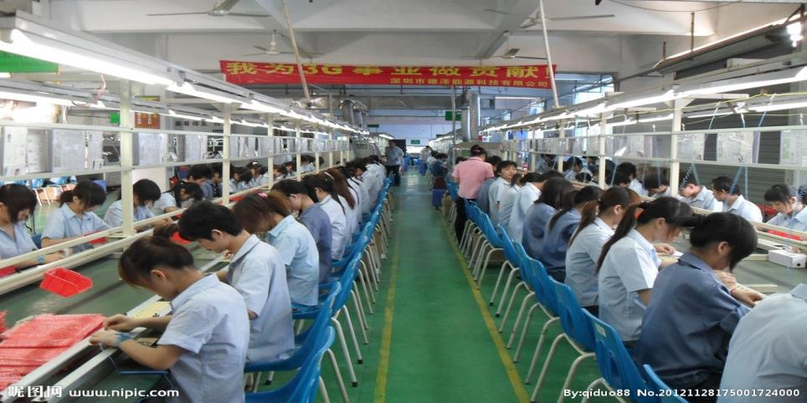
n.制造厂；工厂
factory

Slide 3
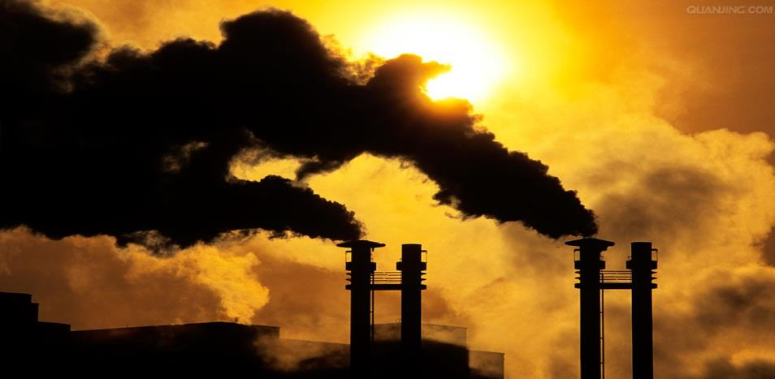
v.污染 n. 污染
pollute pollution

Slide 4
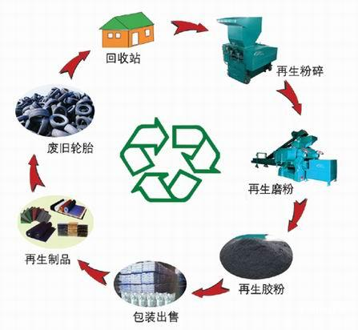
v.回收利用；再使用（废品）
recycle

Slide 5
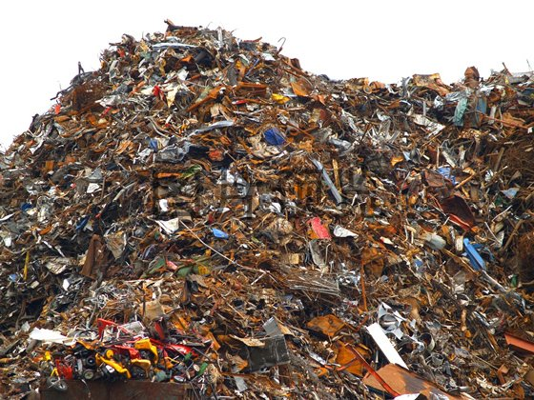
n.废料；废弃物 v.浪费
waste

Slide 6

n.敌人；仇人
enemy

Slide 7
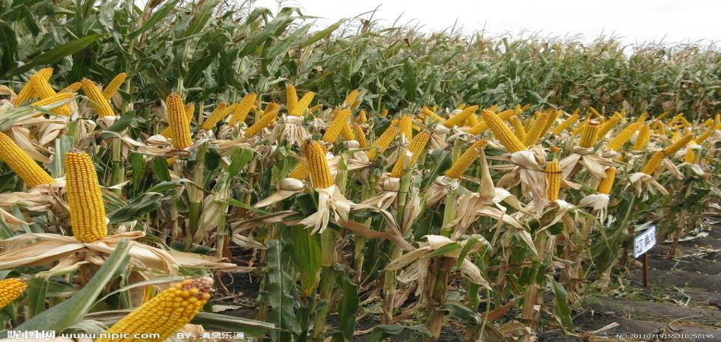
n.庄稼；作物
crop

Slide 8
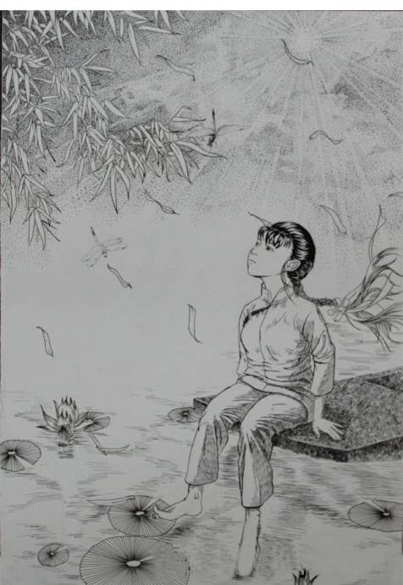
adj.无望的
hopeless

Slide 9
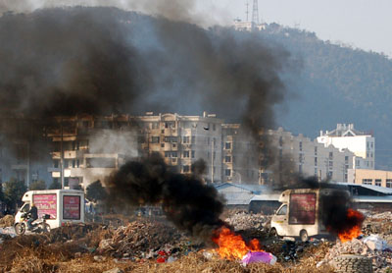
Warming up
What can you see?
We can see that rubbish is being burnt. The smoke goes into the air. It is causing air pollution.

Slide 10
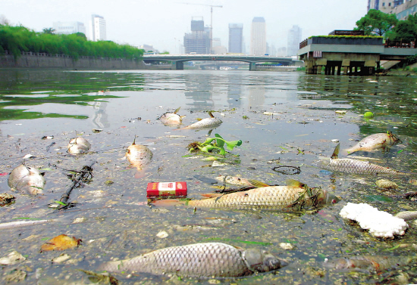
Warming up
What can you see?
We can see a very dirty river. There is lots of rubbish. The fish have been dead because of the water pollution.

Slide 11
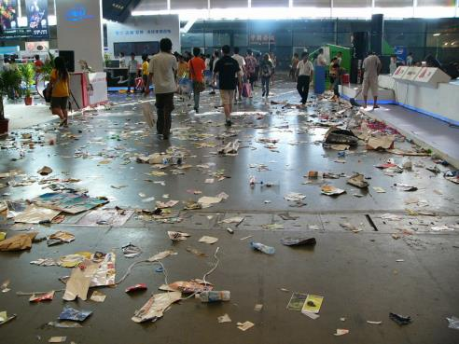
Warming up
What can you see?
We can see some waste paper. It can be recycled, so it is wasteful to throw it away.

Slide 12

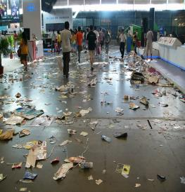
Warming up
What can you learn from these pictures?
From the three pictures, we learn that the environmental problem is serious. It is our duty to protect the environment. And we should save energy. We should try to reuse everything that is reusable. Or our world will be hopeless.

Slide 13





Slide 14

Listening and vocabulary
Work in pairs. Look at the pictures and talk about them. Use the words in the box to help you.
factory, pollute, recycle, waste

Slide 15
Air has been polluted because factories produce electricity and energy for people every day.
A lot of waste paper is thrown away everywhere. We waste plenty of paper.In fact we can recycle it.

Slide 16


2. Listen and complete the sentences.(P96)
pollution
1. The factory is causing a lot of___________.
2. There should be some_____ to stop
pollution.
3. We can_________ waste products, such as
__________and paper in a recycling centre.
rules
recycle
glass

Slide 17
3. Listening part(P96)
StepI Listen for the first time and choose the right answers
(1)._____ is our great enemy, and we have to fight it.
A.pollution B.environment C.factory
(2).Pollution from factories spreads over______.
A.houses B.cities C.towns
(3).They use so much _____ and cause pollution as well.
A.coal B. oil C.cars
A
B
B

Slide 18
3. Listening part(P96)
C
(4).We can make our school a ______ school.
A.blue B.yellow C.green
(5).Though pollution is heavy now,I don’t think it’s ________.
A.hopeless B.careless C.useless
A

Slide 19
3. Listening part(P96)
StepII Listen for the second time and complete the sentences.
(1).It makes people ill,and may even _____ them.
(2).We can’t do anythings about _________ and cars.
(3).It’s no use _______ about things we can’t do.
(4).Then the school sells the _____ and uses the
money to help students in _____ areas.
kill
factories
talking
waste
poor

Slide 20
Reading time

Slide 21

4.Read and complete the notes.
I.Read for the first time and complete the sentences
Problems
farmers can’t
If the rivers are polluted,_____________
_____________________________.
2. In some places, pollution from factories _________________________________ .
3. The cars on the road__________________
_____________________________ .
use water for their crops
spreads over cities and villages
use so much oil and
cause pollution as well

Slide 22
What the students can do?
4. Support a green school: every class _______________________which can be_______________________. Then the school _______________________________to help students__________________.
5. Students learn________________________
_________________. That means__________.
collects waste or rubbish
recycled or used again
sells the waste
in poor areas
ways to save energy and
recycle at home
less waste

Slide 23
4. Read and complete the passage with the correct form
of the words in the box.
cause, enemy, factory, kill, oil, pollute, spread
enemy
Pollution is our great (1)________. Pollution from (2)____________is a danger to our health, and may even (3)____people. Factories sometimes(4)________ rivers, and farmers cannot use the water for their crops. Pollution
(5)________ over cities and villages, and that (6)______ even more danger. Cars in the street use a lot of (7)_____and cause pollution too.
factories
kill
pollute
spreads
causes
oil

Slide 24
课堂导学
1.It’s no use talking about things we can’t do.
谈论我们不能做的事情是没有用的。
句型1：It’s no use doing sth.做某事是没有用的。
固定句式It’s no use doing sth.意为“做某事是没有用的”。其中it是形式主语，真正的主语是动名词短语。
It is no use telling him not to worry.
告诉他不要担心没有用。
It is no use crying over spilt milk.
覆水难收

Slide 25

即学即练一
单项选择
It is no use back to one’s lost youth.
A. look B. looked C. looking D. to look
解析：句意为“回顾流逝的青春是没有用的”，It’s no use doing sth.意为“做某事是没有用的”。故选C。

Slide 26
2. Such as …?比如……？
短语1： such as 例如，比如
such as，意为“例如，比如”。用来列举同类人或物中的几个例子，as后面不可以有逗号。
The farm grows different kinds of crops , such as wheat ,corn , cotton and rice.
这个农场种植不同种类的庄稼，例如小麦、玉米、棉花和水稻。

Slide 27
3. That means less waste.
这意味着更少的浪费。
单词1： less 较小的;较少的
less作形容词，意为“较小的;较少的”。less是little的比较级，可用来修饰不可数名词。
He spent less time doing the experiments.
他做实验花的时间较少

Slide 28
拓展：less也可修饰形容词或副词，意为“较不……；更不……”。
It is less cold than it was yesterday.
今天的天气不如昨天那么冷。
辨析：fewer与less的区别
词条 原级 词义 用法 例句
fewer （few ）更少的 修饰可数名词复数
There will be fewer trees in the future.
将来的树木会更少
less （little ）更少的；更小的 修饰不可数名词
She has less money than me .
她的钱比我的少

Slide 29

即学即练
单项选择
To live a green lift , we should try to save energy and produce pollution.
A. more ; less B. less ; more
C. more ; fewer D. most ; least
解析：more是much和many的比较级，意为“更多的”，可用来修饰可数名词复数和不可数名词； less是little的比较级，意为“较小的;较少的”，可用来修饰不可数名词。根据句意“为了过绿色的生活，我们应该节省更多的能源，制造更少的污染”可知选A。

Slide 30
4. Though pollution is heavy now , I don’t think it’s hopeless.
尽管现在污染很严重但我认为它不是没有希望。
单词2： hopeless无望的
hopeless作形容词，由“hope+后缀-less”构成，意为“无望的”。
It’s trying to convince her.
想说服她简直是徒劳。
hopeless

Slide 31
归纳：常见的加后缀-less构成的形容词
-less是形容词后缀，可加在一些名词之后，表示“无……，没有……”。
careless
useless
fearless
homeless
粗心的
无用的
无畏的
无家可归的

Slide 32
即学即练
根据句意及英语提示完成单词
He failed his job interview again , and he felt really (with no hope) about the future.
hopeless

Slide 33
Exercises
一. 根据句意及首字母提示完成单词。
1. Don’t w_____ water. Please turn off the taps
after you wash your hand.
2. I get a job in a f_________.
3. It’s more and more important for everyone to
save e__________ now.
4. Air p_______ is quite harmful to our health.
5. The students from a green school are
helping collect waste paper and bottles for
r_______.
aste
actory
lectricity
ollution
ecycling

Slide 34
二. 用所给单词的适当形式或根据汉语提示填空。
polluted
The river has been __________(pollute).Look , the fish is dead.
2. Some factories________ (cause) pollution.
3. It’s no use ________(cry) .
4. We should ________(回收利用)waste paper and bottles.
5. If we don’t look after our earth well, the future will be _________.(hope)
6.The __________(敌人)were forced to lay down their arms(放下武器).
caused
crying
recycle
hopeless
enemies

Slide 35
三. 根据汉语意思完成英语句子。
1. 污染是我们的敌人，我们必须与之作战
have
Pollution is our great enemy, and we _____ _____ ______ it.
to
fight
2. 来自该市的很多人都决心节约用水。
many
______ _______ people from the city made up their mind to save water.
So

Slide 36
3. 迈克喜欢奶茶和可乐之类的饮料。
Mike likes drinks_____ ______ milk tea and cola.
such
as
4. 应该谈谈我们的事情。
talk
about
We should ____ _____ what we can do.

Slide 37
Homework
1.For some students ,you should read the conversation more and remember the key points.
2.For the other students ,you’d better finish task1 and do the exercises of our exercise book.

